Slide 1
Using Direct Memory Access to Improve Performance

Slide 2
Overview
Basic Concepts
DMA Peripherals in STM32F4
DMA Applications
Data Transfer
Replacing ISRs

Slide 3
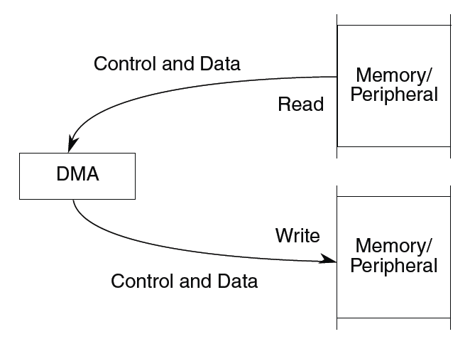
Basic Concepts
Special hardware to read data from a source and write it to a destination
Various configurable options
Number of data items to copy
Source and destination addresses can be fixed or change (e.g. increment, decrement)
Size of data item
When transfer starts
Operation
Initialization: Configure controller
Transfer: Data is copied
Termination: Channel indicates transfer has completed
Post-transfer operation (assert an interrupt)

Slide 4
DMA Controller Features
Two DMA controllers
16 streams in total (8 for each controller)
Up to 8 channels (request) per stream
Each channel is responsible for specific peripheral or memory requests
Arbiter handle the priority between DMA requests
4 levels of software programmable priority
4 separate 32 first-in, first-out memory buffers(FIFOs) per stream

Slide 5
Channels and Streams
Streams are concurrent
Each stream can be only triggered by one of 8 channels at a time

Slide 6
DMA Controller

Slide 7
Registers
DMA_SxCR
Stream x configuration register
DMA_SxPAR
32-bit Stream x Peripheral address register
DMA_SxM0AR
32-bit Stream x Memory address register
Both source and destination transfers can address the entire 4 GB area, at address comprised between 0x0000 0000 and 0xFFFF FFFF

Slide 8
DMA Stream x Configuration Register DMA_SxCR(x=0..7)
Configure the concerned stream
CHESEL[2:0]: channel selection, can be written if EN is cleared.
PL[1:0]: Priority level, with 11 being very high and 00 being low.
MSIZE[1:0]: Memory data size
PSIZE[1:0]: Peripheral data size
DIR[1:0]: Data transfer direction
00: P to M; 01: M to P; 10: M to M; 11: reserved
EN: Stream enable/ flag stream ready when read low

Slide 9
DMA Stream x Configuration Register DMA_SxCR(x=0..7)
Configure the concerned stream
MSIZE[1:0]; PSIZE[1:0] data size configuration
00: byte; 01:half-word; 10:word; 11:reserved
TCIE: transfer complete interrupt enable
Other configuration includes:
Direct mode
Error interrupt
Circular mode
Burst transfer
Increment

Slide 10
DMA stream x number of data register DMA_SxNDTR(x = 0..7)
NDT[15:0] Number of data items to transfer
0 up to 65535
Writable only when the stream is disabled
When the stream is enabled, it is read-only, indicating the remaining data items to be transmitted
When the value is zero, no transaction will be served

Slide 11
Basic Use of DMA
Wait for the stream operation to be finished
Clear DMA_LISR and DMA_HISR
Set the source address
Set the destination address
Specify numbers of datum and width of each datum
Configure the channel and stream
Configure the priority
Configure the FIFO usage
Configure the data transfer direction
Enable the DMA channel
Start to transfer
Wait for end of transfer

Slide 12
End of transfer
It is possible to interrupt in case of the following events:
If the interrupt is disabled, there are still two ways to check if the transfer has ended (in normal mode):
The EN bit of CR will be hardware cleared at the end of the transfer
The value of DMA_SxNDTR register will be 0, indicating no items to be transmitted

Slide 13
Demonstration: Flash to SRAM transfer
Software-triggered by enabling the Channel
Transfer word data buffer from Flash memory to embedded SRAM memory
DMA2 Steam 0 Channel 0 is configured to transfer the 32-word data
Only DMA2 Streams are able to perform memory to memory transfers
Could be used as a fast version of memcpy function, but performed by DMA instead of CPU

Slide 14
DMA vs. ISR
To communicate between CPU and peripherals, there are basically four approaches:
Polling
Interrupt
DMA
Channel I/O
Interrupt improves the performance of the CPU in many ways compared to polling. However, the overhead of interrupt may scale up as the number of peripherals increases.
DMA, on the other hand, take care of the peripheral once the configuration is made by the CPU. Exempt the CPU from being interrupt too frequently.

Slide 15
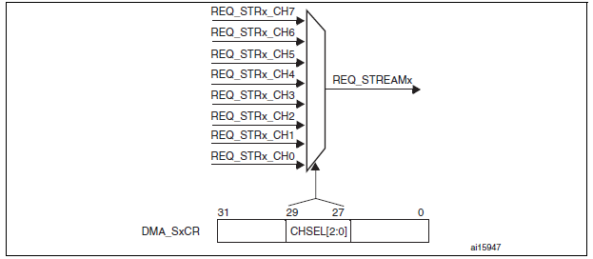
Triggering DMA Activity Using Peripherals
In general cases, have to configure DMA and peripherals at the same time so that DMA can be triggered by a specific peripherals.
Many peripherals have DMA supports (e.g. ADC), but it have to be at least enabled!
Memory to peripheral or peripheral to memory mode.

Slide 16
DMA1 Requests
Peripheral Requests | S0 | S1 | S2 | S3 | S4 | S5 | S6 | S7
C0 | SPI3_RX |  | SPI3_RX | SPI2_RX | SPI2_TX | SPI3_TX |  | SPI3_TX
C1 | I2C1_RX |  | TIM7_UP |  | TIM7_UP | I2C1_RX | I2C1_TX | I2C1_TX
C2 | TIM4_CH1 |  | I2S3_EXT_RX | TIM4_CH2 | I2S2_EXT_TX | I2S3_EXT_TX | TIM4_UP | TIM4_CH3
C3 | I2S3_EXT_RX | TIM2_UP TIM2_CH3 | I2C3_RX | I2S2_EXT_RX | I2C3_TX | TIM2_CH1 | TIM2_CH2 TIM2_CH4 | TIM2_UP TIM2_CH4
C4 | UART5_RX | USART3_RX | UART4_RX | UART3_TX | UART4_TX | USART2_RX | USART2_TX | UART5_TX
C5 |  |  | TIM3_CH4 TIM3_UP |  | TIM3_CH1 TIM3_TRIG | TIM3_CH2 |  | TIM3_CH3
C6 | TIM5_CH3 TIM5_UP | TIM5_CH4 TIM5_TRIG | TIM5_CH1 | TIM5_CH4 TIM5_TRIG | TIM5_CH2 |  | TIM5_UP
C7 |  | TIM6_UP | I2C2_RX | I2C2_RX | USART3_TX | DAC1 | DAC2 | I2S2_TX

Slide 17
DMA2 Requests
Peripheral Requests | S0 | S1 | S2 | S3 | S4 | S5 | S6 | S7
C0 | ADC1 |  | TIM8_CH1 TIM8_CH2 TIM8_CH3 |  | ADC1 |  | TIM8_CH1 TIM8_CH2 TIM8_CH3
C1 |  | DCMI | ADC2 | ADC2 |  |  |  | DCMI
C2 | ADC3 | ADC3 |  |  |  | CRYP_OUT | CRYP_IN | HASH_IN
C3 | SPI1_RX |  | SPI1_RX | SPI1_TX |  | SPI1_TX
C4 |  |  | USART1_RX | SDIO |  | USART1_RX | SDIO | USART1_TX
C5 |  | USART6_RX | USART6_RX |  |  |  | USART6_TX | USART6_TX
C6 | TIM1_TRIG | TIM1_CH1 | TIM1_CH2 | TIM1_CH1 | TIM1_CH4 TIM1_TRIG TIM1_COM | TIM1_UP | TIM1_CH3
C7 |  | TIM8_IP | TIM8_CH1 | TIM8_CH2 | TIM8_CH3 |  |  | TIM8_CH4 TIM8_TRIG TIM8_COM

Slide 18
Demonstration of ISR Replacement: ADC to DMA
Recall that ADC can be read either by polling or can be interrupt-driven (EOC: end of conversion or EOCIE end of conversion interrupt enable)
ADC converted result will be automatically read by DMA thus giving the CPU freedom to perform other tasks.
DMA can interrupt the CPU whenever it is necessary, or a periodic interrupt can perform a regular check of the data collected.
The most optimized way to make full use of both CPU and DMA is quite application-specific. Needs to be decided accordingly.

Slide 19
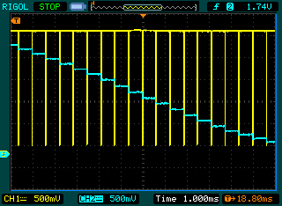
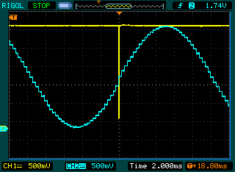
Performance Comparison(Test result from MKL25Z4)
Traces
Yellow: ISR is executing when trace is low
Blue: DAC output
Without DMA: Interrupt per sample
4.7 microseconds per 620 microseconds
0.758% of processor’s time
With DMA: Interrupt per cycle
5.0 microseconds per 20 milliseconds
0.025% of processor’s time
How is this useful?
Saves CPU time
Reduces timing vulnerability to interrupts being disabled
Enables CPU to sleep longer, wake up less often (20 milliseconds vs. 620 microseconds)

