Slide 1
C as Implemented in
Assembly Language

Slide 2
Overview
We program in C for convenience
There are no MCUs which execute C, only machine code
So we compile the C to assembly code, a human-readable representation of machine code
We need to know what the assembly code implementing the C looks like
  To use the processor efficiently
  To analyze the code with precision
  To find performance and other problems
An overview of what C gets compiled to
  C start-up module, subroutines calls, stacks, data classes and layout, pointers, control flow, etc.

Slide 3

Programmer’s World: The Land of Chocolate!
As many functions and variables as you want!
All the memory you could ask for!
So many data types! Integers, floating point,
So many data structures! Arrays, lists, trees, sets, dictionaries
So many control structures! Subroutines, if/then/else, loops, etc.
Iterators! Polymorphism!

Slide 4
Processor’s World
Data types
  Integers
  More if you’re lucky!
Instructions
  Math: +, -, *
  Logic: and, or
  Shift, rotate
  Move, swap
  Compare
  jump, branch,
23 | 251 | 151 | 11 | 3 | 1 | 1 | 1
213 | 6 | 234 | 2 | u | 1 | 1 | 1
2 | 33 | 72 | 1 | a | 1 | 1 | a
a | 4 | h | e | l | l | o | 1
67 | 96 | a | 0 | 9 | 9 | 9 | 1
6 | 11 | d | 72 | 7 | 0 | 0 | 0
28 | 289 | 37 | 54 | 42 | 0 | 0 | 0
213 | 6 | 234 | 2 | 31 | 1 | 1 | 1

Slide 5
Compiler Stages
Parser
  reads in C code,
  checks for syntax errors,
  forms intermediate code (tree representation)
High-Level Optimizer
  Modifies intermediate code (processor-independent)
Code Generator
  Creates assembly code step-by-step from each node of the intermediate code
  Allocates variable uses to registers
Low-Level Optimizer
  Modifies assembly code (parts are processor-specific)
Assembler
  Creates object code (machine code)
Linker/Loader
  Creates executable image from object file

Slide 6
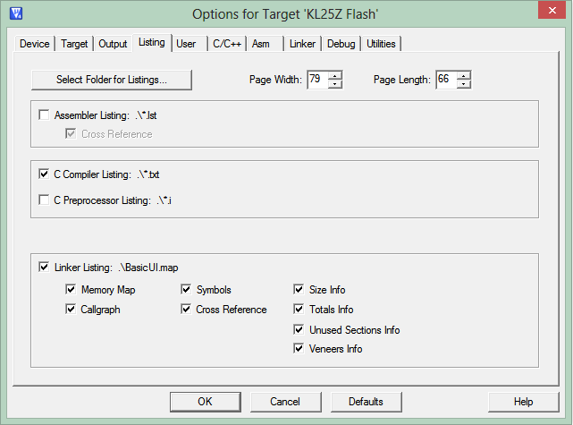
Examining Assembly Code before Debugger
Compiler can generate assembly code listing for reference
Select in project options

Slide 7
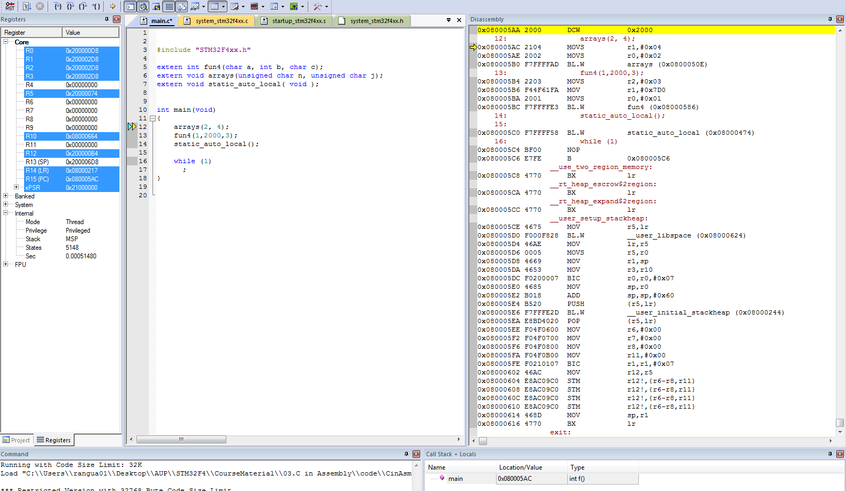
Examining Disassembled Program in Debugger
View->Disassembly Window

Slide 8
Application Binary Interface
  ABI defines rules which allow separately developed functions to work together
ARM Architecture Procedure Call Standard (AAPCS)
  Which registers must be saved and restored
  How to call procedures
  How to return from procedures
C Library ABI (CLIBABI)
  C Library functions
Run-Time ABI (RTABI)
  Run-time helper functions: 32/32 integer division, memory copying, floating-point operations, data type conversions, etc.

Slide 9
A Word on Code Optimizations
Compiler and rest of tool-chain try to optimize code:
  Simplifying operations
  Removing “dead” code
  Using registers
These optimizations often get in way of understanding what the code does
  Fundamental trade-off: Fast or comprehensible code?
  Compiler optimization levels: Level 0 to Level 3
Code examples here may use “volatile” data type modifier to reduce compiler optimizations and improve readability

Slide 10
Using Registers

Slide 11
AAPCS Register Use Conventions
Make it easier to create modular, isolated and integrated code
For cortex-M4,there are two types of registers.
“Caller saved registers”: registers that are not expected to be preserved upon returning from a called subroutine
  R0-R3, R12, LR, PSR
“Callee-saved registers”: Preserved (“variable”) registers are expected to have their original values upon returning from a called subroutine
  R4-R11

Slide 12
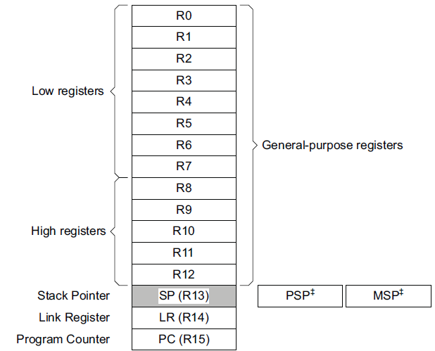
AAPCS Core Register Use
Don’t need to be saved. May be used for arguments, results, or temporary values.
Must be saved, restored by callee-procedure as it may modify them.
Calling subroutine expects these to retain their value.

Slide 13
Memory requirements

Slide 14
What Memory Does a Program Need?
int a, b;
const char c=123;
int d=31;
void main(void) {
int e;
char f[32];
e = d + 7;
a = e + 29999;
strcpy(f,“Hello!”);
}
Five possible types
  Code
  Read-only static data
  Writable static data
    Initialized
    Zero-initialized
    Uninitialized
  Heap
  Stack
What goes where?
  Code is obvious
  And the others?

Slide 15
What Memory Does a Program Need?
int a, b;
const char c=123;
int d=31;
void main(void) {
int e;
char f[32];
e = d + 7;
a = e + 29999;
strcpy(f,“Hello!”);
}
Can the information change?
  No? Put it in read-only, nonvolatile memory
    Instructions
    Constant strings
    Constant operands
    Initialization values
  Yes? Put it in read/write memory
    Variables
    Intermediate computations
    Return address
    Other housekeeping data

Slide 16
What Memory Does a Program Need?
How long does the data need to exist? Reuse memory if possible.
  Statically allocated
    Exists from program start to end
    Each variable has its own fixed location
    Space is not reused
  Automatically allocated
    Exists from function start to end
    Space can be reused
  Dynamically allocated
    Exists from explicit allocation to explicit deallocation
    Space can be reused
int a, b;
const char c=123;
int d=31;
void main(void) {
int e;
char f[32];
e = d + 7;
a = e + 29999;
strcpy(f,“Hello!”);
}

Slide 17
Program Memory Use
RAM
Flash ROM
Zero-Initialized Data
int a, b;
const char c=123;
int d=31;
void main(void) {
int e;
char f[32];
e = d + 7;
a = e + 29999;
strcpy(f,“Hello!”);
}
Constant Data
Initialized Data
InitializationData
Stack
Startup and Runtime Library Code
Heap Data
Program .text

Slide 18
Activation Record
Activation records
are located on the
stack
  Calling a function creates
  an activation record
  Returning from a function
  deletes the activation record
Automatic variables
and housekeeping
information are
stored in a function’s
activation record
Not all fields (LS, RA, Arg) may be present for each activation record
Lower address |  | (Free stack space)
 | Activation record for current function | Local storage | <- Stack ptr
 |  | Return address
 |  | Arguments
 | Activation record for caller function | Local storage
 |  | Return address
 |  | Arguments
 | Activation record for caller’s caller function | Local storage
 |  | Return address
 |  | Arguments
Higher address | Activation record for caller’s caller’s caller function | Local storage
 |  | Return address
 |  | Arguments

Slide 19
Type and Class Qualifiers
Const
  Never written by program, can be put in ROM to save RAM
Volatile
  Can be changed outside of normal program flow: ISR, hardware register
  Compiler must be careful with optimizations
Static
  Declared within function, retains value between function invocations
  Scope is limited to function

Slide 20
Linker Map File
Contains extensive information on functions and variables
  Value, type, size, object
Cross references between sections
Memory map of image
Sizes of image components
Summary of memory requirements

Slide 21
C Run-Time Start-Up Module
After reset, MCU must…
Initialize hardware
  Peripherals, etc.
  Set up stack pointer
Initialize C or C++ run-time environment
  Set up heap memory
  Initialize variables
RAM
Flash ROM
Zero-Initialized Data
a, b
Fill with
zeros
Initialization Data
31
Copy
Initialized Data
d
Constant Data
c: 123
Hello!
Stack
e, f
Startup and Runtime Library Code
Heap Data
Code

Slide 22
Accessing data in Memory

Slide 23
Accessing Data
int siA;
void static_auto_local() {
int aiB;
static int siC=3;
int * apD;
int aiE=4, aiF=5, aiG=6;
siA = 2;
aiB = siC + siA;
apD = & aiB;
(*apD)++;
apD = &siC;
(*apD) += 9;
apD = &siA;
apD = &aiE;
apD = &aiF;
apD = &aiG;
(*apD)++;
aiE+=7;
*apD = aiE + aiF;
}
What does it take to get at a variable in memory?
  Depends on location, which depends on storage type (static, automatic, dynamic)

Slide 24
Static Variables
Static var can be located anywhere in 32-bit memory space, so need a 32-bit pointer
Can’t fit a 32-bit pointer into a 16-bit instruction (or a 32-bit instruction), so save the pointer separate from instruction, but nearby so we can access it with a short PC-relative offset
Load the pointer into a register (r0)
Can now load variable’s value into a register (r1) from memory using that pointer in r0
Similarly can store a new value to the variable in memory
Load r0 with pointer to variable
Load r1 from [r0]
Use value of variable
Label:
32-bit pointer to Variable
Variable

Slide 25
Static Variables
Key
  variable’s value
  variable’s address
  address of copy of variable’s address
Code
  Loads r2 with address of siA (from |L1.240|)
  Loads r1 with contents of siA (via pointer r2, with offset 0)
  Same for siC, with address at |L1.244|
Addresses of siA and siC are stored as literals to be loaded into pointers
Variables siC and siA are located in .data section with initial values
AREA ||.text||, CODE, READONLY, ALIGN=2
;;;20 siA = 2;
00000e 2102 MOVS r1,#2
000010 4a37 LDR r2,|L1.240|
000012 6011 STR r1,[r2,#0] ; siA
;;;21 aiB = siC + siA;
000014 4937 LDR r1,|L1.244|
000016 6809 LDR r1,[r1,#0] ; siC
000018 6812 LDR r2,[r2,#0] ; siA
00001a 1889 ADDS r1,r1,r2
...
|L1.240|
DCD ||siA||
|L1.244|
DCD ||siC||
AREA ||.data||, DATA, ALIGN=2
||siC||
DCD 0x00000003
||siA||
  DCD 0x00000000

Slide 26
Automatic Variables Stored on Stack
Automatic variables are stored in a function’s activation record (unless optimized and promoted to register)
Activation records are located on the stack
Calling a function creates an activation record, allocating space on stack
Returning from a function deletes
the activation record, freeing up space on stack
int main(void) {
auto vars
a();
}
void a(void) {
auto vars
b();
}
void b(void) {
auto vars
c();
}
void c(void) {
auto vars
…
}

Slide 27
Automatic Variables
int main(void) {
auto vars
a();
}
void a(void) {
auto vars
b();
}
void b(void) {
auto vars
c();
}
void c(void) {
auto vars
…
}
Lower address |  | (Free stack space)
 | Activation record for current function C | Local storage | <- Stack pointer while executing C
 |  | Saved regs
 |  | Arguments (optional)
 | Activation record for caller function B | Local storage | <- Stack pointer while executing B
 |  | Saved regs
 |  | Arguments (optional)
 | Activation record for caller’s caller function A | Local storage | <- Stack pointer while executing A
 |  | Saved regs
 |  | Arguments (optional)
Higher address | Activation record for caller’s caller’s caller function main | Local storage | <- Stack pointer while executing main
 |  | Saved regs
 |  | Arguments (optional)

Slide 28
Addressing Automatic Variables
Program must allocate space on stack for variables
Stack addressing uses an offset from the stack pointer: [sp, #offset]
  One byte used for offset, is multiplied by four
  Possible offsets: 0, 4, 8, …, 1020
  Maximum range addressable this way is 1024 bytes
Address | Contents
SP
SP+4
SP+8
SP+0xC
SP+0x10
SP+0x14
SP+0x18
SP+0x1C
SP+0x20

Slide 29
Automatic Variables
Address | Contents
SP | aiG
SP+4 | aiF
SP+8 | aiE
SP+0xC | aiB
SP+0x10 | r0
SP+0x14 | r1
SP+0x18 | r2
SP+0x1C | r3
SP+0x20 | lr
;;;14 void static_auto_local( void ) {
000000 b50f PUSH {r0-r3,lr}
;;;15 int aiB;
;;;16 static int siC=3;
;;;17 int * apD;
;;;18 int aiE=4, aiF=5, aiG=6;
000002 2104 MOVS r1,#4
000004 9102 STR r1,[sp,#8]
000006 2105 MOVS r1,#5
000008 9101 STR r1,[sp,#4]
00000a 2106 MOVS r1,#6
00000c 9100 STR r1,[sp,#0]
…
;;;21 aiB = siC + siA;
…
00001c 9103 STR r1,[sp,#0xc]
Initialize aiE
Initialize aiF
Initialize aiG
Store value for aiB

Slide 30
Using Pointers

Slide 31
Using Pointers to Automatics
C Pointer: a variable which holds the data’s address
aiB is on stack at SP+0xc
Compute r0 with variable’s address from stack pointer and offset (0xc)
Load r1 with variable’s value from memory
Operate on r1, save back to variable’s address
;;;22 apD = & aiB;
00001e a803 ADD r0,sp,#0xc
;;;23 (*apD)++;
000020 6801 LDR r1,[r0,#0]
000022 1c49 ADDS r1,r1,#1
000024 6001 STR r1,[r0,#0]

Slide 32
Using Pointers to Statics
Load r0 with variable’s address from address of copy of variable’s address
Load r1 with variable’s value from memory
Operate on r1, save back to variable’s address
;;;24 apD = &siC;
000026 4833 LDR r0,|L1.244|
;;;25 (*apD) += 9;
000028 6801 LDR r1,[r0,#0]
00002a 3109 ADDS r1,r1,#9
00002c 6001 STR r1,[r0,#0]
|L1.244|
DCD ||siC||
AREA ||.data||, DATA, ALIGN=2
||siC||
DCD 0x00000003

Slide 33
Array Access

Slide 34
Array Access
What does it take to get at an array element in memory?
  Depends on how many dimensions
  Depends on element size and row width
  Depends on location, which depends on storage type (static, automatic, dynamic)
unsigned char buff2[3];
unsigned short int buff3[5][7];
unsigned int arrays(unsigned char n, unsigned char j) {
volatile unsigned int i;
i = buff2[0] + buff2[n];
i += buff3[n][j];
return i;
}

Slide 35
Accessing 1-D Array Elements
Need to calculate element address: sum of…
  array start address
  offset: index * element size
buff2 is array of unsigned characters
Move n (argument) from r0 into r2
Load r3 with pointer to buff2
Load (byte) r3 with first element of buff2
Load r4 with pointer to buff2
Load (byte) r4 with element at address buff2+r2
  r2 holds argument n
Add r3 and r4 to form sum
Address | Contents
buff2 | buff2[0]
buff2 + 1 | buff2[1]
buff2 + 2 | buff2[2]
00009e 4602 MOV r2,r0
;;;76 i = buff2[0] + buff2[n];
0000a0 4b1b LDR r3,|L1.272|
0000a2 781b LDRB r3,[r3,#0] ; buff2
0000a4 4c1a LDR r4,|L1.272|
0000a6 5ca4 LDRB r4,[r4,r2]
0000a8 1918 ADDS r0,r3,r4
|L1.272|
  DCD buff2

Slide 36
Accessing 2-D Array Elements
short int buff3[5][7]
var[rows][columns]
Sizes
  Element: 2 bytes
  Row: 7*2 bytes = 14 bytes (0xe)
Offset based on row index and column index
  column offset = column index * element size
  row offset = row index * row size
Address | Contents
buff3 | buff3[0][0]
buff3+1
buff3+2 | buff3[0][1]
buff3+3
(etc.)
buff3+10 | buff3[0][5]
buff3+11
buff3+12 | buff3[0][6]
buff3+13
buff3+14 | buff3[1][0]
buff3+15
buff3+16 | buff3[1][1]
buff3+17
buff3+18 | buff3[1][2]
buff3+19
(etc.)
buff3+68 | buff3[4][6]
buff3+69

Slide 37
Code to Access 2-D Array
;;;77 i += buff3[n][j];
0000aa 230e MOVS r3,#0xe
0000ac 4353 MULS r3,r2,r3
0000ae 4c19 LDR r4,|L1.276|
0000b0 191b ADDS r3,r3,r4
0000b2 004c LSLS r4,r1,#1
0000b4 5b1b LDRH r3,[r3,r4]
0000b6 1818 ADDS r0,r3,r0
|L1.276|
  DCD buff3
Load r3 with row size
Multiply by row number (n, r2) to put row offset in r3
Load r4 with address of buff3
Add buff 3 address to row offset in r3
Shift column number (j, r1) left by one, multiplying by 2 (bytes/element)
Load (halfword) r3 with element at address r3+r4 (buff3 + row offset + col. offset)
Add r3 into variable i (r0)

Slide 38
Function Prolog and Epilog

Slide 39
Prolog and Epilog
A function’s P&E are responsible for creating and destroying its activation record
Remember AAPCS
  Caller saved registers r0-r3,r12 are not expected to be preserved upon returning from a called subroutine, can be overwritten
  Callee saved (“variable”) registers r4-r11 must have their original values upon returning from a called subroutine
  Prolog must save preserved registers on stack
  Epilog must restore preserved registers from stack
Prolog also may
  Handle function arguments
  Allocate temporary storage space on stack (subtract from SP)
Epilog
  May deallocate stack space (add to SP)
  Returns control to calling function

Slide 40
Return Address
Return address stored in LR by bl, blx instructions
Consider case where a() calls b() which calls c()
  On entry to b(), LR holds return address in a()
  When b() calls c(), LR will be overwritten with return address in b()
  After c() returns, b() will have lost its return address
Does this function call a subroutine?
  Yes: must save and restore LR on stack just like other preserved registers, but LR value is popped into PC rather than LR
  No: don’t need to save or restore LR, as it will not be modified

Slide 41
Function Prolog and Epilog
fun4 PROC
;;;102 int fun4(char a, int b, char c) {
;;;103 volatile int x[8];
00010a b510 PUSH {r4,lr}
00010c b088 SUB sp,sp,#0x20
...
;;;106 return a+b+c;
00011c 1858 ADDS r0,r3,r1
00011e 1880 ADDS r0,r0,r2
;;;107 }
000120 b008 ADD sp,sp,#0x20
000122 bd10 POP {r4,pc}
ENDP
Save r4 (preserved register) and link register (return address)
Allocate 32 (0x20) bytes on stack for array x by subtracting from SP
Compute return value, placing in return register r0
Deallocate 32 bytes from stack
Pop r4 (preserved register) and PC (return address)

Slide 42
Activation Record Creation by Prolog
Smaller address | space for x[0] | Array x | <- 3. SP after sub sp,sp,#0x20
 | space for x[1]
 | space for x[2]
 | space for x[3]
 | space for x[4]
 | space for x[5]
 | space for x[6]
 | space for x[7]
 | lr | Return address | <- 2. SP after push {r4,lr}
 | r4 | Preserved register
Larger address |  | Caller’s stack frame | <- 1. SP on entry to function, before push {r4,lr}

Slide 43
Activation Record Destruction by Epilog
Smaller address | space for x[0] | Array x | <- 1. SP before add sp,sp,#0x20
 | space for x[1]
 | space for x[2]
 | space for x[3]
 | space for x[4]
 | space for x[5]
 | space for x[6]
 | space for x[7]
 | lr | Return address | <- 2. SP after add sp,sp,#20
 | r4 | Preserved register
Larger address |  | Caller’s stack frame | <- 1. SP after pop {r4,pc}

Slide 44
Calling Functions

Slide 45
AAPCS Core Register Use
Don’t need to be saved. May be used for arguments, results, or temporary values.
Must be saved, restored by callee-procedure as it may modify them.
Calling subroutine expects these to retain their value.

Slide 46
Function Arguments and Return Values
First, pass the arguments
  How to pass them?
    Much faster to use registers than stack
    But quantity of registers is limited
  Basic rules
    Process arguments in order they appear in source code
    Round size up to be a multiple of 4 bytes
    Copy arguments into core registers (r0-r3), aligning doubles to even registers
    Copy remaining arguments onto stack, aligning doubles to even addresses
    Specific rules in AAPCS, Section 5.5
Second, call the function
  Usually as subroutine with branch link (bl) or branch link and exchange instruction (blx)
  Exceptions in AAPCS

Slide 47
Return Values
Callee passes Return Value in register(s) or stack
Registers
Stack
  Caller function allocates space for return value, then passes pointer to space as an argument to callee
  Callee stores result at location indicated by pointer
Return value size | Registers used for passing
 | Fundamental Data Type | Composite Data Type
1-4 bytes | r0 | r0
8 bytes | r0-r1 | stack
16 bytes | r0-r3 | stack
Indeterminate size | n/a | stack

Slide 48
Call Example
int fun2(int arg2_1, int arg2_2) {
int i;
arg2_2 += fun3(arg2_1, 4, 5, 6);
…
}
fun2 PROC
;;;85 int fun2(int arg2_1, int arg2_2) {
...
0000e0 2306 MOVS r3,#6
0000e2 2205 MOVS r2,#5
0000e4 2104 MOVS r1,#4
0000e6 4630 MOV r0,r6
0000e8 f7fffffe BL fun3
0000ec 1904 ADDS r4,r0,r4
Argument 4 into r3
Argument 3 into r2
Argument 2 into r1
Argument 0 into r0
Call fun3 with BL instruction
Result was returned in r0, so add to r4 (arg2_2 += result)

Slide 49
Call and Return Example
int fun3(int arg3_1, int arg3_2,
int arg3_3, int arg3_4) {
return arg3_1*arg3_2*
arg3_3*arg3_4;
}
fun3 PROC
;;;81 int fun3(int arg3_1, int arg3_2, int arg3_3, int arg3_4) {
0000ba b510 PUSH {r4,lr}
0000c0 4348 MULS r0,r1,r0
0000c2 4350 MULS r0,r2,r0
0000c4 4358 MULS r0,r3,r0
0000c6 bd10 POP {r4,pc}
Save r4 and Link Register on stack
r0 = arg3_1*arg3_2
r0 *= arg3_3
r0 *= arg3_4
Restore r4 and return from subroutine
Return value is in r0

Slide 50
Control Flow

Slide 51
Control Flow: Conditionals and Loops
How does the compiler implement conditionals and loops?
if (x){
y++;
} else {
y--;
}
switch (x) {
case 1:
y += 3;
break;
case 31:
y -= 5;
break;
default:
y--;
break;
}
while (x<10) {
x = x + 1;
}
for (i = 0; i < 10; i++){
x += i;
}
do {
x += 2;
} while (x < 20);

Slide 52
Control Flow: If/Else
;;;39 if (x){
000056 2900 CMP r1,#0
000058 d001 BEQ |L1.94|
;;;40 y++;
00005a 1c52 ADDS r2,r2,#1
00005c e000 B |L1.96|
|L1.94|
;;;41 } else {
;;;42 y--;
00005e 1e52 SUBS r2,r2,#1
  |L1.96|
;;;43 }

Slide 53
Control Flow: Switch
;;;45 switch (x) {
000060 2901 CMP r1,#1
000062 d002 BEQ |L1.106|
000064 291f CMP r1,#0x1f
000066 d104 BNE |L1.114|
000068 e001 B |L1.110|
  |L1.106|
;;;46 case 1:
;;;47 y += 3;
00006a 1cd2 ADDS r2,r2,#3
;;;48 break;
00006c e003 B |L1.118|
|L1.110|
;;;49 case 31:
;;;50 y -= 5;
00006e 1f52 SUBS r2,r2,#5
;;;51 break;
000070 e001 B |L1.118|
|L1.114|
;;;52 default:
;;;53 y--;
000072 1e52 SUBS r2,r2,#1
;;;54 break;
000074 bf00 NOP
|L1.118|
000076 bf00 NOP
;;;55 }

Slide 54
Iteration: While
;;;57 while (x<10) {
000078 e000 B |L1.124|
|L1.122|
;;;58 x = x + 1;
00007a 1c49 ADDS r1,r1,#1
|L1.124|
00007c 290a CMP r1,#0xa ;57
00007e d3fc BCC |L1.122|
;;;59 }

Slide 55
Iteration: For
;;;61 for (i = 0; i < 10; i++){
000080 2300 MOVS r3,#0
000082 e001 B |L1.136|
|L1.132|
;;;62 x += i;
000084 18c9 ADDS r1,r1,r3
000086 1c5b ADDS r3,r3,#1 ;61
|L1.136|
000088 2b0a CMP r3,#0xa
;61
00008a d3fb BCC |L1.132|
;;;63 }

Slide 56
Iteration: Do/While
;;;65 do {
00008c bf00 NOP
|L1.142|
;;;66 x += 2;
00008e 1c89 ADDS r1,r1,#2
;;;67 } while (x < 20);
000090 2914 CMP r1,#0x14
000092 d3fc BCC |L1.142|

