Slide 1
General Purpose I/O

Slide 2
Overview
How do we make a program light up LEDs in response to a switch?
GPIO
  Basic Concepts
  Port Circuitry
  Control Registers
  Accessing Hardware Registers in C
  Clocking and Muxing
Circuit Interfacing
  Inputs
  Outputs
Additional Configuration

Slide 3
Basic Concepts
GPIO = General-purpose input and output (digital)
  Input: program can determine if input signal is a 1 or a 0
  Output: program can set output to 1 or 0
Can use this to interface with external devices or on board peripherals
  Input: switch, button……
  Output: LEDs, speaker……

Slide 4
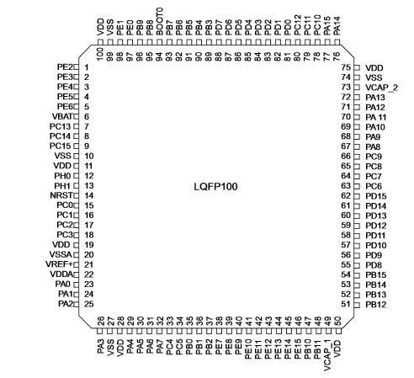
STM32F40x LQFP100 pinout
Port A (PA) through Port E (PE)
Not all port bits are available
Quantity depends on package pin count

Slide 5
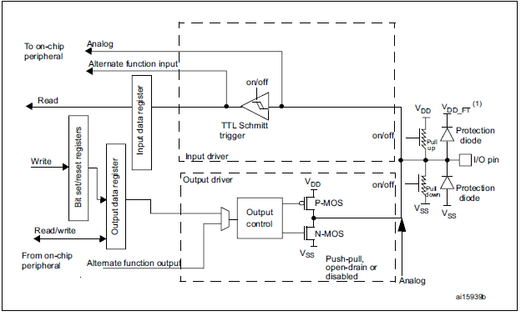
GPIO Port Bit Circuitry in MCU
Configuration
  Direction
  MUX
  Modes
  Speed
Data
  Output (different ways to access it)
  Input
  Analogue
Locking

Slide 6
Control Registers
Each general-purpose I/O port has
  four 32-bit configuration registers (
    GPIOx_MODER (input, output, AF, analog)
    GPIOx_OTYPER (output type: push-pull or open drain)
    GPIOx_OSPEEDR(speed)
    GPIOx_PUPDR(pull-up/pull-down)
  two 32-bit data registers(GPIOx_IDR and GPIOx_ODR)
  a 32-bit set/reset register (GPIOx_BSRR)
  a 32-bit locking register (GPIOx_LCKR)
  two 32-bit alternate function selection register (GPIOx_AFRH and GPIOx_AFRL)
One set of control registers (10 in total) per port
Each bit in a control register corresponds to a port bit
All registers have to be accessed as 32-bit word

Slide 7
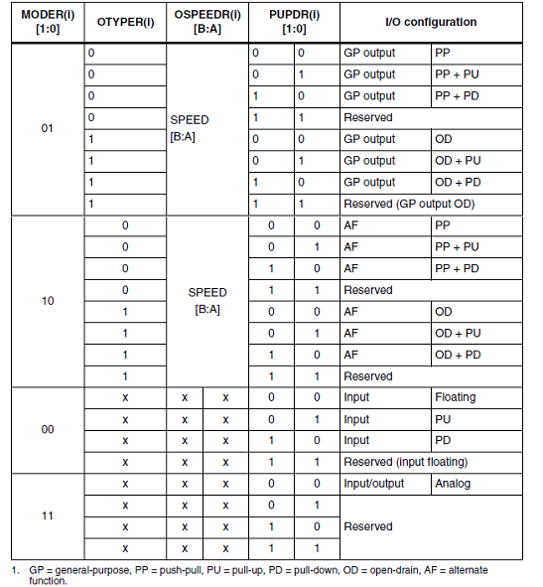
GPIO Configuration registers
Each bit can be configured differently
Reset clears port bit direction to 0
Output modes: push-pull or open drain + pull-up/down
Output data from output data register (GPIOx_ODR) or peripheral (alternate function output)
Input states: floating, pull-up/down, analog
Input data to input data register (GPIOx_IDR) or peripheral (alternate function input)

Slide 8
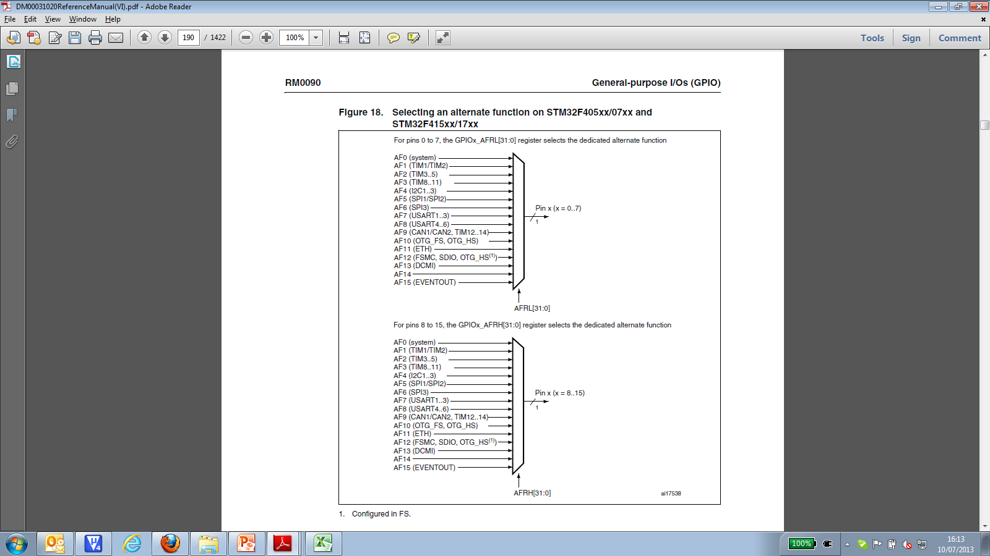
Alternate function selection register
In AF mode, AFRL or AFRH needs to be configured to be driven by specific peripheral
Can be seen as a select signal to the Mux
EVENTOUT is not mapped onto the following I/O pins: PC13, PC14, PC15, PH0, PH1 and PI8.

Slide 9
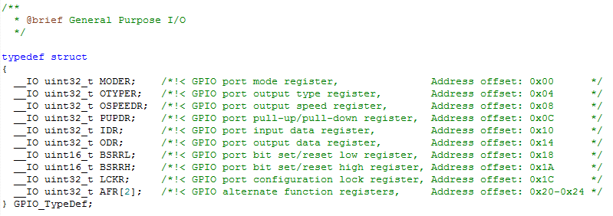
CMSIS - Accessing Hardware Registers in C
Header file stm32f4xx.h defines C data structure types to represent hardware registers in MCU with CMSIS-Core hardware abstraction layer

Slide 10
CMSIS C Support
Header file stm32f4xx.h defines pointers to GPIO_Type registers
#define GPIOA_BASE (AHB1PERIPH_BASE + 0x0000)
#define GPIOB_BASE (AHB1PERIPH_BASE + 0x0400)
#define GPIOC_BASE (AHB1PERIPH_BASE + 0x0800)
#define GPIOD_BASE (AHB1PERIPH_BASE + 0x0C00)
#define GPIOE_BASE (AHB1PERIPH_BASE + 0x1000)
#define GPIOF_BASE (AHB1PERIPH_BASE + 0x1400)
#define GPIOG_BASE (AHB1PERIPH_BASE + 0x1800)
#define GPIOH_BASE (AHB1PERIPH_BASE + 0x1C00)
#define GPIOI_BASE (AHB1PERIPH_BASE + 0x2000)
……
#define AHB1PERIPH_BASE (PERIPH_BASE + 0x00020000)
……
#define PERIPH_BASE ((uint32_t)0x40000000)

Slide 11
Clocking Logic
Need to enable clock to GPIO module
By default, GPIO modules are disabled to save power
Writing to an unclocked module triggers a hardware fault!
Control register RCC_AHB1ENR gates clocks to GPIO ports
Enable clock to Port D
RCC->AHB1ENR|= (1UL << 3);
Header file stm32f4xx.h has definitions
RCC->AHB1ENR|=RCC_AHB1ENR_GPIODEN;

Slide 12
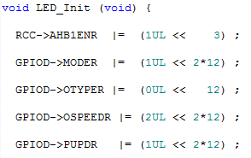
Initializing GPIO
Enable clock for Port
Set the mode
Set the Output type
Set the speed
Set the pull-up or pull down
Set the AF
Not all of these are necessary, default setting is ok (usually all bits cleared after reset)
Need to access the entire 32 registers
Simple example for initializing the orange led on the board
  Port D pin 12

Slide 13
CMSIS C Support
Header file stm32f4xx.h also has bits definition for GPIO register
#define GPIO_MODER_MODER0 ((uint32_t)0x00000003)
#define GPIO_MODER_MODER0_0 ((uint32_t)0x00000001)
#define GPIO_MODER_MODER0_1 ((uint32_t)0x00000002)
    #define GPIO_OTYPER_OT_0 ((uint32_t)0x00000001)
    #define GPIO_OSPEEDER_OSPEEDR0 ((uint32_t)0x00000003)
    #define GPIO_OSPEEDER_OSPEEDR0_0 ((uint32_t)0x00000001)
    #define GPIO_OSPEEDER_OSPEEDR0_1 ((uint32_t)0x00000002)
    #define GPIO_PUPDR_PUPDR0 ((uint32_t)0x00000003)
    #define GPIO_PUPDR_PUPDR0_0 ((uint32_t)0x00000001)
    #define GPIO_PUPDR_PUPDR0_1 ((uint32_t)0x00000002)

Slide 14
Writing/Reading Output/Input Port Data
Direct: write value GPIOx_ODR
Clear (to 0): Write 1 to BSRRL
Set (to 1): write 1 to BSRRH
  GPIOD->ODR|=(1<<12);
  Equivalent to: GPIOD->BSRRL=(1<<12);
  Or with CMSIS: GPIOD-ODR|= GPIO_ODR_ODR_12
  GPIOD->ODR&=~(<<12);
  Equivalent to: GPIOD->BSRRH=(1<<12);
  Or with CMSIS: GPIOD-ODR&=~GPIO_ODR_ODR_12
Read from IDR
  data=GPIOD->IDR&(1<<12)
  Or with CMSIS: data=GPIOD->IDR&GPIO_IDR_IDR_12

Slide 15
Coding Style and Bit Access
Easy to make mistakes dealing with literal binary and hexadecimal values
  “To set bits 13 and 19, use 0000 0000 0000 1000 0010 0000 0000 0000 or 0x00082000”
Make the literal value from shifted bit positions
n = (1UL << 19) | (1UL << 13);
Define names for bit positions
#define POS_0 (13)
#define POS_1 (19)
n = (1UL << POS_0) | (1UL << POS_1);
Create macro to do shifting to create mask
#define MASK(x) (1UL << (x))
n = MASK(POS_0) | MASK(POS_1);

Slide 16
Using Masks
Overwrite existing value in n with mask
  n = MASK(foo);
Set in n all the bits which are one in mask, leaving others unchanged
    n |= MASK(foo);
Complement the bit value of the mask
    ~MASK(foo);
Clear in n all the bits which are zero in mask, leaving others unchanged
  n &= MASK(foo);

Slide 17
Using Masks with CMSIS
#define SET_BIT(REG, BIT) ((REG) |= (BIT))
#define CLEAR_BIT(REG, BIT) ((REG) &= ~(BIT))
#define READ_BIT(REG, BIT) ((REG) & (BIT))
#define CLEAR_REG(REG) ((REG) = (0x0))
#define WRITE_REG(REG, VAL) ((REG) = (VAL))
#define READ_REG(REG) ((REG))
#define MODIFY_REG(REG, CLEARMASK, SETMASK) WRITE_REG((REG), (((READ_REG(REG)) & (~(CLEARMASK))) | (SETMASK)))
  BIT = MASK(foo);

Slide 18
C Code
#define LED1_POS (13)
#define LED2_POS (14)
#define SW1_POS (0)
#define MASK(x) (1UL << (x))
RCC->AHB1ENR|=RCC_AHB1ENR_GPIODEN;
/* Initialization of GPIO */
GPIOD->ODR = MASK(LED1_POS); // turn on LED1, turn off LED2
while (1) {
if (GPIOD->IDR & MASK(SW1_POS)) {
// switch is pressed, then light LED 2
GPIOD->BSRRL = MASK(LED2_POS);
GPIOD->BSRRH = MASK(LED1_POS);
} else {
// switch is pressed, so light LED 1
GPIOD->BSRRL = MASK(LED1_POS);
GPIOD->BSRRH = MASK(LED2_POS);
}
}

Slide 19
Atomic Access
Unlike some of other MCU, the AHB1 on STM32F4Discovery provides atomic access to one or more bits.
Which means do not have to disable the interrupt when programming the GPIOx_ODR at bit level.

Slide 20
Interfacing
Inputs and Outputs, Ones and Zeros, Voltages and Currents

Slide 21
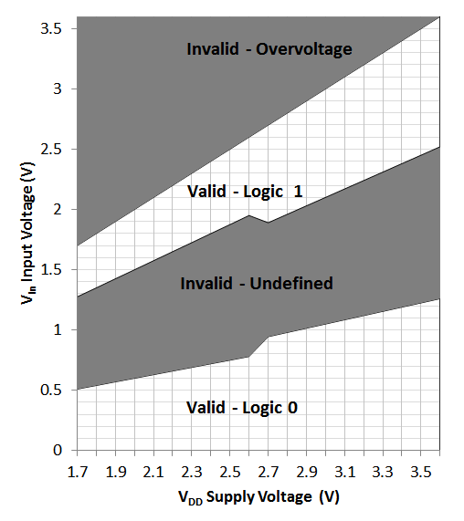
Inputs: What’s a One? A Zero?
Input signal’s value is determined by voltage
Input threshold voltages depend on supply voltage V_{DD}
Exceeding V_{DD} or GND may damage chip

Slide 22
Outputs: What’s a One? A Zero?
Nominal output voltages
  1: V_{DD}-0.5 V to V_{DD}
  0: 0 to 0.5 V
Note: Output voltage depends on current drawn by load on pin
  Need to consider source-to-drain resistance in the transistor
  Above values only specified when current < 5 mA (18 mA for high-drive pads) and V_{DD} > 2.7 V
Logic 1 out
V_{out}
Logic 0 out
I_{out}

Slide 23
Driving External LEDs
Need to limit current to a value which is safe for both LED and MCU port driver
Use current-limiting resistor
  R = (V_{DD} – V_{LED})/I_{LED}
Set I_{LED} = 4 mA
V_{LED} depends on type of LED (mainly color)
  Red: ~1.8V
  Blue: ~2.7 V
Solve for R given VDD = ~3.0 V
  Red: 300 Ω
  Blue: 75 Ω

Slide 24
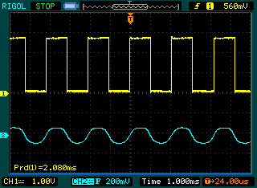
Output Example: Driving a Speaker
Create a square wave with a GPIO output
Use capacitor to block DC value
Use resistor to reduce volume if needed
void Speaker_Beep(uint32_t frequency){
Init_Speaker();
while(1){
GPIOD->BSRRL=(MASK(2));
Delay(frequency);
GPIOD->BSRRH=(MASK(2));
Delay(frequency);
}
}

