Slide 1
Analog Interfacing

Slide 2
Why It’s Needed
Embedded systems often need to measure values of physical parameters
These parameters are usually continuous (analog) and not in a digital form which computers (which operate on discrete data values) can process
Temperature
Thermometer (do you have a fever?)
Thermostat for building, fridge, freezer
Car engine controller
Chemical reaction monitor
Safety (e.g. microprocessor processor thermal management)
Light (or infrared or ultraviolet) intensity
Digital camera
IR remote control receiver
Tanning bed
UV monitor
Rotary position
Wind gauge
Knobs
Pressure
Blood pressure monitor
Altimeter
Car engine controller
Scuba dive computer
Tsunami detector
Acceleration
Air bag controller
Vehicle stability
Video game remote
Mechanical strain
Other
Touch screen controller
EKG, EEG
Breathalyzer

Slide 3
Converting Between Analog and Digital Values

Slide 4
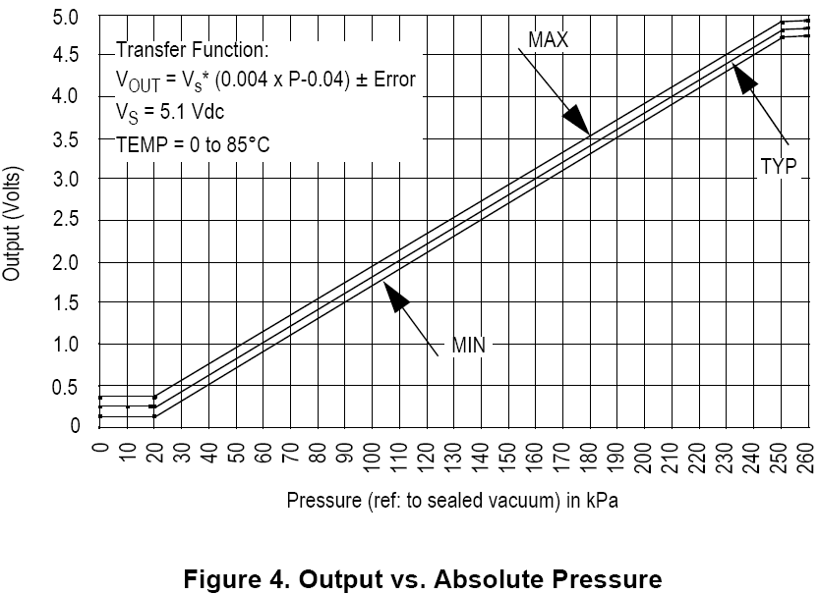
The Big Picture – A Depth Gauge
V_ref
// Your software
ADC_Code = ADC0->R[0];
V_sensor = ADC_code*V_ref/1023;
Pressure_kPa = 250 * (V_sensor/V_supply+0.04);
Depth_ft = 33 * (Pressure_kPa – Atmos_Press_kPa)/101.3;
Pressure Sensor
Analog to Digital Converter
Air Pressure
Voltages
ADC Output Codes
V_sensor
ADC_Code
V_ref
111..111
111..110
111..101
111..100
V_sensor
ADC_Code
Ground
000..001
000..000
Sensor detects air pressure and generates a proportional output voltage V_sensor
ADC generates a proportional digital integer (code) based on V_sensor and V_ref
Code can convert that integer to a something more useful
first a float representing the voltage,
then another float representing pressure,
finally another float representing depth

Slide 5
Getting From Analog to Digital
A Comparator tells us “Is V_{in} > V_{ref}?”
Compares an analog input voltage with an analog reference voltage and determines which is larger, returning a 1-bit number
E.g. Indicate if depth > 100 ft
Set V_{ref} to voltage pressure sensor returns with 100 ft depth.
An Analog to Digital converter [AD or ADC] tells us how large V_{in} is as a fraction of V_{ref}.
Reads an analog input signal (usually a voltage) and produces a corresponding multi-bit number at the output.
E.g. calculate the depth
Comparator
Vin
0
Vref
A/D Converter
Vref
0
1
0
1
Vin
Clock

Slide 6
Digital to Analog Conversion
May need to generate an analog voltage or current as an output signal
E.g. audio signal, video signal brightness.
DAC: “Generate the analog voltage which is this fraction of V_{ref}”
Digital to Analog Converter equation
n = input code
N = number of bits of resolution of converter
V_{ref} = reference voltage
V_{out} = output voltage. Either
V_{out} = V_{ref} * n/(2^{N}) or
V_{out} = V_{ref} * (n+1)/(2^{N})
The offset +1 term depends on the internal tap configuration of the DAC – check the datasheet to be sure
D/A Converter
0
1
0
1
Vout
Vref

Slide 7
Waveform Sampling and Quantization
Digital value
time
A waveform is sampled at a constant rate – every Δt
Each such sample represents the instantaneous amplitude at the instant of sampling
“At 37 ms, the input is 1.91341914513451451234311… V”
Sampling converts a continuous time signal to a discrete time signal
The sample can now be quantized (converted) into a digital value
Quantization represents a continuous (analog) value with the closest discrete (digital) value
“The sampled input voltage of 1.91341914513451451234311… V is best represented by the code 0x018, since it is in the range of 1.901 to 1.9980 V which corresponds to code 0x018.”

Slide 8
Forward Transfer Function Equations
What code n will the ADC use to represent voltage V_{in}?
General Equation
n = converted code
V_{in} = sampled input voltage
V_{+ref} = upper voltage reference
V_{-ref} = lower voltage reference
N = number of bits of resolution in ADC
Simplification with V_{-ref} = 0 V
(
V
)
2
N
n
=
⎢
in
+
1
/
2
⎥
⎢
V
⎥
⎣
+
ref
⎦
(
)
3
.
30
v
2
10
−
N
n
=
⎢
+
1
/
2
⎥
=
676
V
V
−
2
⎣
5
v
⎦
n
=
⎢
in
ref
+
1
/
2
⎥
⎢
V
−
V
⎥
⎣
+
ref
−
ref
⎦
X = I
floor function: nearest integer I such that I <= X
floor(x+0.5) rounds x to the nearest integer
⎣
⎦

Slide 9
Inverse Transfer Function
What range of voltages V_{in_min} to V_{in_max} does code n represent?
General Equation
n = converted code
V_{in_min} = minimum input voltage for code n
V_{in_max} = maximum input voltage for code n
V_{+ref} = upper voltage reference
V_{-ref} = lower voltage reference
N = number of bits of resolution in ADC
Simplification with V_{-ref} = 0 V
$$V_{in_min}=\frac{n−\frac{1}{2}}{2^{N}}\left(V_{+ref}\right)$$
$$V_{in_max}=\frac{n+\frac{1}{2}}{2^{N}}\left(V_{+ref}\right)$$
$$V_{in_min}=\frac{n−\frac{1}{2}}{2^{N}}\left(V_{+ref}−V_{−ref}\right)+V_{−ref}$$
$$V_{in_max}=\frac{n+\frac{1}{2}}{2^{N}}\left(V_{+ref}−V_{−ref}\right)+V_{−ref}$$

Slide 10
What if the Reference Voltage is not known?
Example - running off an unregulated battery (to save power)
Measure a known voltage and an unknown voltage
Many MCUs include an internal fixed voltage source which ADC can measure for this purpose
Can also solve for Vref
$$V_{unknown}=V_{known}\frac{n_{unknown}}{n_{known}}$$
$$V_{ref}=V_{known}\frac{2^{N}}{n}$$
“My ADC tells me that channel 27 returns a code of 0x6543, so I can calculate that V_{REFSH} = 1.0V * 2¹⁶/0x6543 = …

Slide 11
Analog to Digital conversion concepts

Slide 12
A/D – Flash Conversion
A multi-level voltage divider is used to set voltage levels over the complete range of conversion.
A comparator is used at each level to determine whether the voltage is lower or higher than the level.
The series of comparator outputs are encoded to a binary number in digital logic (a priority encoder)
Components used
2^{N} resistors
2^{N}-1 comparators
Note
This particular resistor divider generates voltages which are not offset by ½ bit, so maximum error is 1 bit
We could change this offset voltage by using resistors of values R, 2R, 2R ... 2R, 3R (starting at bottom)
1V
Comparators
7/8 V
R
+
1
R
6/8 V
-
R
+
1
5/8 V
-
R
+
1
4/8 V
-
R
+
Encoder
3
0
3/8 V
-
R
+
0
2/8 V
-
R
+
0
1/8 V
-
R
+
0
-
V
in

Slide 13
ADC - Successive Approximation Conversion
Successively approximate input voltage by using a binary search and a DAC
SA Register holds current approximation of result
Set all DAC input bits to 0
Start with DAC’s most significant bit
Repeat
Set next input bit for DAC to 1
Wait for DAC and comparator to stabilize
If the DAC output (test voltage) is smaller than the input then set the current bit to 1, else clear the current bit to 0
111111
Test voltage (DAC output)
Analog Input
100110
Voltage
100100
100000
know xxxxxx, try 100000
know 10011x, try 100111
know 1001xx, try 100110
know 100xxx, try 100100
know 10xxxx, try 101000
know 1xxxxx, try 110000
know 100110. Done.
T
T
T
T
T
T
000000
1
2
3
4
5
6
Start of
Conversion
Time

Slide 14
A/D - Successive Approximation
Converter Schematic
Converter

Slide 15
ADC Performance Metrics
Linearity measures how well the transition voltages lie on a straight line.
Differential linearity measure the equality of the step size.
Conversion time: between start of conversion and generation of result
Conversion rate = inverse of conversion time

Slide 16
Sampling Problems
Nyquist criterion
F_{sample} >= 2 * F_{max frequency component}
Frequency components above ½ F_{sample} are aliased, distort measured signal
Nyquist and the real world
This theorem assumes we have a perfect filter with “brick wall” roll-off
Real world filters have more gentle roll-off
Inexpensive filters are even worse (e.g. first order filter is 20 dB/decade, aka 6 dB/octave)
So we have to choose a sampling frequency high enough that our filter attenuates aliasing components adequately

Slide 17
Inputs
Differential
Use two channels, and compute difference between them
Very good noise immunity
Some sensors offer differential outputs (e.g. Wheatstone Bridge)
Multiplexing
Typically share a single ADC among multiple inputs
Need to select an input, allow time to settle before sampling
Signal Conditioning
Amplify and filter input signal
Protect against out-of-range inputs with clamping diodes

Slide 18
Sample and Hold Devices
Some A/D converters require the input analog signal to be held constant during conversion, (e.g. successive approximation devices)
In other cases, peak capture or sampling at a specific point in time necessitates a sampling device.
This function is accomplished by a sample and hold device as shown to the right:
These devices are incorporated into some A/D converters

Slide 19
STM32F4Discovery Analog Interfacing Peripherals

Slide 20
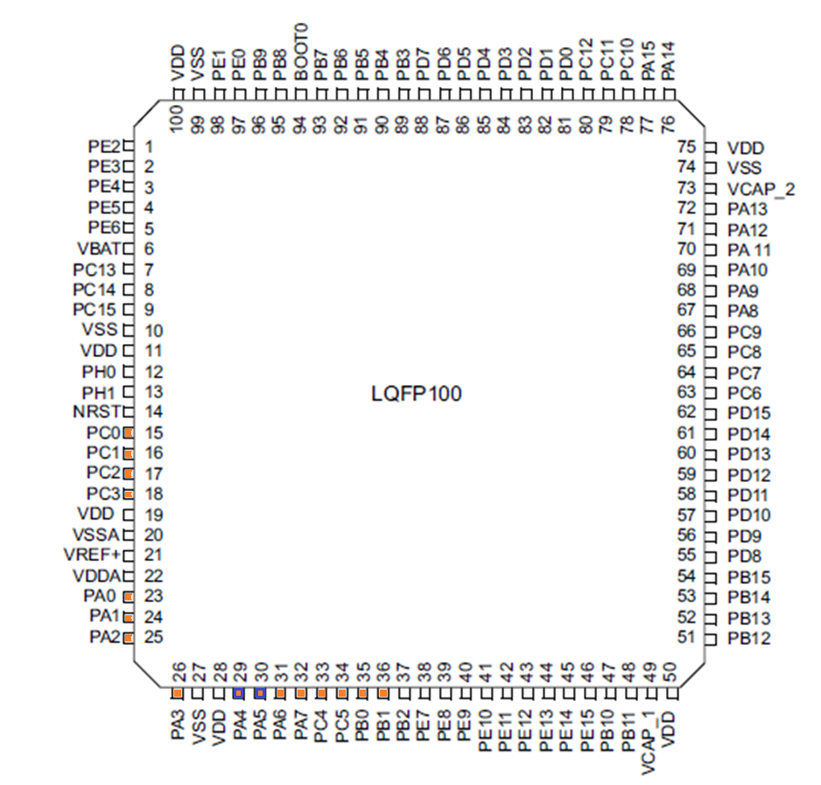
STM32F40x LQFP100 Analog Interface Pins
100-pin QFP
Inputs
16 12-bit ADC
Output
2 12-bit DAC

Slide 21
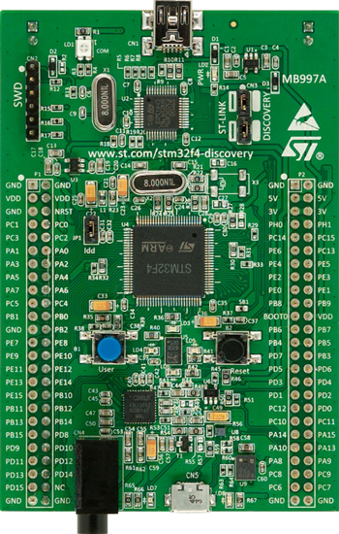
STM32F4 Discovery Analog I/O
Inputs
16 external 12-bit ADC channels
Output
2 12-bit DAC, one channel each

Slide 22
GPIO Port Bit Circuitry in MCU
Configuration
Direction
MUX
Modes
Speed
Data
Output (different ways to access it)
Input
Analogue
Locking

Slide 23
Configuration of the GPIO registers
Mode 11
GPIOA->MODER|=GPIO_MODER_MODERx;
PUPD 00
GPIOA->PUPDR&=~(GPIO_PUPDR_PUPDRx);

Slide 24
Digital to Analog Converter

Slide 25
DAC Overview
Two independent channels
DAC1 connects to PA4;DAC2 connects to PA5
Output buffers, better ability to drive external loads
Different Data formats
DAC_{output(12bit)} = V_{REF}×DOR÷4095
Range from 0 to V_{REF}+
Dual Channel mode
Support DMA

Slide 26
Single DAC channel mode
Data Format
8-bit right alignment DAC_DHR8Rx [7:0]
12-bit left alignment DAC_DHR12Lx [15:4]
12-bit right alignment DAC_DHR12Rx [11:0]
Buffered
Data to output is stored in 16-word buffer DAC_DHRx
DAC_DHRx will update DAC_DORx after one APB1 clock cycle
If hardware trigger is selected (TENx bit in DAC_CR register) then then update will be delayed to three APB1 clock cycles after the trigger event.
Depends on power supply voltage and output load, the analog output voltage will be available after a time t_{SETTLING} (typically 3us) since the last update.
DAC_{output} = V_{REF}×DOR÷4095 (12-BIT MODE)
Range from 0 to V_{REF+}

Slide 27
TEN(Trigger Enable)
The timing diagram for when trigger is disabled (TEN=0)
When the trigger is enabled, can select external event to trigger the DAC
Can also be triggered by software

Slide 28
DAC Control Register : DAC_CR
Lower 16 bits are for channel 1 and higher 16 bits are for channel 2
Fruitful functions: DMA, wave/noise generator, trigger
EN bit: enable the DAC channel
TEN bit: trigger enable bit, also decides how many clock cycles before DHR load into DOR
TSEL bits: trigger selection
BOFF bit: output buffer disable, to enhance the driving ability but the output may not reach 0 if enabled, set 1 to disable
Wave bits: To generate noise wave or triangle wave (Only use when TEN is 1)

Slide 29
DHR Data Holding Registers
CMSIS provides access to different format of data by defining different DHR
Slightly different from single channel and dual channel

Slide 30
Example: Waveform Generator
Configure corresponding GPIO
Enable the Clock (APB1)
Enable DAC
Configure DAC
Mode
Trigger
Normal mode (not buffered)
Write to DAC DHR data register

Slide 31
Analog to Digital Converter

Slide 32
ADC Overview
Uses successive approximation for conversion
Supports multiple resolutions: 12, 10, 8 and 6 bits
4 injected channels and 16 regular channels
Supports single and continuous conversions
DUAL/Triple ADC mode
DMA
Analog watchdog
Temperature sensor

Slide 33
ADC Overview
High sampling speed
Conversion range from 0 to 3.6 V
Different Supply requirement
Scan mode for automatic conversion
DUAL/Triple ADC mode
Channel by channel programmable sampling time
Interrupt generation on
End of (Injected)conversion
Analog watchdog
Overrun

Slide 34
ADC System Fundamentals
Output Registers
Analog Input
ADC
Clock

Slide 35
Using the ADC
ADC initialization
Configure GPIO (if using on board pins)
Enable clock
Enable ADC
Select voltage reference
Select trigger source
Select input channel
Select other parameters
Trigger conversion
Read results
Calibrate? Average?

Slide 36
On-off Control
For power efficiency, the ADC module is usually turned off (even if it is clocked).
If ADON bit in ADC control register 2 is set, the module is powered on; otherwise it is powered off.
Good practical to shut down ADC whenever you are not using it.

Slide 37
Clock Configuration
Analog Clock
ADCCLK, common to all ADCs
From APB2 (72Mhz) (Can be prescale by 1,2,4,8 or 16)
Can be prescaled by 2, 4, 6 or 8, which means at most 36MHz
ADC common control register(ADC_CCR) bit 17:16
Digital Interface Clock
Used for registers read/write access
From APB2 (72Mhz)
Need to be enable individually for each channel (RCC_APB2ENR)

Slide 38
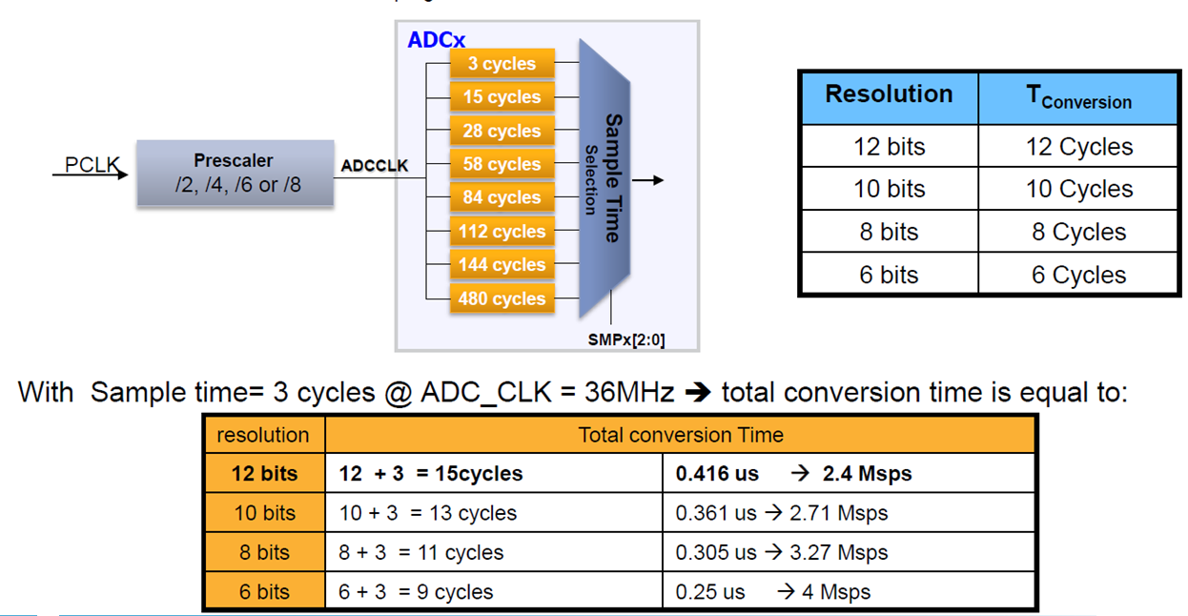
ADC Conversion Time
Programmable sample time for all channels
Sample time register 1 to 2 (ADC_SMPRx)
Total conversion time = T_{sampling} + T_{conversion}

Slide 39
Channel Selection
Two groups of channels
Regular group
Up to 16 conversions
Consists of a sequence of conversions that can be done on any channel in any order
Specify each sequence by configuring the ADC_SQRx registers
Specify the total number of conversions by configuring the least 4 bits in the ADC_SQR1 register
Injected group
Up to 4 conversions
Similar to regular group
But the sequence is specified by the ADC_JSQR register
Specify the total number of conversions by configuring the least 2 bits in the ADC_JSQR register
Modifying either ADC_SQRx or ADC_JSQR will reset the current ADC process.

Slide 40
Channel Selection
Three other channels
ADC1_IN16 is internally connected to the temperature sensor
ADC1_IN17 is internally connected to the reference voltage VREFINT
ADC1_IN18 is connected to the VBAT. Can be use as regular or injected channel.
But only available on the master ADC1 peripheral.

Slide 41
Voltage Reference Selection
Input range from V_{REF-} to V_{REF+}
V_{REF+} Positive analog reference
V_{DDA} equal to Vdd
V_{REF-} Negative analog reference, =V_{SSA}
V_{SSA} Grounded and equal to V_{SS}
By default, can convert input range from 0 to 3V

Slide 42
Conversion Trigger Selection
Can be triggered by software
Setting SWSTART bit in control register 2 (ADC_CR2) for regular group
Setting JSWSTART bit in control register 2 (ADC_CR2) for injected group
Or by external trigger
Select the trigger detection mode
Specify the trigger event
Different bits for specifying regular group and injected group

Slide 43
Hardware Trigger Sources
ADC control register 2
Similar for Injected group

Slide 44
Conversion Options Selection
Continuous?
Single conversion or continuous conversion (CR2 CONT bit)
Discontinuous mode available(CR1 DISCEN bit)
Sample time
Data alignment
CR2 ALIGN
Scan mode: convert all the channels
CR1 SCAN
Resolution
CR1 RES[1:0]

Slide 45
Conversion Completion
In single conversion mode
Regular channel
Store the result into the 16-bit ADC_DR register
Set the EOC (end of conversion) flag
Interrupt if EOCIE bit is set
Injected channel
Store the result into the 16-bit ADC_JDR1 register
Set the JEOC (end of conversion injected) flag
Interrupt if JEOCIE bit is set
Behave differently in other modes. And if there is a sequence of conversions, can be specified to set the flag at the end of the sequence or at the end of every conversion

Slide 46
Result Registers
After the conversion, may need extra processing
Offset subtraction from calibration
Averaging: 1, 4, 8, 16 or 32 samples
Formatting: Right justification, sign- or zero-extension to 16 bits
Output comparison
Result registers for two groups
ADC_DR for regular group
ADC_JDRx(x=1..4) for injected group

Slide 47
Common Control Register
Select different modes by writing to MULTI [4:0] bits
Prescale the clock by writing to ADCPRE bits
Enable the V_{BAT} or the temperature sensor by setting VBATE or TSVREFE
Decide the delay between to sampling phases by writing to DELAY bits

Slide 48
Using ADC Values
The ADC gives an integer representing the input voltage relative to the reference voltages
Several conversions may be needed
For many applications you will need to compute the approximate input voltage
V_{in} = …
For some sensor-based applications you will need to compute the physical parameter value based on that voltage (e.g. pressure) – this depends on the sensor’s transfer function
You will likely need to do additional computations based on this physical parameter (e.g. compute depth based on pressure)
Data type
It’s likely that doing these conversions with integer math will lead to excessive loss of precision, so use floating point math
AFTER you have the application working, you can think about accelerating the program using fixed-point math (scaled integers).
Sometimes you will want to output ASCII characters (to the LCD, for example). You will need to convert the floating point number to ASCII using sprintf, ftoa, or another method.

Slide 49
Example: Temperature Sensor
ADC1 Channel 16
The minimum ADC sampling time for the temperature channel is 10 microseconds
Sampling cycles at least 110
T(°C) = {(Vsense-V25)/Avg_Slope}+25
V25=Vsense value for 25°C(typical value:0.78V)
Avg_Slope=average slope of the temperature vs. Vsense curve(typical value:1.3mv/°C)
Vsense=DR×3/4096 (If Vref+=3v, Vref-=0v, 12-bit format)
Statics really vary from board to board!
Use your finger to press the chip in the center of the board, the temperature will go high.

Slide 50
Analog watchdog

Slide 51
Analog Watchdog
Watchdog basically tries to detect exception and recover the MCU from specific situations.
Analog Watchdog is actually an ADC followed by one (or two) comparator(s).
ADC1 Channel 17
Set the status bit (or generate an interrupt) if voltage converted is below a lower threshold or is above a higher threshold.
Can select to watch all channels (either injected or regular groups or even both) or single channels.
Monitor analog input and bark e.g., if temperature goes crazy!

Slide 52
Example: Power Failure Detection
Need warning of when power has failed
Use continuous mode and the analog watchdog interrupt
Do the last second jobs!
Very limited amount of time before capacitor discharges
Save critical information
Turn off output devices
Put system into safe mode
Can use a comparator to compare V_{REFINT} (1.2V) against a fixed reference voltage V_{ref}
Save data, money or even life if lucky enough

Slide 53
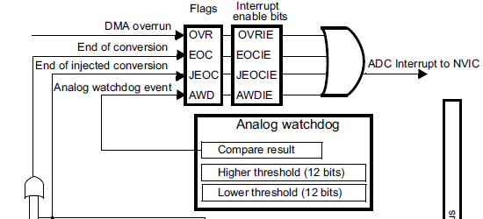
Analog Watchdog
Put the Higher threshold into the 12 least significant bits into the ADC_HTR
Put the Lower threshold into the 12 least significant bits into the ADC_LTR
Enable the interrupt by setting the AWDIE bit in ADC_CR1 register

Slide 54
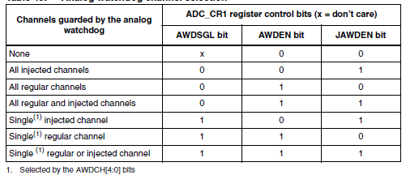
Channel Selection
If monitor single channel then needs to select the channel
For monitoring the V_{REFINT} (Channel 17), write 10001 into AWDCH
Need to enable the channel by writing setting the TSVREFE bit in CCR (which enables both temperature sensor and V_{REFINT})

Slide 55
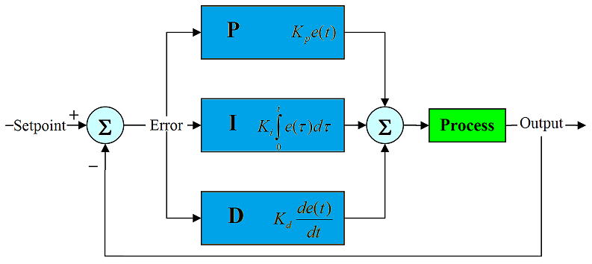
PID Control
Analog Watchdog can also be a good tool to implement PID control
Keep the power/temperature/pressure/speed/distance as close as possible to the targeted value.
Dynamically update the HTR and LTR for Analog Watchdog.
Refer to your control theory text book for more inspiration

