Slide 1
Timer Peripherals

Slide 2
STM32F4 Clock tree
Various Clock sources
Highly configurable
Can be controlled independently
Possible to prescale
Can output clock from some pins
To achieve the balance between performance and power consumption

Slide 3
Timer/Counter Peripheral Introduction
Events
Reload Value
Reload
or
Presettable Binary Counter
÷2 or RS
PWM
Clock
Interrupt
Current Count
Common peripheral for microcontrollers
Based on presettable binary counter, enhanced with configurability
Count value can be read and written by MCU
Count direction can often be set to up or down
Counter’s clock source can be selected
Counter mode: count pulses which indicate events (e.g. odometer pulses)
Timer mode: clock source is periodic, so counter value is proportional to elapsed time (e.g. stopwatch)
Counter’s overflow/underflow action can be selected
Generate interrupt
Reload counter with special value and continue counting
Toggle hardware output signal
Stop!

Slide 4
STM32F4 Timer Peripherals
Advanced Control Timer
TIM1 and TIM8
Input capture, output compare, PWM, one pulse mode
16-bit auto-reload register
Additional control for driving motor or other devices
General Purpose Timer
TIM2 to TIM5
Input capture, output compare, PWM, one pulse mode
16-bit or 32-bit auto-reload register
General Purpose Timer
TIM9 to TIM14
Input capture, output compare, PWM, one pulse mode
Only 16-bit auto-reload register
Basic Timer (Simple timer)
TIM6 and TIM7
Can be generic counter and internally connected to DAC
16-bit auto reload register
Also a 24 bit system timer(SysTick)

Slide 5
General Purpose Timer Block Diagram

Slide 6
General Purpose Timer
Reload Value
TIMx_ARR
Reload
Clock
TIMx_CNT
TIMx_PSC
ISR
Resume
Interrupt
Current Count
Timer can count down or up or up/down (up by reset)
A prescaler can divide the counter clock
4 independent channels for the timer
Input capture
Output compare
PWM generation
One-pulse mode output
Overflow or underflow will cause an update event (UEV), thus the interrupt and possibly the reload

Slide 7
General Purpose Timer Control Registers
Highly Configurable

Slide 8
Periodic Interrupt

Slide 9
Timer as A periodic Interrupt Source
Reload Value
TIMx_ARR
Reload
Clock
TIMx_CNT
TIMx_PSC
ISR
Resume
Interrupt
Current Count
STM32F4 families enjoy sophisticated and powerful timer
One of the basic function of the timer is to cause independent and periodic interrupts
Best for regularly repeating some certain small tasks

Slide 10
General Purpose Timer Control Registers
Highly Configurable
Only few need to be configure for periodic interrupt setup

Slide 11
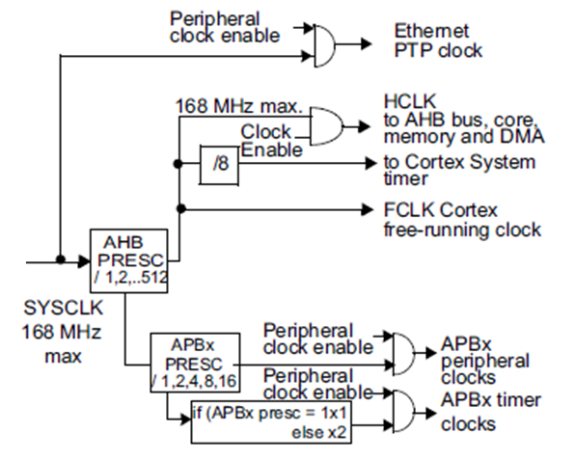
General Purpose Timer Clock selection
There are 4 possible sources of clock
Internal clock(CK_INT)
External clock mode1: external input pin(TIx)
External clock mode2: external trigger input (ETR) (some timers only)
Internal trigger inputs (ITRx)
Access TIMx_SMCR (Bit 2:0 SMS) slave mode control register to select the clock source and mode
For example, for the periodic interrupt, with SMS being 000, the counter will clocked by the internal clock (APB1)
By default, the prescaler for APB1 is 4 (defined by the system_stm32f4xx.c), which means the CK_INT is 42Mhz (SYSCLK is 168Mhz)

Slide 12
Specify PSC and ARR
Reload Value
TIMx_ARR
Reload
Clock
TIMx_CNT
TIMx_PSC
ISR
Resume
Interrupt
Current Count
TIMx_PSC prescale register stores the value which will be used to divide the clock input.
In count up mode, overflow will occur if TIMx_CNT counter value reach the TIMx_ARR auto-reload value. And then the TIMx_CNT will be updated with 0.
Both TIMx_ARR and TIMx_PSC are 16-bit register!
So the total periodic time can be calculated as
Tout=((ARR+1)×(PSC+1))$÷$Fclk
When Fclk is 42MHz, setting ARR to 5999 and PSC to 13999 makes one second periodic time.

Slide 13
More on PSC and ARR
Reload Value
TIMx_ARR
Reload
Clock
TIMx_CNT
TIMx_PSC
ISR
Resume
Interrupt
Current Count
Accessing the ARR only write or read from a preload register of ARR, there is another shadow register which is the register that actually performs the reloading. The content of the preload register will be transfer to the shadow register permanently if the APRE bit in TIMx_CR1 is clear or at each UEV if APRE bit is set.
PSC, on the other hand, is always buffered. Which means though it can be changed on the fly, the new ratio will only be taken into account at the next UEV.

Slide 14
Initialize the TIM2 with CMSIS
Enable clock to Timer2
RCC->APB1ENR|=RCC_APB1ENR_TIM2EN;
Set the auto-reload
TIM2->ARR=arr;
Set the prescaler
TIM2->PSC=psc;
Enable the update interrupt
TIM2->DIER|=TIM_DIER_UIE;
Enable counting
TIM2->CR1|=TIM_CR1_CEN

Slide 15
Interrupt Handler
Enable the interrupt
__enable_irq() ;
CMSIS ISR name: TIM2_IRQHandler
NVIC_EnableIRQ(TIM2_IRQn);
ISR activities
Clear pending IRQ
NVIC_ClearPendingIRQ(TIM2_IRQn);
Do the ISR’s work
Clear pending flag for timer
TIM2->SR&=~TIM_SR_UIF;

Slide 16
SysTick as Periodic Interrupt Source
Alternatively, we can use the SysTick provided by CortexM4 core to generate exactly the same periodic interrupt.
The configuration of Systick is however much simpler.
Four registers:
Since this is part of the core, it is fully supported by CMSIS
SysTick_Config(uint32_t ticks) Initialize the Systick
SysTick_Config(SystemCoreClock / 1000) makes 1ms
168M/1000*(1/f)= 1 ms

Slide 17
Example: Stopwatch
Measure time with 100 us resolution
Display elapsed time, updating screen every 10 ms
UUse Systick
Counter increment every 100 us
LCD Update every 10 ms
Update LCD every nth periodic interrupt
n = 10 ms/100us = 100
Don’t update LCD in ISR! Too slow.
Instead set flag LCD_Update in ISR, poll it in main loop
Usually the ISR is only for update the timer or for delaying (precise timing!)

Slide 18
Capture/compare mode

Slide 19
Capture/Compare Channels
Different channels but same blocks
Capture mode can be used to measure the pulse width or frequency
Input stage includes digital filter, multiplexing and prescaler
Output stage includes comparator and output control
A capture register (with shadow register)
Input Stage Example
Input signal->filter->edge detector->slave mode controller or capture command

Slide 20
Capture/Compare Channels
Main Circuit
The block is made of one preload register and a shadow register.
In capture mode, captures are done in shadow register than copied into preload register
In compare mode, the content of the preload register is copied into the shadow register which is compared to the counter

Slide 21
Capture/Compare Channels
Output stage
Generates an intermediate waveform which is then used for reference.

Slide 22
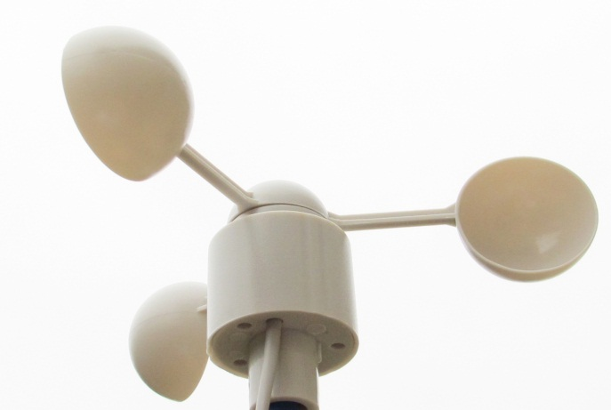
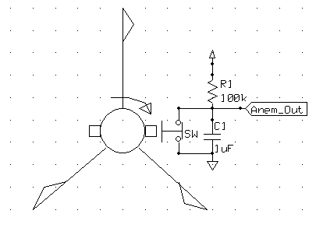
Wind Speed Indicator (Anemometer)
Rotational speed (and pulse frequency) is proportional to wind velocity
Two measurement options:
Frequency (best for high speeds)
Width (best for low speeds)
Can solve for wind velocity v
How can we use the Timer for this?
Use Input Capture Mode to measure period of input signal

Slide 23
Input Capture Mode for Anemometer
Operation: Repeat
First capture - on rising edge
Reconfigure channel for input capture on falling edge
Clear counter, start new counting
Second Capture - on falling edge
Read capture value, save for later use in wind speed calculation
Reconfigure channel for input capture on rising edge
Clear counter, start new counting
Solve the wind speed
V_{wind} = K÷(C_{falling} – C_{rising})×Freq

Slide 24
Registers for Anemometer
TIMx_ARR (Refer to the periodic interrupt)
TIMx_PSC (Refer to the periodic interrupt )
TIMx_CCMR1 Capture/compare mode register 1 (Channel 1 and 2)
TIMx_CCMR2 (for channel 3 and 4)
TIMx_CCER Capture/compare enable register
TIMx_DIER DMA/interrupt enable register
TIMx_CR1 Control register
TIMx_CCRx Capture compare register
TIMx_SR Status register

Slide 25
Capture/Compare Mode Register 1
[0:7] bits are for channel 1, [8:15] bits are for channel 2
Set CC1S (Capture/compare 1 selection) to 01, configure channel 1 as input and map IC1 to TI1 (Only writable when channel is OFF)
IC1PSC (Input capture 1 prescaler)
IC1F (Input capture 1 filter) decide sampling frequency and N events needed to validate a transition on the output
For example, if set to 0001, and set to capture rising edge, when rising edge detected, sample the channel twice with the F_{CK_INT ,}if they are both high then the capture is validated.

Slide 26
Capture/Compare Enable Register
3 Bits for each channel and 4 bits in total are reserved
CC1NP/CC1P: 00 to be sensitive to rising edge, 01 to be sensitive to falling edge, different meaning in other modes
CC1E, set to 1 to enable the capture
Also needs to enable the interrupt on capture
TIMx_DIER: set CC1IE
Finally, enable the counting
Also remember to clear the pending bit(write 0 to TIM_SR_CC1IF) in the ISR

Slide 27
Configure the GPIO - AF
Refer to the user manual to make sure which pin is able to connect to the TIM
Then configure the GPIO as AF mode, be careful with the pull up or down setting since it should match the setting of edge detection
Configure the GPIO AF register

Slide 28
Output Compare Mode
Control an output waveform or indicating when a period of time has elapsed
When a Match occur (CCRx=CNT)
Generate specific output on corresponding pin
Set the CCxIF(Interrupt status) bit in the SR
Generate Interrupt if configured
Generate DMA request if configured
Configure steps
Select the counter clock
Write the desired data in ARR and CCR registers
Enable Interrupt or DMA request if needed
Select the output mode
Enable the counter

Slide 29
PWm Mode

Slide 30
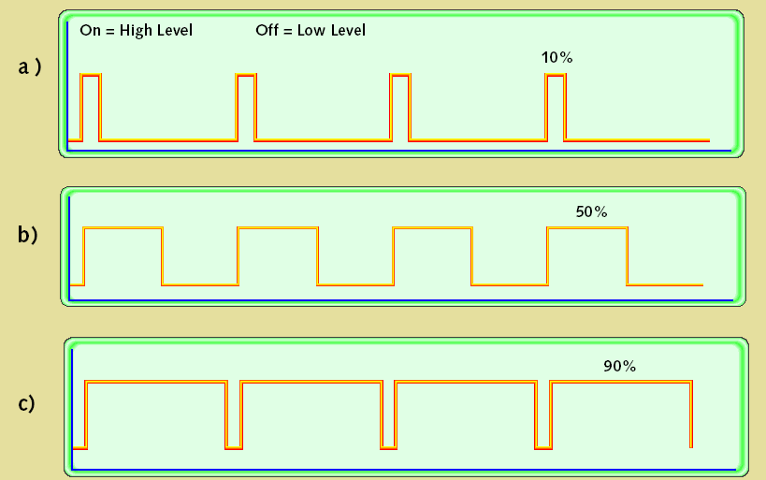
Pulse-Width Modulation
Uses of PWM
Digital power amplifiers are more efficient and less expensive than analog power amplifiers
Applications: motor speed control, light dimmer, switch-mode power conversion
Load (motor, light, etc.) responds slowly, averages PWM signal
Digital communication is less sensitive to noise than analog methods
PWM provides a digital encoding of an analog value
Much less vulnerable to noise
PWM signal characteristics
Modulation frequency – how many pulses occur per second (fixed)
Period – 1/(modulation frequency)
On-time – amount of time that each pulse is on (asserted)
Duty-cycle – on-time/period
Adjust on-time (hence duty cycle) to represent the analog value

Slide 31
Pulse-Width Modulation
Timer also provides the PWM mode, generate a signal with frequency determined by the value of ARR and a duty cycle determined by the CCR.
CCMRx_OCxM bits, 110 (PWM mode 1) 111(PWM Mode 2) (differs in polarity)
Enable the corresponding preload register (OCxPE in TIMx_CCMRx)
Enable the auto reload by setting ARPE bit in TIMxCR1
Enable the output Ocx in TIMx_CCER CCxE bit
PWM done by comparing TIMx_CCR and TIMx_CNT, i.e., if TIMx_CCRx≤TIMx_CNT or TIMx_CNT≤TIMx_CCRx then output high or low.
Also can be configured as input mode, so that it can measure external PWM.

Slide 32
Edge-Aligned
CMS bits in TIMx_CR1 are 00
As long as TIMx_CNT<TIMx_CCRx then the OCXREF is high
Select down-counting or up-counting using DIR bit in TIMx_CR1

Slide 33
Center-Aligned
CMS bits in TIMx_CR1 are not 00: many possible wave forms

Slide 34
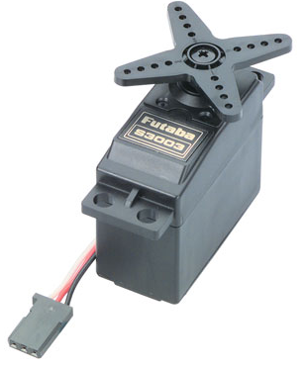
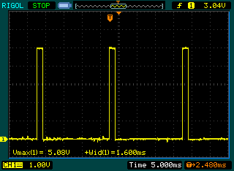
PWM to Drive Servo Motor
Servo PWM signal
20 ms period
1 to 2 ms pulse width

