Slide 1
Serial Communications

Slide 2
Overview
Serial communications
Concepts
Tools
Software: polling, interrupts and buffering
UART communications
Concepts
STM32F4Discovery UART peripheral
SPI communications
Concepts
STM32F4Discovery SPI peripheral
I²C communications
Concepts
STM32F4Discovery I2C peripheral

Slide 3
Why Communicate Serially?
Native word size is multi-bit (8, 16, 32, etc.)
Often it’s not feasible to support sending all the word’s bits at the same time
Cost and weight: more wires needed, larger connectors needed
Mechanical reliability: more wires => more connector contacts to fail
Timing Complexity: some bits may arrive later than others due to variations in capacitance and resistance across conductors
Circuit complexity and power: may not want to have 16 different radio transmitters + receivers in the system

Slide 4
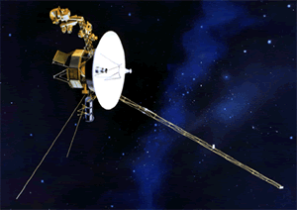
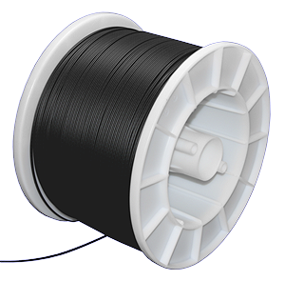
Example System: Voyager Spacecraft
???
Launched in 1977
Constraints: Reliability, power, size, weight, reliability, etc.
“Uplink communications is via S-band (16-bits/sec command rate) while an X-band transmitter provides downlink telemetry at 160 bits/sec normally and 1.4 kbps for playback of high-rate plasma wave data. All data are transmitted from and received at the spacecraft via the 3.7 meter high-gain antenna (HGA).” http://voyager.jpl.nasa.gov/spacecraft/index.html
Uplink – to spacecraft
Downlink – from spacecraft

Slide 5
Example System
Dedicated point-to-point connections
Parallel data lines, read and write lines between MCU and each peripheral
Fast, allows simultaneous transfers
Requires many connections, PCB area, scales badly

Slide 6
Parallel Buses
All devices use buses to share data, read and write signals
MCU uses individual select lines to address each peripheral
MCU requires fewer pins for data, but still one per data bit
MCU can communicate with only one peripheral at a time

Slide 7
Synchronous Serial Data Transmission
Transmitting Device
Receiving Device
Clock
Serial Data
Data Sampling Time at Receiver
Use shift registers and a clock signal to convert between serial and parallel formats
Synchronous: an explicit clock signal is along with the data signal

Slide 8
Synchronous Full-Duplex Serial Data Bus
Now can use two serial data lines - one for reading, one for writing.
Allows simultaneous send and receive full-duplex communication

Slide 9
Synchronous Half-Duplex Serial Data Bus
Share the serial data line
Doesn’t allow simultaneous send and receive - is half-duplex communication

Slide 10
Asynchronous Serial Communication
Data
bits
Data Sampling Time at Receiver
Time Zero
T_{bit}*1.5
T_{bit}*2.5
T_{bit}*3.5
T_{bit}*4.5
T_{bit}*5.5
T_{bit}*6.5
T_{bit}*7.5
T_{bit}*8.5
T_{bit}*9.5
T_{bit}*10.5
Eliminate the clock line!
Transmitter and receiver must generate clock locally
Transmitter must add start bit (always same value) to indicate start of each data frame
Receiver detects leading edge of start bit, then uses it as a timing reference for sampling data line to extract each data bit N at time T_{bit}*(N+1.5)
Stop bit is also used to detect some timing errors

Slide 11
Serial Communication Specifics
Data frame fields
Start bit (one bit)
Data (LSB first or MSB, and size – 7, 8, 9 bits)
Optional parity bit is used to make total number of ones in data even or odd
Stop bit (one or two bits)
All devices must use the same communications parameters
E.g. communication speed (300 baud, 600, 1200, 2400, 9600, 14400, 19200, etc.)
Sophisticated network protocols have more information in each data frame
Medium access control – when multiple nodes are on bus, they must arbitrate for permission to transmit
Addressing information – for which node is this message intended?
Larger data payload
Stronger error detection or error correction information
Request for immediate response (“in-frame”)
Data
bits
Message

Slide 12
Error Detection
Can send additional information to verify data was received correctly
Need to specify which parity to expect: even, odd or none.
Parity bit is set so that total number of “1” bits in data and parity is even (for even parity) or odd (for odd parity)
01110111 has 6 “1” bits, so parity bit will be 1 for odd parity, 0 for even parity
01100111 has 5 “1” bits, so parity bit will be 0 for odd parity, 1 for even parity
Single parity bit detects if 1, 3, 5, 7 or 9 bits are corrupted, but doesn’t detect an even number of corrupted bits
Stronger error detection codes (e.g. Cyclic Redundancy Check) exist and use multiple bits (e.g. 8, 16), and can detect many more corruptions.
Used for CAN, USB, Ethernet, Bluetooth, etc.

Slide 13
Tools for Serial Communications Development
Tedious and slow to debug serial protocols with just an oscilloscope
Instead use a logic analyzer to decode bus traffic
Worth its weight in gold!
Saelae 8-Channel Logic Analyzer
$150 (www.saelae.com)
Plugs into PC’s USB port
Decodes SPI, asynchronous serial, I²C, 1-Wire, CAN, etc.
Build your own: with Logic Sniffer or related open-source project

Slide 14
Software Structure – Handling asynchronous Communication

Slide 15
Software Structure
Communication is asynchronous to program
Don’t know what code the program will be executing …
when the next item arrives
when current outgoing item completes transmission
when an error occurs
Need to synchronize between program and serial communication interface somehow
Options
Polling
Wait until data is available
Simple but inefficient of processor time
Interrupt
CPU interrupts program when data is available
Efficient, but more complex

Slide 16
Serial Communications and Interrupts
Want to provide multiple threads of control in the program
Main program (and subroutines it calls)
Transmit ISR – executes when serial interface is ready to send another character
Receive ISR – executes when serial interface receives a character
Error ISR(s) – execute if an error occurs
Need a way of buffering information between threads
Solution: circular queue with head and tail pointers
One for tx, one for rx
Main Program or other threads
get_string
send_string
rx_isr
tx_isr
Serial Interface

Slide 17
Enabling and Connecting Interrupts to ISRs
ARM Cortex-M4 provides various IRQs for all communication interface’s events
I2C1EVENT
I2C1ERROR
I2C2EVENT
I2C2ERROR
SPI1
SPI2
USART1
USART2
USART3
Decide which operation to take in each IRQ
void USART2_IRQHandler() {
if (transmitter ready) {
if (more data to send) {
get next byte
send it out transmitter
}
}
if (received data) {
get byte from receiver
save it
}
if (error occurred) {
handle error
}
}

Slide 18
Code to Implement Queues
Enqueue at tail: tail_ptr points to next free entry
Dequeue from head: head_ptr points to item to remove
#define the queue size to make it easy to change
One queue per direction
tx ISR unloads tx_q
rx ISR loads rx_q
Other threads (e.g. main) load tx_q and unload rx_q
Need to wrap pointer at end of buffer to make it circular,
Use % (modulus, remainder) operator if queue size is not power of two
Use & (bitwise and) if queue size is a power of two
Queue is empty if size == 0
Queue is full if size == Q_SIZE
older data
newer data
read data from head
write data to tail
get_string
send_string
rx_isr
tx_isr
Serial
Interface

Slide 19
Defining the Queues
#define Q_SIZE (32)
typedef struct {
unsigned char Data[Q_SIZE];
unsigned int Head; // points to oldest data element
unsigned int Tail; // points to next free space
unsigned int Size; // quantity of elements in queue
} Q_T;
Q_T tx_q, rx_q;

Slide 20
Initialization and Status Inquiries
void Q_Init(Q_T * q) {
unsigned int i;
for (i=0; i<Q_SIZE; i++)
q->Data[i] = 0; // to simplify our lives when debugging
q->Head = 0;
q->Tail = 0;
q->Size = 0;
}
int Q_Empty(Q_T * q) {
return q->Size == 0;
}
int Q_Full(Q_T * q) {
return q->Size == Q_SIZE;
}

Slide 21
Enqueue and Dequeue
int Q_Enqueue(Q_T * q, unsigned char d) {
// What if queue is full?
if (!Q_Full(q)) {
q->Data[q->Tail++] = d;
q->Tail %= Q_SIZE;
q->Size++;
return 1; // success
} else
return 0; // failure
}
unsigned char Q_Dequeue(Q_T * q) {
// Must check to see if queue is empty before dequeueing
unsigned char t=0;
if (!Q_Empty(q)) {
t = q->Data[q->Head];
q->Data[q->Head++] = 0; // to simplify debugging
q->Head %= Q_SIZE;
q->Size--;
}
return t;
}

Slide 22
Using the Queues
Sending data:
if (!Queue_Full(…)) {
Queue_Enqueue(…, c)
}
Receiving data:
if (!Queue_Empty(…)) {
c=Queue_Dequeue(…)
}

Slide 23
Software Structure – Parsing Messages

Slide 24
Decoding Messages
Two types of messages
Actual binary data sent
First identify message type
Second, based on this message type, copy binary data from message fields into variables
May need to use pointers and casting to get code to translate formats correctly and safely
ASCII text characters representing data sent
First identify message type
Second, based on this message type, translate (parse) the data from the ASCII message format into a binary format
Third, copy the binary data into variables

Slide 25
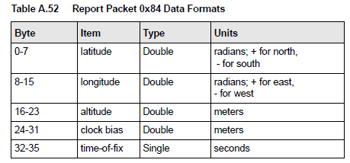
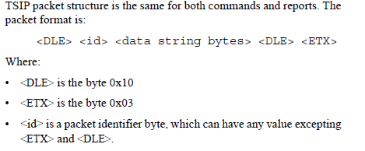
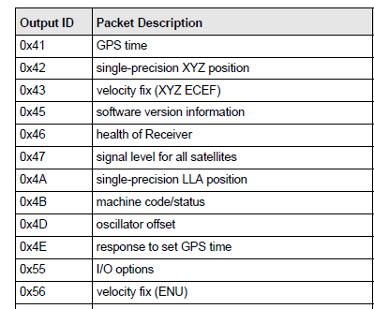
Example Binary Serial Data: TSIP
switch (id) {
case 0x84:
lat = *((double *) (&msg[0]));
lon = *((double *) (&msg[8]));
alt = *((double *) (&msg[16]));
clb = *((double *) (&msg[24]));
tof = *((float *) (&msg[32]));
break;
case 0x4A: …
default:
break;
}

Slide 26
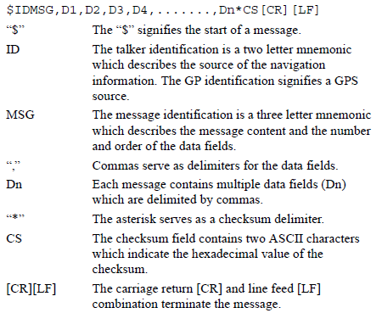
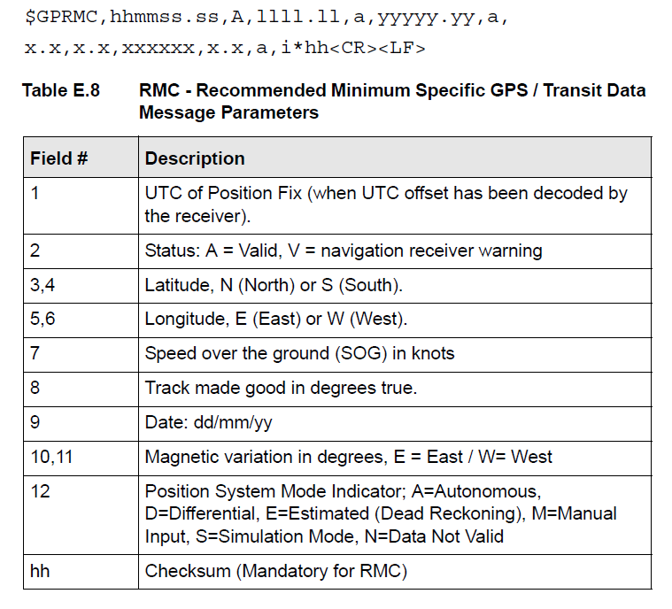
Example ASCII Serial Data: NMEA-0183

Slide 27
State Machine for Parsing NMEA-0183
Start
Any char. except *, \r or \n
Append char to buf. Inc. counter
$ Append char to buf.
Talker + Sentence Type
*, \r or \n, non-text, or counter>6
buf==$SDDBT, $VWVHW, or $YXXDR
Enqueue all chars. from buf
/r or /n
Sentence Body
Any char. except *
Enqueue char
*
Enqueue char
Checksum 1
Any char.
Save as checksum1
Checksum 2
Any char.
Save as checksum2

Slide 28
Parsing
switch (parser_state) {
case TALKER_SENTENCE_TYPE:
switch (msg[i]) {
‘*’:
‘\r’:
‘\n’:
parser_state = START;
break;
default:
if (Is_Not_Character(msg[i]) || n>6) {
parser_state = START;
} else {
buf[n++] = msg[i];
}
break;
}
if ((n==6) & … ){
parser_state = SENTENCE_BODY;
}
break;
case SENTENCE_BODY:
break;

Slide 29
STM32F407VG and DIscovery Specifics

Slide 30
Discovery Serial I/O
For full detail, refer to DM00039084 the User Manual of Discovery board.

Slide 31
Clock Gating for Serial Comm.
SPI 1,2; USART 2,3; UART 4,5 and I2C 1,2,3 are clocked through APB1
USART 1 and 6 are clocked through APB2
Enable the clock before using these serial communication modules.

Slide 32
Universal synchronous asynchronous receiver transmitter (USART)

Slide 33
USART Block Diagram

Slide 34
USART
Like other modules, USART in the STM32F4 families is capable to operate in many modes.
This slide will introduce the Asynchronous mode, which is sometimes referred as Universal asynchronous receiver/transmitter (UART).

Slide 35
Transmitter Basics
Data
bits
Data Sampling Time at Receiver
T_{bit}
T_{bit}
T_{bit}
T_{bit}
T_{bit}
T_{bit}
T_{bit}
T_{bit}
T_{bit}
T_{bit}
T_{bit}
Time Zero
If no data to send, keep sending 1 (stop bit) – idle line
When there is a data word to send
Send a 0 (start bit) to indicate the start of a word
Send each data bit in the word (use a shift register for the transmit buffer)
Send a 1 (stop bit) to indicate the end of the word

Slide 36
Receiver Basics
Data
bits
Data Sampling Time at Receiver
Time Zero
T_{bit}*1.5
T_{bit}*2.5
T_{bit}*3.5
T_{bit}*4.5
T_{bit}*5.5
T_{bit}*6.5
T_{bit}*7.5
T_{bit}*8.5
T_{bit}*9.5
T_{bit}*10.5
Wait for a falling edge (beginning of a Start bit)
Then wait ½ bit time
Do the following for as many data bits in the word
Wait 1 bit time
Read the data bit and shift it into a receive buffer (shift register)
Wait 1 bit time
Read the bit
if 1 (Stop bit), then OK
if 0, there’s a problem!

Slide 37
For this to work…
Transmitter and receiver must agree on several things (protocol)
Order of data bits
Number of data bits
What a start bit is (1 or 0)
What a stop bit is (1 or 0)
How long a bit lasts
Transmitter and receiver clocks must be reasonably close, since the only timing reference is the start bit

Slide 38
How the STM32F4 works
Transmitter and receiver must agree on several things (protocol)
Order of data bits
LSB will be transmitted first
Number of data bits
Can be configured as 8 or 9 bits
What a start bit is (1 or 0)
0
What a stop bit is (1 or 0)
1
Configurable length (0.5, 1, 1.5 or 2)
How long a bit lasts
Software programmable phase and polarity
Many of them are configurable as well

Slide 39
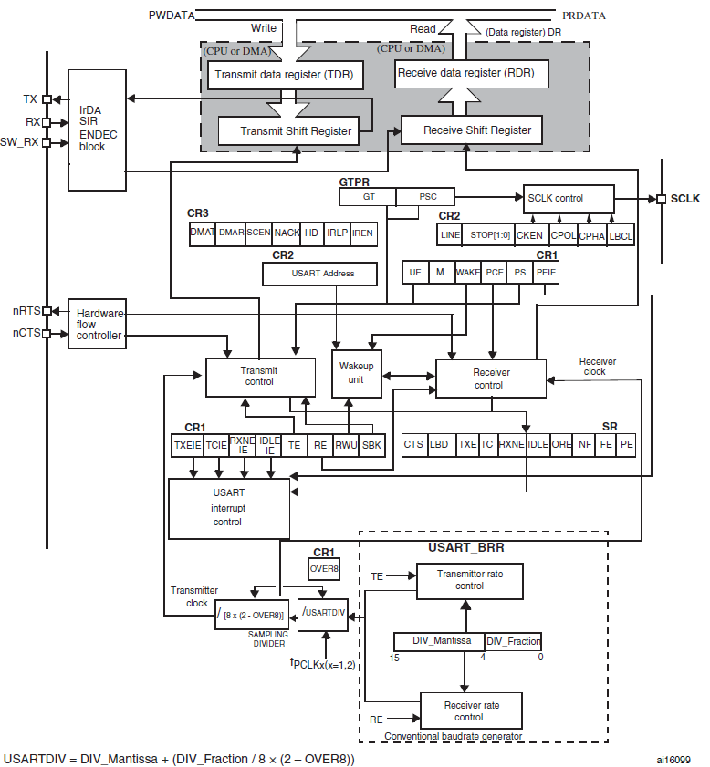
USART Module Block Diagram

Slide 40
Input Data Oversampling
When receiving, UART oversamples incoming data line
Extra samples allow voting, improving noise immunity
Better synchronization to incoming data, improving noise immunity
FTM32F4 provides configurable oversampling rate of either 8 or 16 times the baud rate clock
Two voting method: Single sample in the center or majority vote of the three samples in the center

Slide 41
Fractional Baud Rate Generation
Both Rx and Tx are set to the same baud rate as programmed in the Mantissa and Fration values of USARTDIV
In standard USART (SPI mode included)
Baud rate = $\frac{fck}{8×(2−OVER8)×USARTDIV }$
Example: derive USARTDIV value from USART_BRR (OVER8=0)
DIV_Mantissa=0d27 DIV_Fraction=0d12 (USART_BRR=0x1BC)
Mantissa=0d27, Fraction=12/16=0d0.75(left shift by 4 bits)
Therefore the USARTDIV=0d27.75

Slide 42
Using the UART
Transmitter
Configure the GPIO
AF mode, fast speed
Enable the USART (Set UE in CR1)
Define word length (writing M bit in CR1)
Program the stop bits (CR2)
Using DMA? (DMAT in CR3)
Parity Check? (PCE/PS in CR1)
Configure Baud Rate (USART_BRR)
First transmission (Set TE in CR1)
Write data to send (DR)
Repeat writing data to send (DR)
For ending the transmission, wait until the last frame is complete (when TC=1)
Receiver
Configure the GPIO
AF mode, fast speed
Enable the USART (Set UE in CR1)
Define word length (M bit in CR1)
Program the stop bits (CR2)
Using DMA? (DMAR in CR3)
Parity Check?(PCE/PS in CR1)
Configure Baud Rate (USART_BRR)
Begin waiting for start bit (Set RE in CR1)
If RXNE is set, then the data has been received and can be read
Interrupt if RXNEIE bit is set

Slide 43
USART Control Register 1 (USART_CR1)
OVER8: 0 oversampling by 16/; 1 oversampling by 8
UE: Write 1 to enable
M: Word length: 0 8 data bits; 1 9 data bits
M: Select 9-bit data mode (instead of 8-bit data)
WAKE: Wakeup method
PCE: Parity enabled with 1
PS: Odd parity with 1, even parity with 0
TE: Transmitter enable
RE: Receiver enable

Slide 44
USART Control Register 2 and 3 (USART_CR2/3)
STOP: STOP bits:
00 1 Stop bit; 01 0.5 Stop bit; 10 2 Stop bits 11 1.5 Stop bit
ONEBIT: Sample method
0: Three sample bit method; 1: One sample bit method
DMAT: DMA enable transmitter
DMAR: DMA enable Reciever

Slide 45
Baud Rate Register (USART_BRR)
DIV_Mantissa[11:0]
Mantissa for the USART Divider
DIV_Fraction[3:0]
Fraction of USART Divider
When OVER8 is set, DIV_Fraction3 bit is not considered and must be cleared

Slide 46
Data Register
DR[8:0]:Data value
The data to be transmitted or the data received, depending on whether it is read from or written to
The TDR register provides the parallel interface between the internal bus and the output shift register .
The RDR register provides the parallel interface between the input shift register and the internal bus.

Slide 47
UART Status Register (USART_SR)
TXE: Transmit data register empty
TC: Transmission complete.
IDLE:IDLE line detected
ORE: Receive overrun. Received data has overwritten previous data in receive buffer
NF: Noise flag. Receiver data bit samples don’t agree.
FE: Framing error. Received 0 for a stop bit, expected 1.
PE: Parity error. Incorrect parity received.

Slide 48
Software for Polled Serial Comm.
void usart2_init(uint32_t pclk, uint32_t baudrate){
uint32_t temp=0x00;
uint32_t integer=0x00;
uint32_t fraction=0x00;
integer=((25*pclk*1000000)/(4*baudrate));
temp=(integer/100)<<4;
fraction=integer-(100*(temp>>4));
temp|=((((fraction*16)+50)/100))&((uint8_t) 0x0F);
RCC->AHB1ENR|=RCC_AHB1ENR_GPIOAEN;
RCC->APB1ENR|=RCC_APB1ENR_USART2EN;
GPIOA->MODER|=GPIO_MODER_MODER2_1;//Pin2 mode AF
//GPIOA->PUPDR|=GPIO_PUPDR_PUPDR2_0;//Pull up
GPIOA->OSPEEDR|=GPIO_OSPEEDER_OSPEEDR2_1;
GPIOA->AFR[0]|=0x00000700;//Set the AF to AF7(USART1~3);
SET_BIT(RCC->AHB1RSTR,RCC_APB1RSTR_USART2RST);
CLEAR_BIT(RCC->AHB1RSTR,RCC_APB1RSTR_USART2RST);
USART2->CR1|=USART_CR1_UE;
USART2->BRR=temp;
USART2->CR1|=USART_CR1_TE;}

Slide 49
Software for Polled Serial Comm.
void usart2_send(uint16_t data){
USART2->DR=(data&(uint16_t)0x01ff);
while(!READ_BIT(USART2->SR, USART_SR_TC)){}
}
uint16_t usart3_receive(){
while(!READ_BIT(USART3->SR, USART_SR_RXNE)){}
return (uint16_t)(USART3->DR & (uint16_t)0x01FF);
}

Slide 50
Example Transmitter
while(1){
usart2_send(data);
}

Slide 51
Example Receiver
while (1) {
echo=usart3_receive();
}
Also possible to display the received data on LCD screen.
Using the module we built in the previous lectures

Slide 52
Software for Interrupt-Driven Serial Comm.
Use interrupts
First, initialize peripheral to generate interrupts
Second, create single ISR with three sections corresponding to cause of interrupt
Transmitter
Receiver
Error

Slide 53
USART Control Register 1 (USART_CR1)
TCIE: Transmission complete interrupt enable
RXNEIE: RXNE interrupt enable, this means whenever overrun error or read data register is not empty(ORE=1 or RXNE=1), it will assert the interrupt.

Slide 54
Interrupt Initialization(transmitter)
void Init_UART2(uint32_t pclk,uint32_t baud_rate) {
…
NVIC_SetPriority(USART2_IRQn, 0);
NVIC_ClearPendingIRQ(USART2_IRQn);
NVIC_EnableIRQ(USART2_IRQn);
USART2->CR1|=USART_CR1_TCIE;
…
}

Slide 55
Interrupt Handler: Transmitter
void UART2_IRQHandler(void) {
NVIC_ClearPendingIRQ(USART2_IRQn);
usart2_send(echo-1);
…
}

Slide 56
Interrupt Handler: Receiver
void UART2_IRQHandler(void) {
…
if (READ_BIT(USART2->SR, USART_SR_RXNE)) {
// received a character
}
}

Slide 57
Interrupt Handler: Error Cases
void UART2_IRQHandler(void) {
…
if (READ_BIT(USART2->SR, USART_SR_ORE){
// handle the error
// clear the flag
}
}

Slide 58
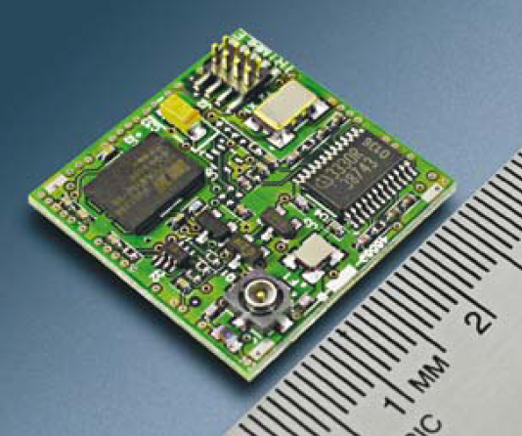
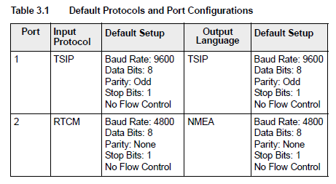
Example UART Application
Many subsystems connect with the rest of the system using asynchronous serial communications
Lassen iQ GPS receiver module from Trimble
Two full-duplex asynch. serial connections
Three protocols supported
Support higher speeds through reconfiguration

Slide 59
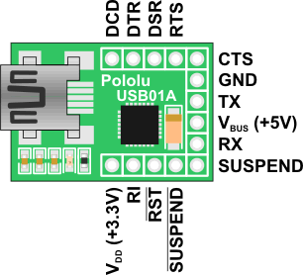
USB to UART Interface
PCs haven’t had external asynchronous serial interfaces for a while, so how do we communicate with a UART?
USB to UART interface
USB connection to PC
Logic level (0-3.3V) to microcontroller’s UART (not RS232 voltage levels)
USB01A USB to serial adaptor
http://www.pololu.com/catalog/product/391
Can also supply 5 V, 3.3 V from USB

Slide 60
Building on Asynchronous Comm.
Problem #1
Logic-level signals (0 to 1.65 V, 1.65 V to 3.3 V) are sensitive to noise and signal degradation
Problem #2
Point-to-point topology does not support a large number of nodes well
Need a dedicated wire to send information from one device to another
Need a UART channel for each device the MCU needs to talk to
Single transmitter, single receiver per data wire

Slide 61
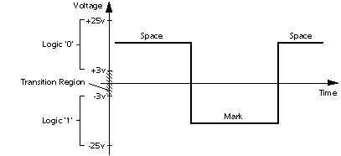
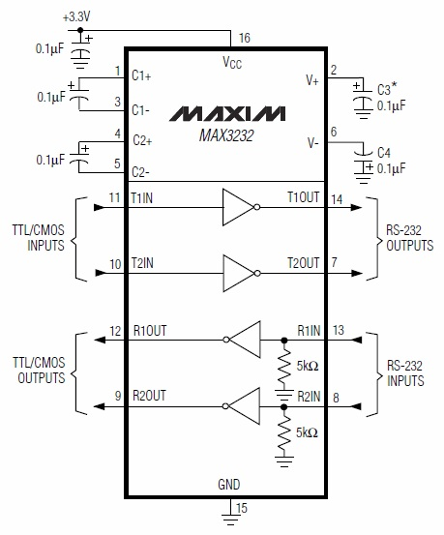
Solution to Noise: Higher Voltages
Use higher voltages to improve noise margin: +3 to +15 V, -3 to -15 V
Example IC (Maxim MAX3232) uses charge pumps to generate higher voltages from 3.3V supply rail

Slide 62
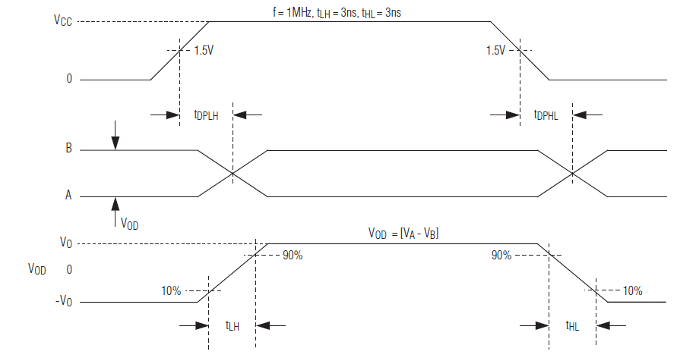
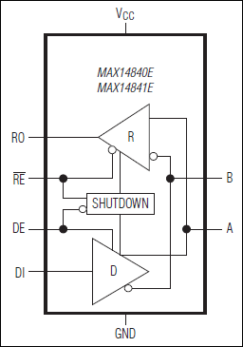
Solution to Noise: Differential Signaling
Data into Transmitter
Data out of Transmitter, on bus
Data out of Receiver
Use differential signaling
Send two signals: Buffered data (A), buffered complement of data (B)
Receiver compares the two signals to determine if data is a one (A > B) or a zero (B > A)

Slide 63
Solutions to Poor Scaling
Approaches
Allow one transmitter to drive multiple receivers (multi-drop)
Connect all transmitters and all receivers to same data line (multi-point network). Need to add a medium access control technique so all nodes can share the wire
Example Protocols
RS-232: higher voltages, point-to-point
RS-422: higher voltages, differential data transmission, multi-drop
RS-485: higher voltages, multi-point

Slide 64
Example Protocols
RS-232: higher voltages, point-to-point
RS-422: higher voltages, differential data transmission, multi-drop
RS-485: higher voltages, multi-point

Slide 65
Demonstration: Echo back
Transmit bytes through USART2 and received by USART3
After successful receiving a byte, decrement and send it to DR of USART2 to send again
No interrupt, pulling only
USART2
USART3
MCU

Slide 66
SPI Communications

Slide 67
Hardware Architecture
All chips share bus signals
Clock SCK
Data lines MOSI (master out, slave in) and MISO (master in, slave out)
Each peripheral has its own chip select line (CS)
Master (MCU) asserts the CS line of only the peripheral it’s communicating with
SPI interface of STM32F4 also supports I²S audio protocol.

Slide 68
Serial Data Transmission
Transmitting Device
Receiving Device
Clock
Serial Data
Data Sampling Time at Receiver
Use shift registers and a clock signal to convert between serial and parallel formats
Synchronous: an explicit clock signal is along with the data signal

Slide 69
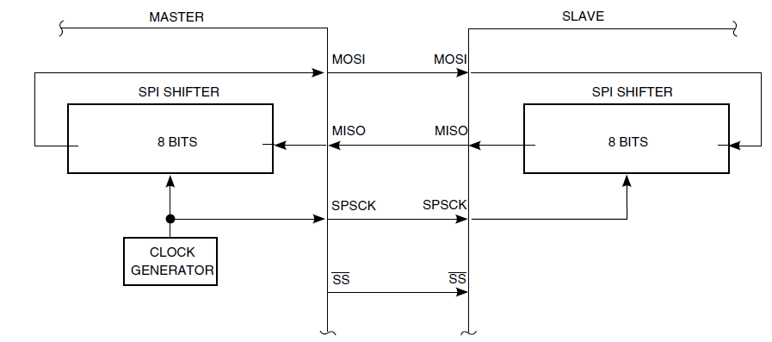
SPI Signal Connection Overview
is also referred as NSS in some documents.

Slide 70
Using the SPI
Slave mode
Decide data frame format (DFF)
Select the relationship (CPOL/CPHA)
MSB or LSB first? (LSBFIRST in CR1)
Using DMA? (DMAT in CR3)
Handle the NSS or SSM and SSI bit depending on the mode
TI mode protocol? (FRF in CR2)
Clear the MSTR and set SPE in CR1
MOSI is input and MISO is output
Transmit
Parallel-load data byte into Tx buffer during a write cycle
Transfer data from buffer to shift register
Receive
Transfer data from shift register to Rx buffer and set the RXNE flag
Master mode
Baud rate (BR in CR1)
Select the relationship (CPOL/CPHA)
Decide data frame format (DFF)
MSB or LSB first? (LSBFIRST in CR1)
Handle the NSS or SSM and SSI bit depending on the mode
TI mode protocol? (FRF in CR2)
Set MSTR and SPE in CR1
MOSI is output and MISO is input
Transmit
Write a byte into Tx buffer
Transfer data from buffer to shift register
Receive
Transfer data from shift register to RX buffer and set the RXNE flag

Slide 71
SPI Control Register 1 (SPI_CR1)
DFF: data frame format
0: 8-bit ; 1: 16-bit
LSBFIRST: frame format
0:MSB first; 1:LSB first
SPI: SPI enable
BR[2:0]:Baud rate control
000: fPCLK/2100: fPCLK/32
001: fPCLK/4101: fPCLK/64
010: fPCLK/8110: fPCLK/128
011: fPCLK/16111: fPCLK/256
MSTR: Master selection
0: Slave; 1:Master

Slide 72
SPI Control Register 2 (SPI_CR2)
TXEIE: Tx buffer empty interrupt enable
RXNEIE: Rx buffer not empty interrupt enable
ERRIE: Error interrupt enable
FRF: Frame format
0:SPI Motorola mode
1:SPI TI mode
SSOE:SS output enable
TXDMAEN:Tx buffer DMA enable
RXDMAEN:Rx buffer DMA enable

Slide 73
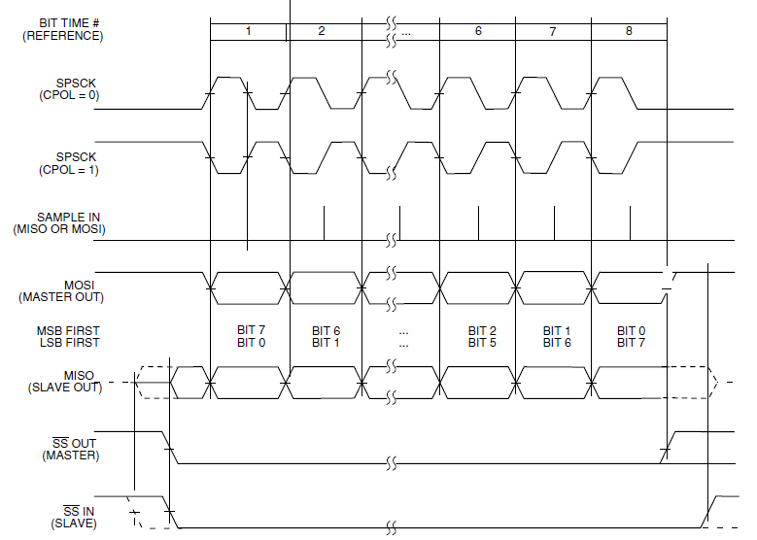
Clock and Phase Settings: CPHA = 1

Slide 74
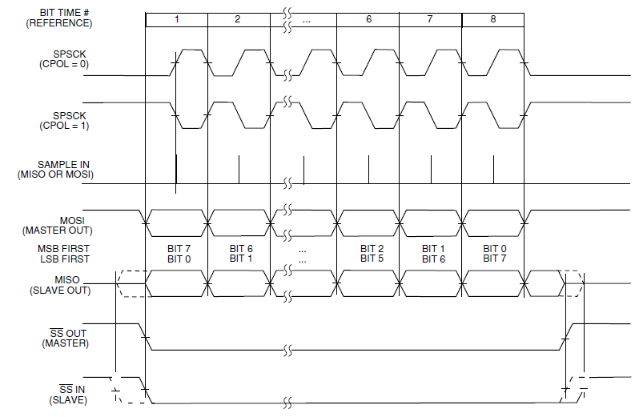
Clock and Phase Settings: CPHA = 0

Slide 75
SPI Status Register (SPI_SR)
FRE: Frame format error
BSY: Busy flag
OVR: Overrun flag
MODF: Mode fault
UDR: Underrun flag
TXE: Transmit buffer empty
RXNE: Receive buffer not empty

Slide 76
Normal and Bidirectional Modes

Slide 77
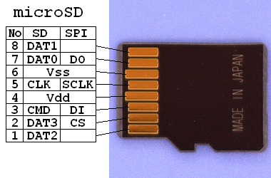
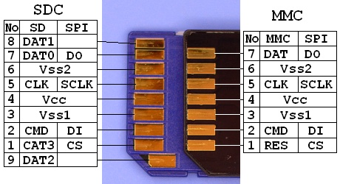
SPI Example: Secure Digital Card Access
SD cards have two communication modes
Native 4-bit
Legacy SPI 1-bit
SPI mode 0
CPHA=0
CPOL=0
V_{DD} from 2.7 to 3.6 V
CS: Chip Select (active low)
Source – FatFS FAT File System Module:
http://elm-chan.org/docs/mmc/mmc_e.html
http://elm-chan.org/fsw/ff/00index_e.html

Slide 78
SPI Commands
Host sends a six-byte command packet to card
Index, argument, CRC
Host reads bytes from card until card signals it is ready
Card returns
0xff while busy
0x00 when ready without errors
0x01-0x7f when error has occurred

Slide 79
SD Card Transactions
Single Block Read
Multiple Block Read
Single Block Write
Multipe Block Write

Slide 80
I²C Communications

Slide 81
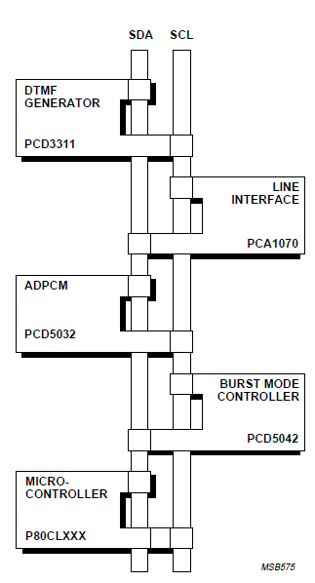
I²C Bus Overview
“Inter-Integrated Circuit” bus
Multiple devices connected by a shared serial bus
Bus is typically controlled by master device, slaves respond when addressed
I²C bus has two signal lines
SCL: Serial clock
SDA: Serial data
Full details available in “The I²C-bus Specification”

Slide 82
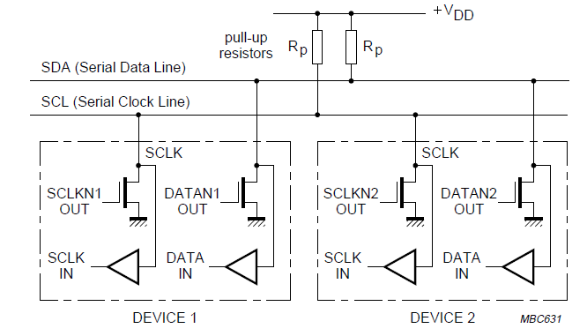
I²C Bus Connections
Resistors pull up lines to V_{DD}
Open-drain transistors pull lines down to ground
Master generates SCL clock signal
Can range up to 400 kHz, 1 MHz, or more

Slide 83
I²C Message Format
Message-oriented data transfer with four parts
Start condition
Slave Address transmission
Address
Command (read or write)
Acknowledgement by receiver
Data fields
Data byte
Acknowledgement by receiver
Stop condition

Slide 84
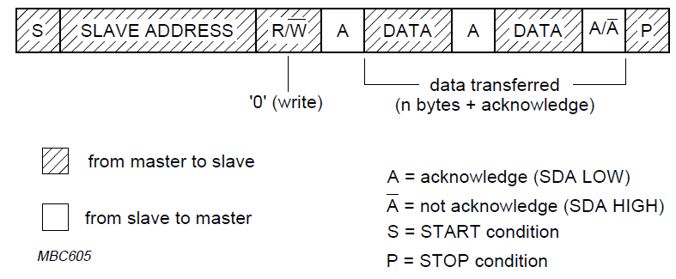
Master Writing Data to Slave

Slide 85
Master Reading Data from Slave

Slide 86
I²C with Register Addressing
Master drives communication
Sends start condition, address of slave, read/write command
Listens for acknowledgement from slave
Sends register address (byte)
Listens for acknowledgement from slave

Slide 87
I²C Addressing
Each device (IC) has seven-bit address
Different types of device have different default addresses
Sometimes can select a secondary default address by tying a device pin to a different logic level
What if we treat the first byte of data as a register address?
Can specify registers within a given device: eight bits
Example: Accelerometer has up to 58 registers

Slide 88
STM32F40x/41x I²C Controller

Slide 89
I²C Slave Mode
By default I²C operates in slave mode
Detect start condition
Compare the address received from the SDA line with interface address(OAR1) and with OAR2 (if ENDUAL=1) or the General Call address (if ENGC=1)
Header or address not matched: ignores it and wait for another start condition
Header matched (10-bit mode only)
Address matched: ACK or Interrupt or read the DUALF bit
Following the address reception and after clearing ADDR Slave will either
Send bytes from DR register to SDA line via shift register if in transmitter mode
Receive bytes from SDA line to DR register via shift register if in receiver mode
ACK or interrupt upon after each byte is completed.

Slide 90
I²C Master Mode
Generation of a Start condition will switch the Salve mode to Master mode
Master initiates a data transfer and generates the clock signal.
After the Start condition, read the Status register 1 and write the Data register with the Slave address
Then wait for a read of the SR1 register followed by a read of the SR2 register
Then send the slave address with LSB cleared to enter Transmitter mode or with LSB set to enter Receiver mode
Following the address reception and after clearing ADDR Master will either
Send bytes from DR register to SDA line via shift register if in transmitter mode
Receive bytes from SDA line to DR register via shift register if in receiver mode
Wait for ACK or ACK and then continue for the next byte
Send Stop condition

Slide 91
I²C Control Register 1 I2C_CR1
ACK: Acknowledge enable
STOP: Stop generation
In master mode, if set, will generate a Stop condition after the current byte transfer
In slave mode, if set, will release the SCL and SDA line after the current byte transfer
START: Start generation
PE: Peripheral enable
When STOP, START or PEC bit is set, the software must not perform any write access to CR1 before this bit is cleared by hardware in case it does not set a second STOP, START or PEC request.
Must not reset PE bit before the end of the communication in master mode.

Slide 92
I²C Control Register 2 I2C_CR2
Interrupt enable bits
FREQ[5:0]: Peripheral clock frequency
I2C peripheral connected to APB
Configure the clock frequency between 2MHz(0b000010) to 42MHz(0b101010)
Baud rate = Freq (if not in fast mode)

Slide 93
I²C Own address registers
OAR1
ADDMODE: 7-bit slave address or 10-bit slave address
Bit 14 should be kept at 1 by software
10-bit mode: ADD[9:0]: interface address
7-bit mode: ADD[7:1]: interface address
OAR2
Dual addressing mode
ENDUAL: Enable dual addressing mode with 1
ADD2[7:1]: secondary address in dual addressing mode

Slide 94
I²C Status Register 1 I2C_SR1
Error related bits
TxE: Data register empty (transmitters)
0: DR not empty
1: DR empty
RxNE: Date register empty (receivers)
0: DR empty
1: DR not empty
STOPF: Stop detection (Slave mode)
BTF: Byte transfer finished
ADDR: Address sent (master mode)/matched(slave mode)
SB: Start bit(Master mode)

Slide 95
I²C Status Register 2 I2C_SR2
GENCALL: General call address (slave mode)
TRA: Transmitter / Receiver
BUSY: Bus busy
MSL: Master / Slave

Slide 96
Required sequence
Program the peripheral input clock in I2C_CR2 Register to generate right timings
Configure the clock control registers
Configure the rise time registers
Enable the peripheral
Set the START bit to generate a Start condition

Slide 97
Protocol Comparison

Slide 98
Factors to Consider
How fast can the data get through?
Depends on raw bit rate, protocol overhead in packet
How many hardware signals do we need?
May need clock line, chip select lines, etc.
How do we connect multiple devices (topology)?
Dedicated link and hardware per device - point-to-point
One bus for master transmit/slave receive, one bus for slave transmit/master receive
All transmitters and receivers connected to same bus – multi-point
How do we address a target device?
Discrete hardware signal (chip select line)
Address embedded in packet, decoded internally by receiver
How do these factors change as we add more devices?

Slide 99
Protocol Trade-Offs
Protocol | Speed | Signals Req. for Bidirectional Communication with N devices | Device Addressing | Topology
UART (Point to Point) | Fast – Tens of Mbit/s | 2*N (TxD, RxD) | None | Point-to-point full duplex
UART (Multi-drop) | Fast – Tens of Mbit/s | 2 (TxD, RxD) | Added by user in software | Multi-drop
SPI | Fast – Tens of Mbit/s | 3+N for SCLK, MOSI, MISO, and one SS per device | Hardware chip select signal per device | Multi-point full-duplex, multi-drop half-duplex buses
I²C | Moderate – 100 kbit/s, 400 kbit/s, 1 Mbit/s, 3.4 Mbit/s. Packet overhead. | 2: SCL, SDA | In packet | Multi-point half-duplex bus

