Slide 1
Using Direct Memory Access to Improve Performance

Slide 2
Overview
Basic Concepts
DMA Peripherals in Cortex-M0+
DMA Applications
Data Transfer
Replacing ISRs

Slide 3
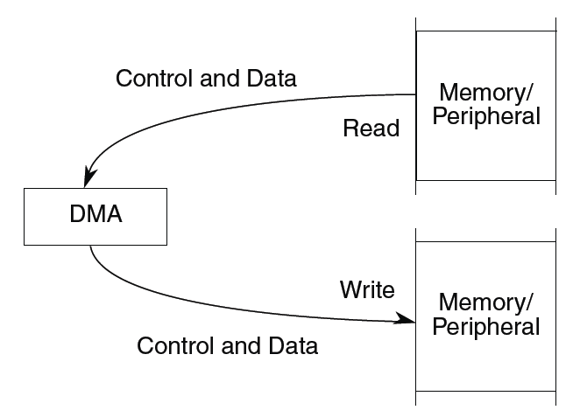
Basic Concepts
Special hardware to read data from a source and write it to a destination
Various configurable options
Number of data items to copy
Source and destination addresses can be fixed or change (e.g. increment, decrement)
Size of data item
When transfer starts
Operation
Initialization: Configure controller
Transfer: Data is copied
Termination: Channel indicates transfer has completed

Slide 4
DMA Controller Features
4 independent channels
Channel 0 has highest priority
8-, 16- or 32-bit transfers, data size can differ between source and destination
Modulo addressable
Can trigger with hardware signal or software
Can run continuously or periodically (“cycle-stealing”)
Hardware acknowledge/done signal

Slide 5
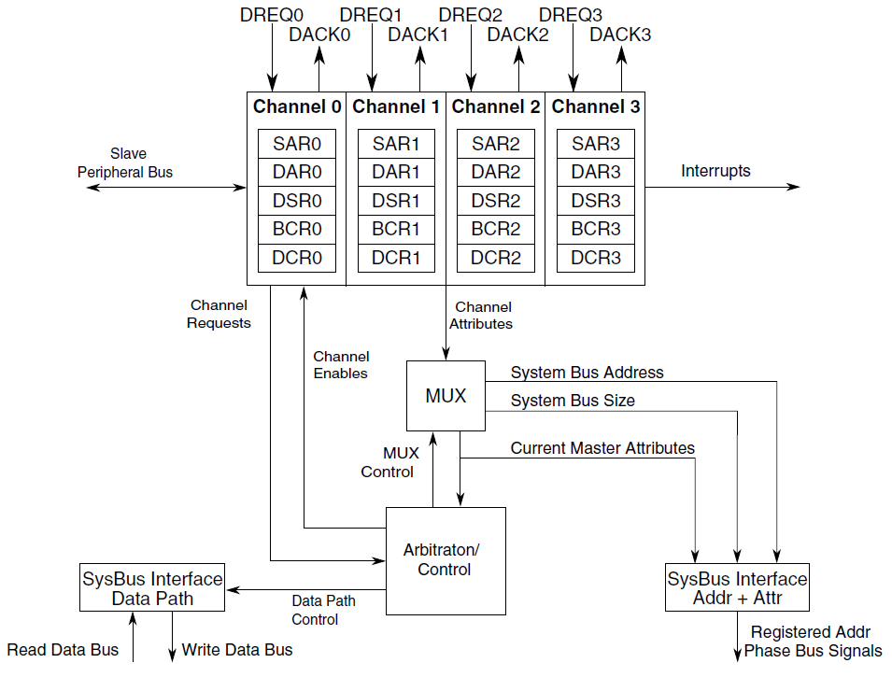
DMA Controller

Slide 6
Registers
DMA_SARn
Source address register,
Valid values 0 to 0x000f ffff
DMA_DARn
Destination address register
Valid values 0 to 0x000f ffff

Slide 7
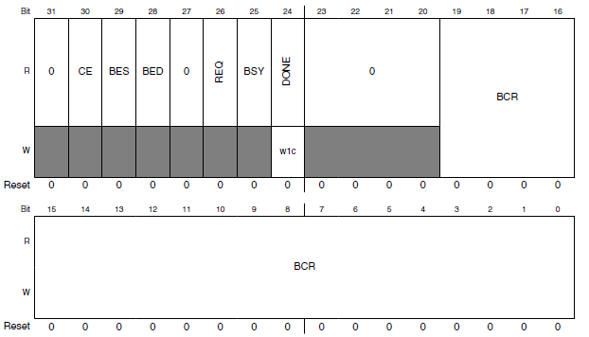
Status Register/Byte Count Register DMA_DSR_BCRn
Status flags: 1 indicates error
CE: Configuration error
BES: Bus error on source
BED: Bus error on destination
REQ: A transfer request is pending (more transfers to perform)
BSY: DMA channel is busy
DONE: Channel transfers have completed or an error occurred. Clear this bit in an ISR.

Slide 8
Byte Count Register
BCR: Bytes remaining to transfer
Decremented by 1, 2 or 4 after completing write (determined by destination data size)

Slide 9
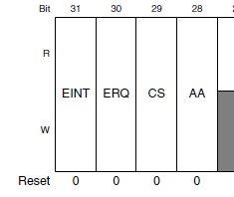
DMA Control Register (DMA_DCRn)
EINT: Enable interrupt on transfer completion
ERQ: Enable peripheral request to start transfer
CS: Cycle steal
0: Greedy - DMA makes continuous transfers until BCR == 0
1: DMA shares bus, performs only one transfer per request
AA: Autoalign

Slide 10
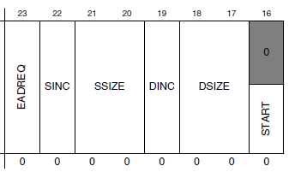
DMA Control Register (DMA_DCRn)
EADRQ – Enable asynchronous DMA requests when MCU is in Stop mode
SINC/DINC – Increment SAR/DAR by 1,2 or 4 based on size of data
SSIZE/DSIZE – Source/Destination data size.
Don’t need to match – controller will perform extra reads or writes as needed (e.g. read one word, write two bytes).
00: longword (32 bits)
01: byte (8 bits)
10: word (16 bits)
START – Write 1 to start transfer

Slide 11
DMA Control Register (DMA_DCRn)
SMOD, DMOD – Source/Destination address modulo
When non-zero, supports circular data buffer – address wraps around after 2^{n+3} bytes (16 bytes to 64 kilobytes)
When zero, circular buffer is disabled
D_REQ: If 1, then when BCR reaches zero ERQ bit will be cleared
LINKCC: Enables this channel to trigger another channel
00: Disabled
01: Two stages:
Link to channel LCH1 after each cycle-steal transfer
Link to channel LCH2 after BCR reaches 0
10: Link to channel LCH1 after each cycle-steal transfer
11: Link to channel LCH1 after BCR reaches 0
LCH1, LCH2: Values 00 to 11 specify linked DMA channel (0 to 3)

Slide 12
Basic Use of DMA
Enable clock to DMA module (in SIM register SCGC7)
Initialize control registers
Load SARn with source address
Load DARn with destination address
Load BCRn with number of bytes to transfer
Clear DSRn[DONE]
Start transfer by setting DCRn[START]
Wait for end of transfer
Interrupt generated if DCRn[EINT] is set (DMAn_IRQHandler)
Poll DSRn[DONE]

Slide 13
Demonstration: Memory Copy
Software-triggered
void Copy_Longwords(uint32_t * source, uint32_t * dest, uint32_t count)
Could use as a fast version of memcpy function, but need to handle all cases
Alignment of source and destination
Data size
Detecting overlapping buffers

Slide 14
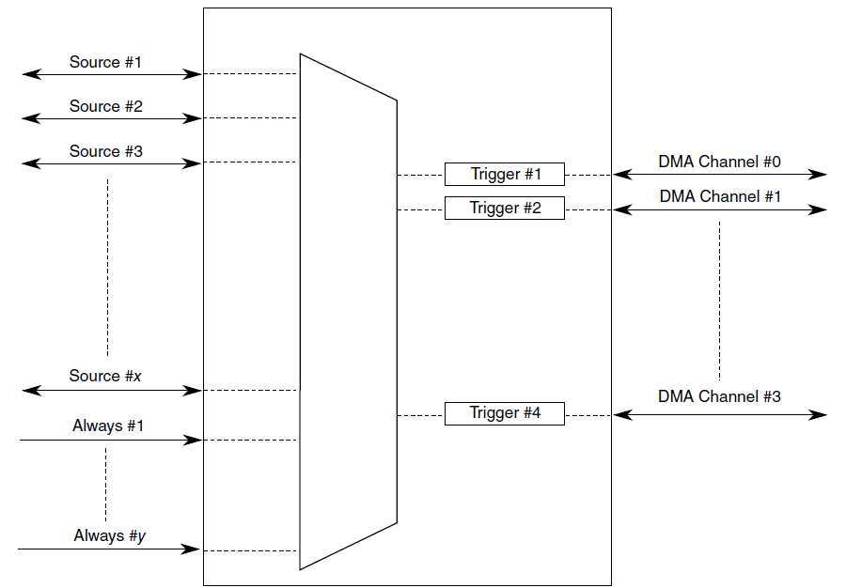
Triggering DMA Activity Using Peripherals
Can use trigger events from peripherals to start DMA transfer
Upon triggering, DMA can perform:
One transfer (cycle steal mode)
All transfers until BCR == 0 (continuous mode)
DMA Multiplexer (DMAMUX)
Selects which source will trigger a DMA channel
Each DMA channel n has a configuration register DMAMUX_CHCFGn
ENBL: Enable DMA channel
TRIG: Enables triggering of DMA channel
SOURCE: Selects triggering source

Slide 15
Trigger Sources
Trigger sources are chip-specific, so see KL25 Sub-Family Reference Manual (rev. 1), Chapter 3 - Chip Configuration, Section 3.4.8.1 DMA MUX Request Sources
Source # | Module | Description
0 | - | Disabled
2-7 | UART0,1, 2 | Receive, Transmit
16-19 | SPI0, 1 | Receive, Transmit
22-23 | I²C0, 1
24-29 | TPM0 | Channels 0-5
32-35 | TPM1-2 | Channels 0-1
40 | ADC0
42 | CMP0
45 | DAC0
49-53 | Port Control Module | Port A-E
54-56 | TPM0-2 | Overflow
57 | TSI
60-63 | DMAMUX | Always enabled

Slide 16
Triggering DMA Transfers with PITs
DMA Channels 0, 1 can be triggered by PITs 0 and 1 as well as the previously listed sources
PIT generates a trigger pulse each time it reaches 0
Disable interrupt for PITn by clearing TIE (interrupt enable) bit.
Clear ENBL and TRIG bits in CHCFGn register
Configure DMA Controller channel
Configure timer
Select trigger source with CHCFGn register and set ENBL and TRIG bits

Slide 17
Demonstration of ISR Replacement: DAC Playback
TPM0 expires each time we need to update the DAC
When DMA is triggered by TPM:
Copy one 16-bit data element from wave table (source) to DAC data register (DAC0->DAT[0])
Increment source address, decrement byte count
When DMA finishes last transfer
Generate interrupt
IRQ handler will clear interrupt flags, restart DMA transfers
DMA Configuration
Source, destination sizes = 2 bytes: SSIZE = DSIZE = 2
Enable peripheral request: ERQ = 1
Select hardware trigger
One transfer per peripheral request, so use cycle-steal mode: CS = 1
Two bytes per transfer: BCR = 2 bytes
Increment source register: SINC = 1
Do not increment destination register: DINC = 0
TPM Configuration
Don’t enable timer interrupt
TPM will still generate trigger event

Slide 18
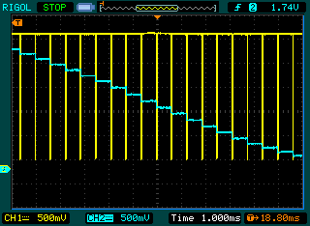
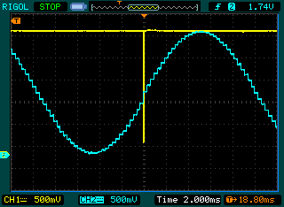
Performance Comparison
Traces
Yellow: ISR is executing when trace is low
Blue: DAC output (PTE30, pin 11 of J10)
Without DMA: Interrupt per sample
4.7 microseconds per 620 microseconds
0.758% of processor’s time
With DMA: Interrupt per cycle
5.0 microseconds per 20 milliseconds
0.025% of processor’s time
How is this useful?
Saves CPU time
Reduces timing vulnerability to interrupts being disabled
Enables CPU to sleep longer, wake up less often (20 milliseconds vs. 620 microseconds)

