Slide 1
Cortex-M0+ CPU Core

Slide 2
Overview
Cortex-M0+ Processor Core Registers
Memory System and Addressing
Thumb Instruction Set
References
DDI0419C Architecture ARMv6-M Reference Manual

Slide 3
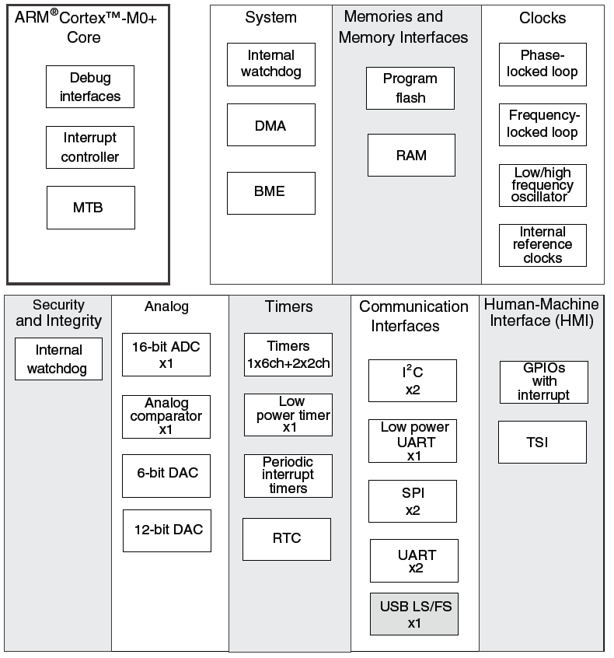
Microcontroller vs. Microprocessor
Both have a CPU core to execute instructions
Microcontroller has peripherals for embedded interfacing and control
Analog
Non-logic level signals
Timing
Clock generators
Communications
point to point
network
Reliability and safety

Slide 4
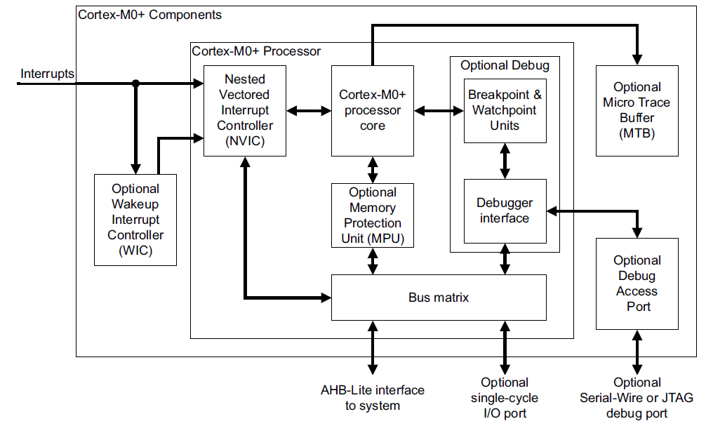
Cortex-M0+ Core

Slide 5
Architectures and Memory Speed
Load/Store Architecture
Developed to simplify CPU design and improve performance
Memory wall: CPUs keep getting faster than memory
Memory accesses slow down CPU, limit compiler optimizations
Change instruction set to make most instructions independent of memory
Data processing instructions can access registers only
Load data into the registers
Process the data
Store results back into memory
More effective when more registers are available
Register/Memory Architecture
Data processing instructions can access memory or registers
Memory wall is not very high at lower CPU speeds (e.g. under 50 MHz)

Slide 6
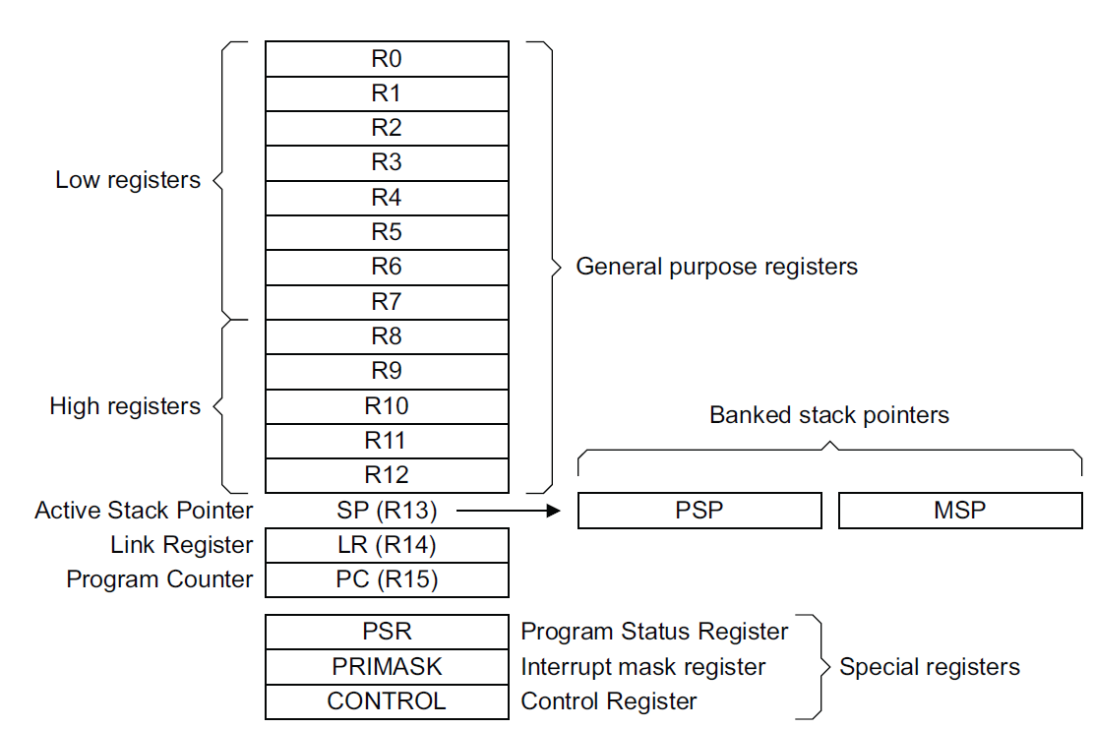
ARM Processor Core Registers

Slide 7
ARM Processor Core Registers (32 bits each)
R0-R12 - General purpose registers for data processing
SP - Stack pointer (R13)
Can refer to one of two SPs
Main Stack Pointer (MSP)
Process Stack Pointer (PSP)
Uses MSP initially, and whenever in Handler mode
When in Thread mode, can select either MSP or PSP using SPSEL flag in CONTROL register.
LR - Link Register (R14)
Holds return address when called with Branch & Link instruction (B&L)
PC - program counter (R15)

Slide 8
Operating Modes
Reset
Thread
Mode. MSP or PSP.
Exception Processing
Completed
Starting Exception Processing
Handler Mode
MSP
Which SP is active depends on operating mode, and SPSEL (CONTROL register bit 1)
SPSEL == 0: MSP
SPSEL == 1: PSP

Slide 9
ARM Processor Core Registers
Program Status Register (PSR) is three views of same register
Application PSR (APSR)
Condition code flag bits Negative, Zero, oVerflow, Carry
Interrupt PSR (IPSR)
Holds exception number of currently executing ISR
Execution PSR (EPSR)
Thumb state

Slide 10
ARM Processor Core Registers
PRIMASK - Exception mask register
Bit 0: PM Flag
Set to 1 to prevent activation of all exceptions with configurable priority
Access using CPS, MSR and MRS instructions
Use to prevent data race conditions with code needing atomicity
CONTROL
Bit 1: SPSEL flag
Selects SP when in thread mode: MSP (0) or PSP (1)
Bit 0: nPRIV flag
Defines whether thread mode is privileged (0) or unprivileged (1)
With OS environment,
Threads use PSP
OS and exception handlers (ISRs) use MSP

Slide 11
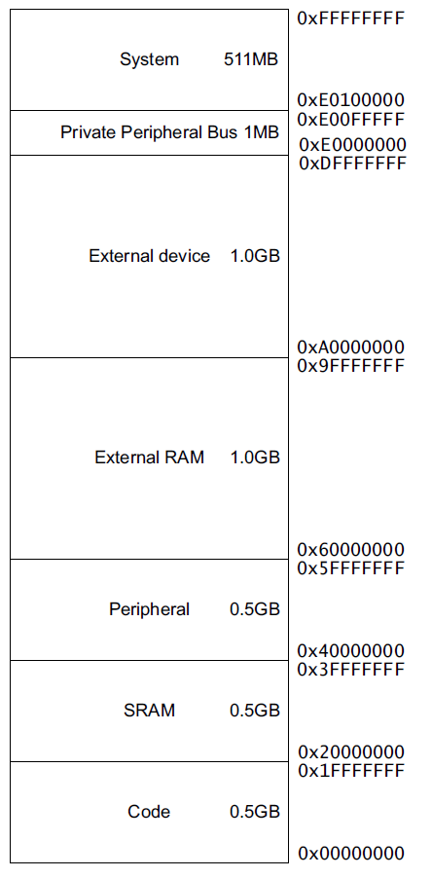
Memory Maps For Cortex M0+ and MCU
KL25Z128VLK4
0x2000_2FFF
16 KB SRAM
SRAM_U (3/4)
0x2000_0000
SRAM_L (1/4)
0x1FFF_F000
0x0001_FFFF
128KB Flash
0x0000_0000

Slide 12
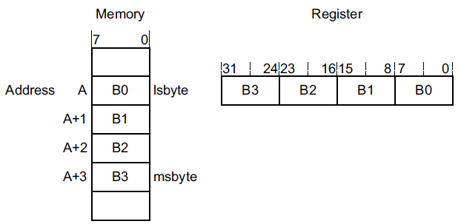
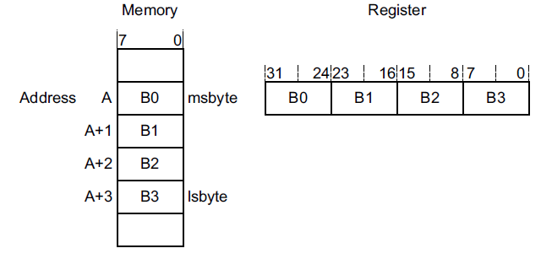
Endianness
For a multi-byte value, in what order are the bytes stored?
Little-Endian: Start with least-significant byte
Big-Endian: Start with most-significant byte

Slide 13
ARMv6-M Endianness
Instructions are always little-endian
Loads and stores to Private Peripheral Bus are always little-endian
Data: Depends on implementation, or from reset configuration
Kinetis processors are little-endian

Slide 14
ARM, Thumb and Thumb-2 Instructions
ARM instructions optimized for resource-rich high-performance computing systems
Deeply pipelined processor, high clock rate, wide (e.g. 32-bit) memory bus
Low-end embedded computing systems are different
Slower clock rates, shallow pipelines
Different cost factors – e.g. code size matters much more, bit and byte operations critical
Modifications to ARM ISA to fit low-end embedded computing
1995: Thumb instruction set
16-bit instructions
Reduces memory requirements but also performance
2003: Thumb-2 instruction set
Adds some 32 bit instructions
Improves speed with little memory overhead
CPU decodes instructions based on whether in Thumb state or ARM state - controlled by T bit

Slide 15
Instruction Set
Cortex-M0+ core implements ARMv6-M Thumb instructions
Only uses Thumb instructions, always in Thumb state
Most instructions are 16 bits long, some are 32 bits
Most 16-bit instructions can only access low registers (R0-R7), but some can access high registers (R8-R15)
Thumb state indicated by program counter being odd (LSB = 1)
Branching to an even address will cause an exception, since switching back to ARM state is not allowed
Conditional execution only supported for 16-bit branch
32 bit address space
Half-word aligned instructions
See ARMv6-M Architecture Reference Manual for specifics per instruction (Section A.6.7)

Slide 16
Assembler Instruction Format
<operation> <operand1> <operand2> <operand3>
There may be fewer operands
First operand is typically destination (<Rd>)
Other operands are sources (<Rn>, <Rm>)
Examples
ADDS <Rd>, <Rn>, <Rm>
Add registers: <Rd> = <Rn> + <Rm>
AND <Rdn>, <Rm>
Bitwise and: <Rdn> = <Rdn> & <Rm>
CMP <Rn>, <Rm>
Compare: Set condition flags based on result of computing <Rn> - <Rm>

Slide 17
Where Can the Operands Be Located?
In a general-purpose register R
Destination: Rd
Source: Rm, Rn
Both source and destination: Rdn
Target: Rt
Source for shift amount: Rs
An immediate value encoded in instruction word
In a condition code flag
In memory
Only for load, store, push and pop instructions

Slide 18
Update Condition Codes in APSR?
“S” suffix indicates the instruction updates APSR
ADD vs. ADDS
ADC vs. ADCS
SUB vs. SUBS
MOV vs. MOVS

Slide 19
Instruction Set Summary
Instruction Type | Instructions
Move | MOV
Load/Store | LDR, LDRB, LDRH, LDRSH, LDRSB, LDM, STR, STRB, STRH, STM
Add, Subtract, Multiply | ADD, ADDS, ADCS, ADR, SUB, SUBS, SBCS, RSBS, MULS
Compare | CMP, CMN
Logical | ANDS, EORS, ORRS, BICS, MVNS, TST
Shift and Rotate | LSLS, LSRS, ASRS, RORS
Stack | PUSH, POP
Conditional branch | IT, B, BL, B{cond}, BX, BLX
Extend | SXTH, SXTB, UXTH, UXTB
Reverse | REV, REV16, REVSH
Processor State | SVC, CPSID, CPSIE, SETEND, BKPT
No Operation | NOP
Hint | SEV, WFE, WFI, YIELD

Slide 20
Load/Store Register
ARM is a load/store architecture, so must process data in registers, not memory
LDR: load register from memory
LDR <Rt>, source address
STR: store register to memory
STR <Rt>, destination address

Slide 21
Addressing Memory
Offset Addressing mode: [<Rn>, <offset>] accesses address <Rn>+<offset>
Base Register <Rn>
Can be register R0-R7, SP or PC
<offset> is added or subtracted from base register to create effective address
Can be an immediate constant
Can be another register, used as index <Rm>
Auto-update: Can write effective address back to base register
Pre-indexing: use effective address to access memory, then update base register with that effective address
Post-indexing: use base register to access memory, then update base register with effective address

Slide 22
Other Data Sizes
Load and store instructions can handle half-word (16 bits) and byte (8 bits)
Store just writes to half-word or byte
STRH, STRB
Load a byte or half-word: What do we put in the upper bits?
How do we extend 0x80 into a full word?
Unsigned? Then 0x80 = 128, so zero-pad to extend to word 0x0000_0080 = 128
Signed? Then 0x80 = -128, so sign-extend to word 0xFFFF_FF80 = -128
 | Signed | Unsigned
Byte | LDRSB | LDRB
Half-word | LDRSH | LDRH

Slide 23
Data Size Extension
Can also extend byte or half-word already in a register
Signed or unsigned (zero-pad)
How do we extend 0x80 into a full word?
Unsigned? Then 0x80 = 128, so zero-pad to extend to word 0x0000_0080 = 128
Signed? Then 0x80 = -128, so sign-extend to word 0xFFFF_FF80 = -128
 | Signed | Unsigned
Byte | SXTB | UXTB
Half-word | SXTH | UXTH

Slide 24
Load/Store Multiple
LDM/LDMIA: load multiple registers starting from [base register], update base register afterwards
LDM <Rn>!,<registers>
LDM <Rn>,<registers>
STM/STMIA: store multiple registers starting at [base register], update base register after
STM <Rn>!, <registers>
LDMIA and STMIA are pseudo-instructions, translated by assembler

Slide 25
Load Literal Value into Register
Assembly instruction: LDR <rd>, =value
Assembler generates code to load <rd> with value
Assembler selects best approach depending on value
Load immediate
MOV instruction provides 8-bit unsigned immediate operand (0-255)
Load and shift immediate values
Can use MOV, shift, rotate, sign extend instructions
Load from literal pool
1. Place value as a 32-bit literal in the program’s literal pool (table of literal values to be loaded into registers)
2. Use instruction LDR <rd>, [pc,#offset] where offset indicates position of literal relative to program counter value
Example formats for literal values (depends on compiler and toolchain used)
Decimal: 3909
Hexadecimal: 0xa7ee
Character: ‘A’
String: “44??”

Slide 26
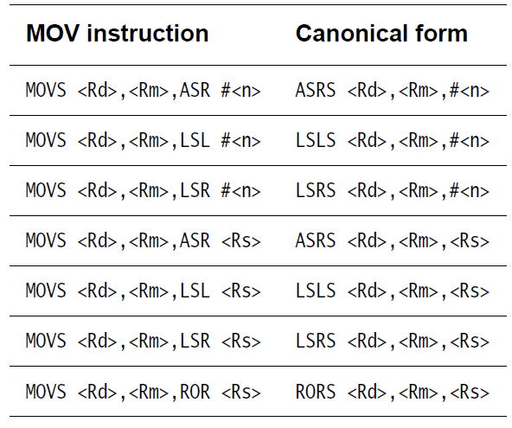
Move (Pseudo-)Instructions
Copy data from one register to another without updating condition flags
MOV <Rd>, <Rm>
Assembler translates pseudo- instructions into equivalent instructions (shifts, rotates)
Copy data from one register to another and update condition flags
MOVS <Rd>, <Rm>
Copy immediate literal value (0-255) into register and update condition flags
MOVS <Rd>, #<imm8>

Slide 27
Stack Operations
Push some or all of registers (R0-R7, LR) to stack
PUSH {<registers>}
Decrements SP by 4 bytes for each register saved
Pushing LR saves return address
PUSH {r1, r2, LR}
Pop some or all of registers (R0-R7, PC) from stack
POP {<registers>}
Increments SP by 4 bytes for each register restored
If PC is popped, then execution will branch to new PC value after this POP instruction (e.g. return address)
POP {r5, r6, r7}

Slide 28
Add Instructions
Add registers, update condition flags
ADDS <Rd>,<Rn>,<Rm>
Add registers and carry bit, update condition flags
ADCS <Rdn>,<Rm>
Add registers
ADD <Rdn>,<Rm>
Add immediate value to register
ADDS <Rd>,<Rn>,#<imm3>
ADDS <Rdn>,#<imm8>

Slide 29
Add Instructions with Stack Pointer
Add SP and immediate value
ADD <Rd>,SP,#<imm8>
ADD SP,SP,#<imm7>
Add SP value to register
ADD <Rdm>, SP, <Rdm>
ADD SP,<Rm>

Slide 30
Address to Register Pseudo-Instruction
Add immediate value to PC, write result in register
ADR <Rd>,<label>
How is this used?
Enables storage of constant data near program counter
First, load register R2 with address of const_data
ADR R2, const_data
Second, load const_data into R2
LDR R2, [R2]

Slide 31
Subtract
Subtract immediate from register, update condition flags
SUBS <Rd>,<Rn>,#<imm3>
SUBS <Rdn>,#<imm8>
Subtract registers, update condition flags
SUBS <Rd>,<Rn>,<Rm>
Subtract registers with carry, update condition flags
SBCS <Rdn>,<Rm>
Subtract immediate from SP
SUB SP,SP,#<imm7>

Slide 32
Multiply
Multiply source registers, save lower word of result in destination register, update condition flags
MULS <Rdm>, <Rn>, <Rdm>
<Rdm> = <Rdm> * <Rn>
Note: upper word of result is truncated

Slide 33
Logical Operations
Bitwise AND registers, update condition flags
ANDS <Rdn>,<Rm>
Bitwise OR registers, update condition flags
ORRS <Rdn>,<Rm>
Bitwise Exclusive OR registers, update condition flags
EORS <Rdn>,<Rm>
Bitwise AND register and complement of second register, update condition flags
BICS <Rdn>,<Rm>
Move inverse of register value to destination, update condition flags
MVNS <Rd>,<Rm>
Update condition flags by ANDing two registers, discarding result
TST <Rn>, <Rm>

Slide 34
Compare
Compare - subtracts second value from first, discards result, updates APSR
CMP <Rn>,#<imm8>
CMP <Rn>,<Rm>
Compare negative - adds two values, updates APSR, discards result
CMN <Rn>,<Rm>

Slide 35
Shift and Rotate
Common features
All of these instructions update APSR condition flags
Shift/rotate amount (in number of bits) specified by last operand
Logical shift left - shifts in zeroes on right
LSLS <Rd>,<Rm>,#<imm5>
LSLS <Rdn>,<Rm>
Logical shift right - shifts in zeroes on left
LSRS <Rd>,<Rm>,#<imm5>
LSRS <Rdn>,<Rm>
Arithmetic shift right - shifts in copies of sign bit on left (to maintain arithmetic sign)
ASRS <Rd>,<Rm>,#<imm5>
Rotate right
RORS <Rdn>,<Rm>

Slide 36
Reversing Bytes
REV - reverse all bytes in word
REV <Rd>,<Rm>
REV16 - reverse bytes in both half-words
REV16 <Rd>,<Rm>
REVSH - reverse bytes in low half-word (signed) and sign-extend
REVSH <Rd>,<Rm>
MSB
LSB
MSB
LSB
MSB
LSB
MSB
LSB
MSB
LSB
Sign extend
MSB
LSB

Slide 37
Changing Program Flow - Branches
Unconditional Branches
B <label>
Target address must be within 2 KB of branch instruction (-2048 B to +2046 B)
Conditional Branches
B<cond> <label>
<cond> is condition - see next page
B<cond> target address must be within of branch instruction
B target address must be within 256 B of branch instruction (-256 B to +254 B)

Slide 38
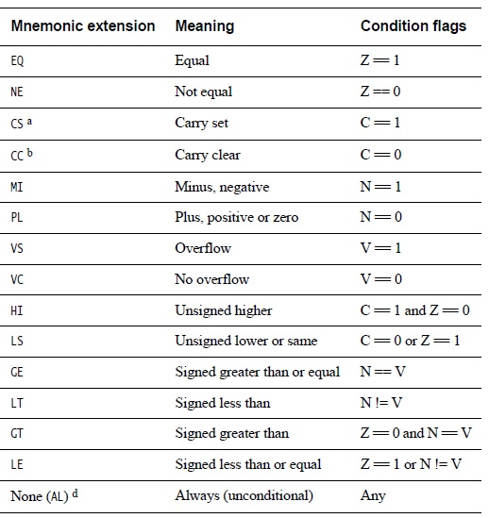
Condition Codes
Append to branch instruction (B) to make a conditional branch
Full ARM instructions (not Thumb or Thumb-2) support conditional execution of arbitrary instructions
Note: Carry bit = not-borrow for compares and subtractions

Slide 39
Changing Program Flow - Subroutines
Call
BL <label> - branch with link
Call subroutine at <label>
PC-relative, range limited to PC+/-16MB
Save return address in LR
BLX <Rd> - branch with link and exchange
Call subroutine at address in register Rd
Supports full 4GB address range
Save return address in LR
Return
BX <Rd> branch and exchange
Branch to address specified by <Rd>
Supports full 4 GB address space
BX LR - Return from subroutine

Slide 40
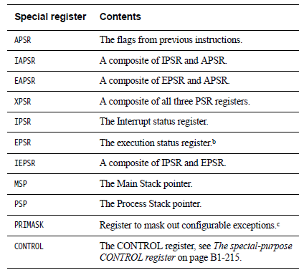
Special Register Instructions
Move to Register from Special Register
MSR <Rd>, <spec_reg>
Move to Special Register from Register
MRS <spec_reg>, <Rd>
Change Processor State - Modify PRIMASK register
CPSIE - Interrupt enable
CPSID - Interrupt disable

Slide 41
Other
No Operation - does nothing!
NOP
Breakpoint - causes hard fault or debug halt - used to implement software breakpoints
BKPT #<imm8>
Wait for interrupt - Pause program, enter low-power state until a WFI wake-up event occurs (e.g. an interrupt)
WFI
Supervisor call generates SVC exception (#11), same as software interrupt
SVC #<imm>

