Slide 1
Timer Peripherals

Slide 2
KL25 Timer Peripherals
PIT - Periodic Interrupt Timer
Can generate periodically generate interrupts or trigger DMA (direct memory access) transfers
TPM - Timer/PWM Module
Connected to I/O pins, has input capture and output compare support
Can generate PWM signals
Can generate interrupts and DMA requests
LPTMR - Low-Power Timer
Can operate as timer or counter in all power modes (including low-leakage modes)
Can wake up system with interrupt
Can trigger hardware
Real-Time Clock
Powered by external 32.768 kHz crystal
Tracks elapsed time (seconds) in 32-bit register
Can set alarm
Can generate 1Hz output signal and/or interrupt
Can wake up system with interrupt
SYSTICK
Part of CPU core’s peripherals
Can generate periodic interrupt

Slide 3
Timer/Counter Peripheral Introduction
Events
Reload Value
Reload
or
Presettable Binary Counter
÷2 or RS
PWM
Clock
Interrupt
Current Count
Common peripheral for microcontrollers
Based on presettable binary counter, enhanced with configurability
Count value can be read and written by MCU
Count direction can often be set to up or down
Counter’s clock source can be selected
Counter mode: count pulses which indicate events (e.g. odometer pulses)
Timer mode: clock source is periodic, so counter value is proportional to elapsed time (e.g. stopwatch)
Counter’s overflow/underflow action can be selected
Generate interrupt
Reload counter with special value and continue counting
Toggle hardware output signal
Stop!

Slide 4
Periodic Interrupt Timer

Slide 5
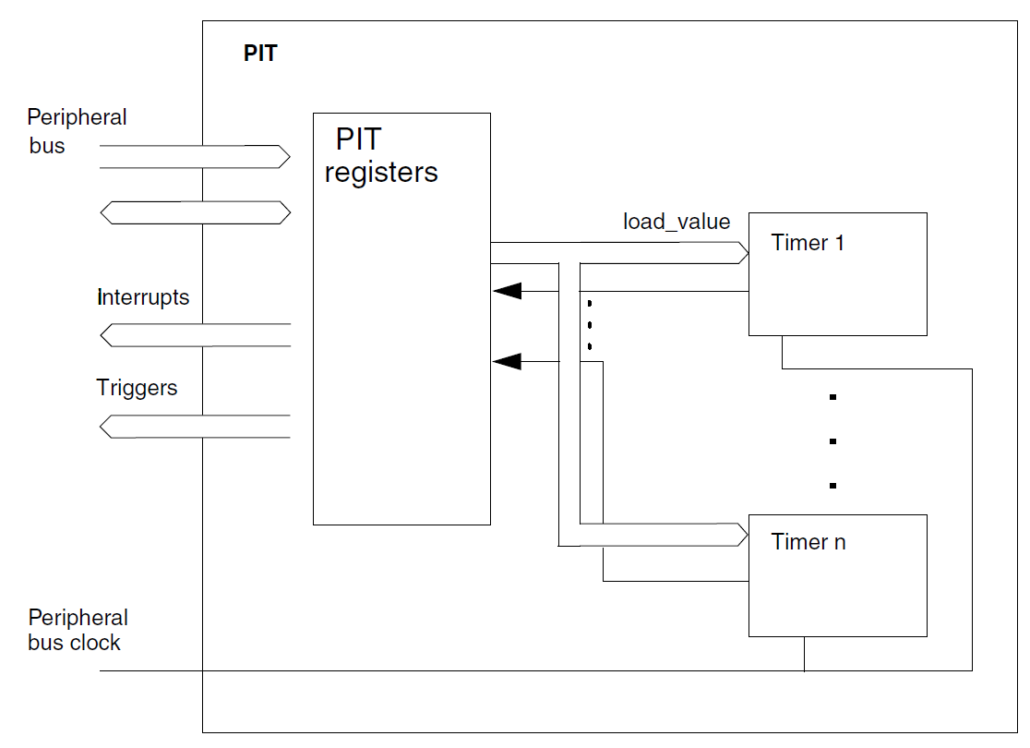
PIT - Periodic Interrupt Timer
Generates periodic interrupts with specified period

Slide 6
Periodic Interrupt Timer
PIT Interrupt
Write 1000 to TSV
Enabling timer loads counter with 1000, starts counting
TVL counts down to 0
PIT interrupt generated, counter reloads with 1000, starts counting
PIT interrupt generated, counter reloads with 400, starts counting
PIT interrupt generated, counter reloads with 400, starts counting
PIT interrupt generated, counter reloads with 400, starts counting
Write 700 to TSV
32-bit counter
Load start value (32-bit) from LDVAL
Counter counts down with each clock pulse
Fixed clock source for PIT - Bus Clock from Multipurpose Clock Generator - e.g. 24 MHz
When timer value (CVAL) reaches zero
Generates interrupt
Reloads timer with start value
Read/write timer start value (TSV) from PIT_LDVALn
Start Value
Reload
Clock
Presettable Binary Counter
Interrupt
Read current timer value (TVL) from PIT_CVALn

Slide 7
PIT Configuration
First: Clock gating
SIMCGC6 PIT
Second: Module Control Register (PIT->MCR)
MDIS - Module disable
0: module enabled
1: module disabled (clock disabled)
FRZ - Freeze - stops timers in debug mode
0: timers run in debug mode
1: timers are frozen (don’t run) in debug mode
Multiple timer channels within PIT
KL25Z has two channels
Can chain timers together to create 64-bit timer

Slide 8
Control of Each Timer Channel n
CMSIS Interface:
General PIT settings accessed as struct: PIT->MCR, etc.
Channels are accessed as an array of structs: PIT->CHANNEL[n].LDVAL, etc
PIT_LDVALn: Load value (PIT->CHANNEL[n].LDVAL)
PIT_CVALn: Current value (PIT->CHANNEL[n].CVAL)
PIT_TCTRLn: Timer control (PIT->CHANNEL[n].TCTRL)
CHN: Chain
0: independent timer operation, uses own clock source
1: timer n is clocked by underflow of timer n-1
TIE: Timer interrupt enable
0: Timer will not generate interrupts
1: Interrupt will be requested on underflow (i.e. when TIF is set)
TEN: Timer enable
0: Timer will not count
1: Timer is enabled, will count
PIT_TFLG0: Timer flags
TIF: Timer interrupt flag
1: Timeout has occurred

Slide 9
Configuring the PIT
Enable clock to PIT module
SIM->SCGC6 |= SIM_SCGC6_PIT_MASK;
Enable module, freeze timers in debug mode
PIT->MCR &= ~PIT_MCR_MDIS_MASK;
PIT->MCR |= PIT_MCR_FRZ_MASK;
Initialize PIT0 to count down from starting_value
PIT->CHANNEL[0].LDVAL = PIT_LDVAL_TSV(starting_value);
No chaining of timers
PIT->CHANNEL[0].TCTRL &= PIT_TCTRL_CHN_MASK;

Slide 10
Calculating Load Value
Goal: generate an interrupt every T seconds
LDV = round(T*f_{count} - 1)
-1 since the counter counts to 0
Round since LDV register is an integer, not a real number
Rounding provides closest integer to desired value, resulting in minimum timing error
Example: Interrupt every 137.41 ms
LDV = 137.41 ms * 24 MHz - 1 = 3297839
Example: Interrupt with a frequency of 91 Hz
LDV = (1/91 Hz)*24 MHz - 1 = round (263735.2637-1) = 263734

Slide 11
Configuring the PIT and NVIC for Interrupts
Configure PIT
Let the PIT channel generate interrupt requests
PIT->CHANNEL[0].TCTRL |= PIT_TCTRL_TIE_MASK;
Configure NVIC
Set PIT IRQ priority
NVIC_SetPriority(PIT_IRQn, 128); // 0, 64, 128 or 192
Clear any pending IRQ from PIT
NVIC_ClearPendingIRQ(PIT_IRQn);
Enable the PIT interrupt in the NVIC
NVIC_EnableIRQ(PIT_IRQn);
Make sure interrupts are not masked globally
__enable_irq();

Slide 12
Interrupt Handler
One interrupt for entire PIT
CMSIS ISR name: PIT_IRQHandler
ISR activities
Clear pending IRQ
NVIC_ClearPendingIRQ(PIT_IRQn);
Determine which channel triggered interrupt
if (PIT->CHANNEL[n].TFLG & PIT_TFLG_TIF_MASK) {
Clear interrupt request flag for channel
PIT->CHANNEL[0].TFLG &= PIT_TFLG_TIF_MASK;
Do the ISR’s work

Slide 13
Starting and Stopping the Timer Channel
Start the timer channel
PIT->CHANNEL[0].TCTRL |= PIT_TCTRL_TEN_MASK;
Stop the timer channel
PIT->CHANNEL[0].TCTRL &= ~PIT_TCTRL_TEN_MASK;

Slide 14
Example: Stopwatch
Measure time with 100 us resolution
Display elapsed time, updating screen every 10 ms
Controls
S1: toggle start/stop
Use PIT
Counter increment every 100 us
Set to PIT Channel 0 to expire every 100 us
Calculate load value LDVAL = round (100 us * 24 MHz -1) = 2399
LCD Update every 10 ms
Update LCD every nth PIT ISR
n = 10 ms/100us = 100
Don’t update LCD in ISR! Too slow.
Instead set flag LCD_Update in ISR, poll it in main loop

Slide 15
Timer/PWM Module (TPM)

Slide 16
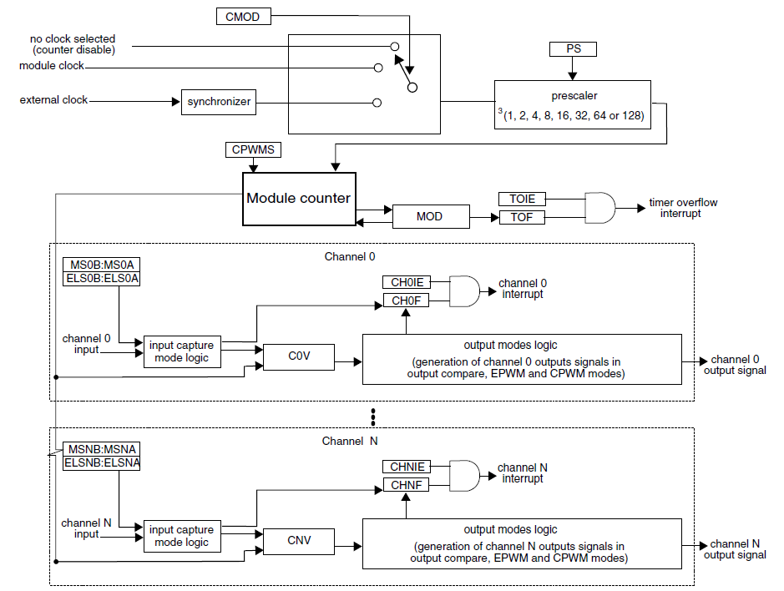
TPM - Timer/PWM Module
Core: Module counter
Two clock options - external or internal
Prescaler to divide clock by 1 to 128
16-bit counter
Can count up or up/down
Can reload with set load value or wrap around (to FFFF or 0000)
Six channels
3 modes
Capture Mode: capture timer’s value when input signal changes
Output Compare: Change output signal when timer reaches certain value
PWM: Generate pulse-width-modulated signal. Width of pulse is proportional to specified value.
Each channel can generate interrupt, DMA request, hardware trigger on overflow
One I/O pin per channel TPM_CHn

Slide 17
Timer Configuration
Clock source
CMOD: selects internal or external clock
Prescaler
PS: divide selected clock by 1, 2, 4, 8, 16, 32,64, 128
Count Mode and Modulo
CPWMS: count up (0) or up and down (1)
MOD: 16-bit value up to which the counter counts
Up counting: 0, 1, 2, … MOD, 0/Overflow, 1, 2, … MOD
Up/down counting: 0, 1, 2, … MOD, MOD-1/Interrupt, MOD-2, … 2, 1, 0, 1, 2, …
Timer overflows when counter goes 1 beyond MOD value
DMA: Enable DMA transfer on overflow
TOF: Flag indicating timer has overflowed

Slide 18
Basic Counter Mode
Count external events applied on input pin
Set CMOD = 01 to select external clock
Set PS = 000 (unless division needed
Timer overflow flag TOF set to 1 upon receiving MOD * prescaler pulses
Can generate interrupt if TOIE is set
2-0 PS | Prescaler Factor
000 | 1
001 | 2
010 | 4
011 | 8
100 | 16
101 | 32
110 | 64
111 | 128

Slide 19
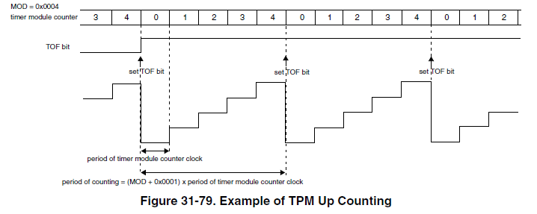
Count Mode and Modulo - Counting Up

Slide 20
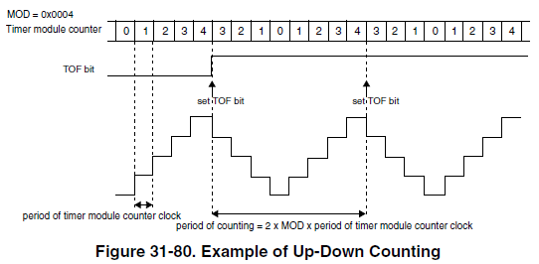
Count Mode and Modulo - Counting Up and Down

Slide 21
TPM Configuration (TPMx_CONF)
TRGSEL - input trigger select
CROT - counter reload on trigger
CSOO - counter stop on overflow
CSOT - counter start on trigger
GTBEEN - external global time base enable (rather than LPTPM counter)
DBGMODE - let LPTPM counter increment during debug mode
DOZEEN - pause LPTPM when in doze mode

Slide 22
TPM Status (TPMx_STATUS)
TOF - LPTPM counter has overflowed
CHxF - Channel event has occurred (event depends on mode)

Slide 23
Major Channel Modes
Input Capture Mode
Capture timer’s value when input signal changes
Rising edge, falling edge, both
How long after I started the timer did the input change?
Measure time delay
Output Compare Mode
Modify output signal when timer reaches specified value
Set, clear, pulse, toggle (invert)
Make a pulse of specified width
Make a pulse after specified delay
Pulse Width Modulation
Make a series of pulses of specified width and frequency

Slide 24
Channel Configuration and Value
Configuration: TPMx_CnSC
CHF - set when event occurs
CHIE - enable channel to generate an interrupt
MSB:MSA - mode select
ELSB:ELSA - edge or level select
DMA - enable DMA transfers
Value: TPMx_CnV
16-bit value for output compare or input capture

Slide 25
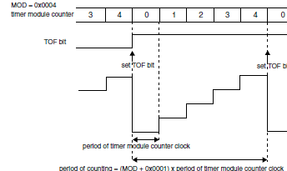
Input Capture Mode
Select mode with CPWMS = 0, MSnB:MSnA = 00
TPM_CHn I/O pin operates as edge- sensitive input
ELSnB:ELSnA select rising (01) or falling edge (10) or both (11)
When valid edge is detected on TPM_CHn…
Current value of counter is stored in CnV
Interrupt is enabled (if CHnIE = 1)
CHnF flag is set (after 3 clock delay)
TPM_CHn
CnV
initialized value
3

Slide 26
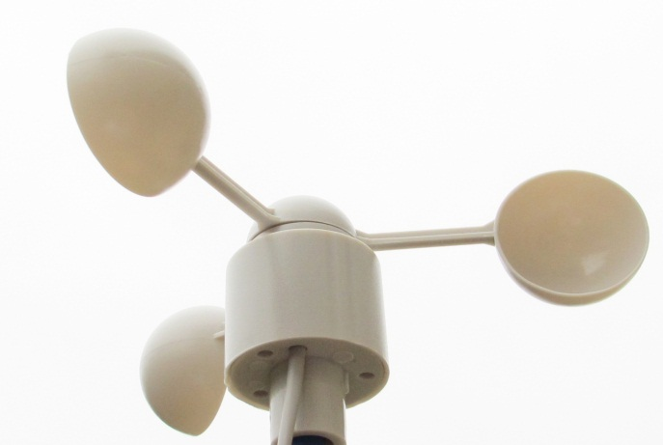
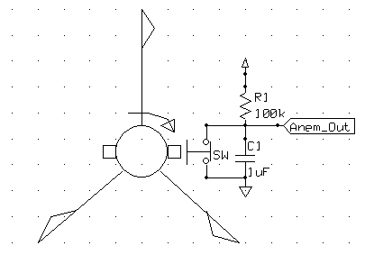
Wind Speed Indicator (Anemometer)
Rotational speed (and pulse frequency) is proportional to wind velocity
Two measurement options:
Frequency (best for high speeds)
Width (best for low speeds)
Can solve for wind velocity v
How can we use the TPM for this?
Use Input Capture Mode to measure period of input signal
$$v_{wind}= \frac{K∗f_{clk}}{T_{anemometer}}$$

Slide 27
TPM Capture Mode for Anemometer
Configuration
Set up TPM to count at given speed from internal clock
Set up TPM channel for input capture on rising edge
Operation: Repeat
First TPM interrupt - on rising edge
Reconfigure channel for input capture on falling edge
Clear TPM counter, start it counting
Second TPM interrupt - on falling edge
Read capture value from CnV, save for later use in wind speed calculation
Reconfigure channel for input capture on rising edge
Clear TPM counter, start it counting

Slide 28
Output Compare Mode
Select mode with CPWMS = 0, MSnA = 1
TPM_CHn I/O pin operates as output, MSnB and ELSnB:ELSnA select action on match
If MSnB = 0
Toggle (01)
Clear (00)
Set (11)
If MSnB = 1
Pulse low (10)
Pulse high (x1)
When CNT matches CnV …
Output signal is generated
CHnF flag is set
CHnI Interrupt is enabled (if CHnIE = 1)

Slide 29
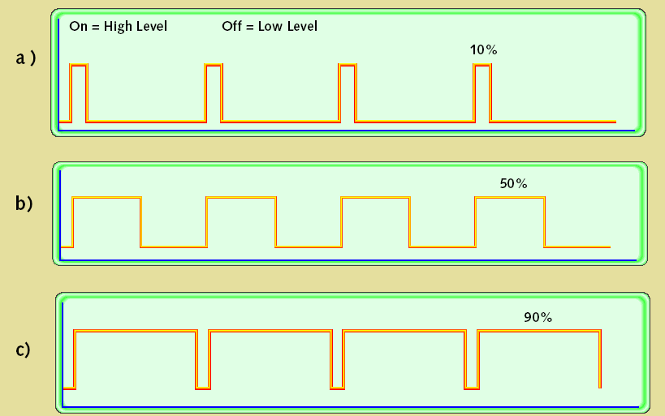
Pulse-Width Modulation
Uses of PWM
Digital power amplifiers are more efficient and less expensive than analog power amplifiers
Applications: motor speed control, light dimmer, switch-mode power conversion
Load (motor, light, etc.) responds slowly, averages PWM signal
Digital communication is less sensitive to noise than analog methods
PWM provides a digital encoding of an analog value
Much less vulnerable to noise
PWM signal characteristics
Modulation frequency – how many pulses occur per second (fixed)
Period – 1/(modulation frequency)
On-time – amount of time that each pulse is on (asserted)
Duty-cycle – on-time/period
Adjust on-time (hence duty cycle) to represent the analog value

Slide 30
TPM Channel for PWM Mode
Edge-aligned - leading edges of signals from all PWM channels are aligned
Uses count up mode
Period = (MOD + 1) cycles
Pulse width = (CnV) cycles
MSnB:MSnA = 01, CPWMS = 0
ELSnB:ELSnA = 10 - high-true pulses
ELSnB:ELSnA = x1 - low-true pulses

Slide 31
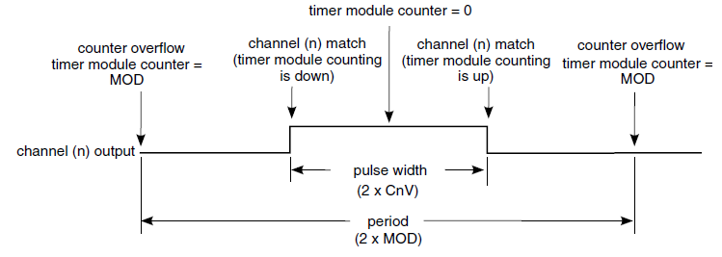
TPM Channel for PWM Mode
Center-aligned - centers of signals from all PWM channels are aligned
Uses count up/down mode
Period = 2*MOD cycles. 0x0001 <= MOD <= 0x7FFFF
Pulse width = 2*CnV cycles
MSnB:MSnA = 10, CPWMS = 1
ELSnB:ELSnA = 10 - high-true pulses
ELSnB:ELSnA = x1 - low-true pulses

Slide 32
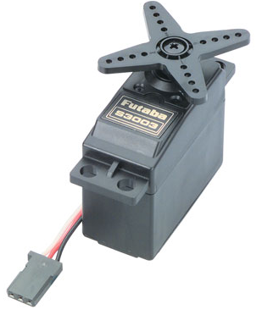
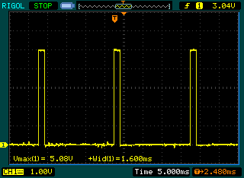
PWM to Drive Servo Motor
Servo PWM signal
20 ms period
1 to 2 ms pulse width

Slide 33
Low Power Timer (LPTMR)

Slide 34
LPTMR Overview
Features
16 bit counter
Can count time or external pulses
Can generate interrupt when counter matches compare value
Interrupt wakes MCU from any low power mode
Registers
Control Status register LPTMRx_CSR
Prescale register LPTMRx_PSR
Counter register LPTMRx_CNR
Compare register LPTRMx_CMR

Slide 35
Control Status Register
TCF: Timer Compare Flag
1 if CNR matches CMR and increments
TIE: Timer Interrupt Enable
Set to 1 to enable interrupt when TCF == 1
TPS: Timer Pin Select for pulse counter mode
Inputs available depend on chip configuration, see KL25 SRM Chapter 3: Chip Configuration

Slide 36
Control Status Register
TPP: Timer Pin Polarity
0: input is active high, increments CNR on rising edge
1: input is active low, increments CNR on falling edge
TFC: Timer Free-running Counter
0: Reset CNR whenever TCF is set (on match)
1: Reset CNR on overflow (wrap around)
TMS: Timer Mode Select
0: Time counter
1: Pulse counter
TEN: Timer Enable
1: Enable LPTMR operation

Slide 37
Prescale Register
PRESCALE: divide by 2 to 65536
Time counter mode: Divide input clock by 2^{PRESCALE+1}
Pulse counter mode: Is glitch filter which recognizes input signal change after 2^{PRESCALE} rising clock cycles
PBYP: Prescaler Bypass
0: use prescaler
1: bypass prescaler
PCS: Prescaler Count Select
Inputs available depend on chip configuration, see KL25 SRM Chapter 3: Chip Configuration

