Slide 1
Serial Communications

Slide 2
Overview
Serial communications
Concepts
Tools
Software: polling, interrupts and buffering
UART communications
Concepts
KL25 I2C peripheral
SPI communications
Concepts
KL25 SPI peripheral
I²C communications
Concepts
KL25 I2C peripheral

Slide 3
Why Communicate Serially?
Native word size is multi-bit (8, 16, 32, etc.)
Often it’s not feasible to support sending all the word’s bits at the same time
Cost and weight: more wires needed, larger connectors needed
Mechanical reliability: more wires => more connector contacts to fail
Timing Complexity: some bits may arrive later than others due to variations in capacitance and resistance across conductors
Circuit complexity and power: may not want to have 16 different radio transmitters + receivers in the system

Slide 4
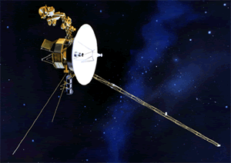
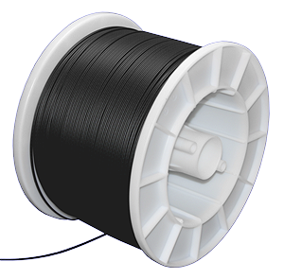
Example System: Voyager Spacecraft
???
Launched in 1977
Constraints: Reliability, power, size, weight, reliability, reliability, etc.
“Uplink communications is via S-band (16-bits/sec command rate) while an X-band transmitter provides downlink telemetry at 160 bits/sec normally and 1.4 kbps for playback of high-rate plasma wave data. All data are transmitted from and received at the spacecraft via the 3.7 meter high-gain antenna (HGA).” http://voyager.jpl.nasa.gov/spacecraft/index.html
Uplink – to spacecraft
Downlink – from spacecraft

Slide 5
Example System
Dedicated point-to-point connections
Parallel data lines, read and write lines between MCU and each peripheral
Fast, allows simultaneous transfers
Requires many connections, PCB area, scales badly

Slide 6
Parallel Buses
All devices use buses to share data, read and write signals
MCU uses individual select lines to address each peripheral
MCU requires fewer pins for data, but still one per data bit
MCU can communicate with only one peripheral at a time

Slide 7
Synchronous Serial Data Transmission
Transmitting Device
Receiving Device
Clock
Serial Data
Data Sampling Time at Receiver
Use shift registers and a clock signal to convert between serial and parallel formats
Synchronous: an explicit clock signal is along with the data signal

Slide 8
Synchronous Full-Duplex Serial Data Bus
Now can use two serial data lines - one for reading, one for writing.
Allows simultaneous send and receive full-duplex communication

Slide 9
Synchronous Half-Duplex Serial Data Bus
Share the serial data line
Doesn’t allow simultaneous send and receive - is half-duplex communication

Slide 10
Asynchronous Serial Communication
Data
bits
Data Sampling Time at Receiver
Time Zero
T_{bit}*1.5
T_{bit}*2.5
T_{bit}*3.5
T_{bit}*4.5
T_{bit}*5.5
T_{bit}*6.5
T_{bit}*7.5
T_{bit}*8.5
T_{bit}*9.5
T_{bit}*10.5
Eliminate the clock line!
Transmitter and receiver must generate clock locally
Transmitter must add start bit (always same value) to indicate start of each data frame
Receiver detects leading edge of start bit, then uses it as a timing reference for sampling data line to extract each data bit N at time T_{bit}*(N+1.5)
Stop bit is also used to detect some timing errors

Slide 11
Serial Communication Specifics
Data frame fields
Start bit (one bit)
Data (LSB first or MSB, and size – 7, 8, 9 bits)
Optional parity bit is used to make total number of ones in data even or odd
Stop bit (one or two bits)
All devices must use the same communications parameters
E.g. communication speed (300 baud, 600, 1200, 2400, 9600, 14400, 19200, etc.)
Sophisticated network protocols have more information in each data frame
Medium access control – when multiple nodes are on bus, they must arbitrate for permission to transmit
Addressing information – for which node is this message intended?
Larger data payload
Stronger error detection or error correction information
Request for immediate response (“in-frame”)
Data
bits
Message

Slide 12
Error Detection
Can send additional information to verify data was received correctly
Need to specify which parity to expect: even, odd or none.
Parity bit is set so that total number of “1” bits in data and parity is even (for even parity) or odd (for odd parity)
01110111 has 6 “1” bits, so parity bit will be 1 for odd parity, 0 for even parity
01100111 has 5 “1” bits, so parity bit will be 0 for odd parity, 1 for even parity
Single parity bit detects if 1, 3, 5, 7 or 9 bits are corrupted, but doesn’t detect an even number of corrupted bits
Stronger error detection codes (e.g. Cyclic Redundancy Check) exist and use multiple bits (e.g. 8, 16), and can detect many more corruptions.
Used for CAN, USB, Ethernet, Bluetooth, etc.

Slide 13
Tools for Serial Communications Development
Tedious and slow to debug serial protocols with just an oscilloscope
Instead use a logic analyzer to decode bus traffic
Worth its weight in gold!
Saelae 8-Channel Logic Analyzer
$150 (www.saelae.com)
Plugs into PC’s USB port
Decodes SPI, asynchronous serial, I²C, 1-Wire, CAN, etc.
Build your own: with Logic Sniffer or related open-source project

Slide 14
Software Structure – Handling asynchronous Communication

Slide 15
Software Structure
Communication is asynchronous to program
Don’t know what code the program will be executing …
when the next item arrives
when current outgoing item completes transmission
when an error occurs
Need to synchronize between program and serial communication interface somehow
Options
Polling
Wait until data is available
Simple but inefficient of processor time
Interrupt
CPU interrupts program when data is available
Efficient, but more complex

Slide 16
Serial Communications and Interrupts
Want to provide multiple threads of control in the program
Main program (and subroutines it calls)
Transmit ISR – executes when serial interface is ready to send another character
Receive ISR – executes when serial interface receives a character
Error ISR(s) – execute if an error occurs
Need a way of buffering information between threads
Solution: circular queue with head and tail pointers
One for tx, one for rx
Main Program or other threads
get_string
send_string
rx_isr
tx_isr
Serial Interface

Slide 17
Enabling and Connecting Interrupts to ISRs
ARM Cortex-M0+ provides one IRQ for all of a communication interface’s events
Within ISR (IRQ Handler), need to determine what triggered the interrupt, and then service it
void UART2_IRQHandler() {
if (transmitter ready) {
if (more data to send) {
get next byte
send it out transmitter
}
}
if (received data) {
get byte from receiver
save it
}
if (error occurred) {
handle error
}
}

Slide 18
Code to Implement Queues
Enqueue at tail: tail_ptr points to next free entry
Dequeue from head: head_ptr points to item to remove
#define the queue size to make it easy to change
One queue per direction
tx ISR unloads tx_q
rx ISR loads rx_q
Other threads (e.g. main) load tx_q and unload rx_q
Need to wrap pointer at end of buffer to make it circular,
Use % (modulus, remainder) operator if queue size is not power of two
Use & (bitwise and) if queue size is a power of two
Queue is empty if size == 0
Queue is full if size == Q_SIZE
older data
newer data
read data from head
write data to tail
get_string
send_string
rx_isr
tx_isr
Serial
Interface

Slide 19
Defining the Queues
#define Q_SIZE (32)
typedef struct {
unsigned char Data[Q_SIZE];
unsigned int Head; // points to oldest data element
unsigned int Tail; // points to next free space
unsigned int Size; // quantity of elements in queue
} Q_T;
Q_T tx_q, rx_q;

Slide 20
Initialization and Status Inquiries
void Q_Init(Q_T * q) {
unsigned int i;
for (i=0; i<Q_SIZE; i++)
q->Data[i] = 0; // to simplify our lives when debugging
q->Head = 0;
q->Tail = 0;
q->Size = 0;
}
int Q_Empty(Q_T * q) {
return q->Size == 0;
}
int Q_Full(Q_T * q) {
return q->Size == Q_SIZE;
}

Slide 21
Enqueue and Dequeue
int Q_Enqueue(Q_T * q, unsigned char d) {
// What if queue is full?
if (!Q_Full(q)) {
q->Data[q->Tail++] = d;
q->Tail %= Q_SIZE;
q->Size++;
return 1; // success
} else
return 0; // failure
}
unsigned char Q_Dequeue(Q_T * q) {
// Must check to see if queue is empty before dequeueing
unsigned char t=0;
if (!Q_Empty(q)) {
t = q->Data[q->Head];
q->Data[q->Head++] = 0; // to simplify debugging
q->Head %= Q_SIZE;
q->Size--;
}
return t;
}

Slide 22
Using the Queues
Sending data:
if (!Queue_Full(…)) {
Queue_Enqueue(…, c)
}
Receiving data:
if (!Queue_Empty(…)) {
c=Queue_Dequeue(…)
}

Slide 23
Software Structure – Parsing Messages

Slide 24
Decoding Messages
Two types of messages
Actual binary data sent
First identify message type
Second, based on this message type, copy binary data from message fields into variables
May need to use pointers and casting to get code to translate formats correctly and safely
ASCII text characters representing data sent
First identify message type
Second, based on this message type, translate (parse) the data from the ASCII message format into a binary format
Third, copy the binary data into variables

Slide 25
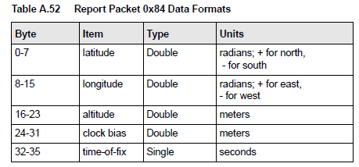
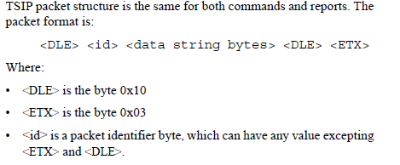
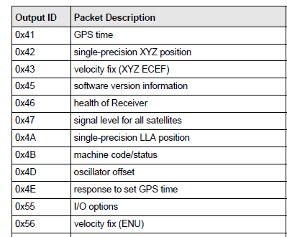
Example Binary Serial Data: TSIP
switch (id) {
case 0x84:
lat = *((double *) (&msg[0]));
lon = *((double *) (&msg[8]));
alt = *((double *) (&msg[16]));
clb = *((double *) (&msg[24]));
tof = *((float *) (&msg[32]));
break;
case 0x4A: …
default:
break;
}

Slide 26
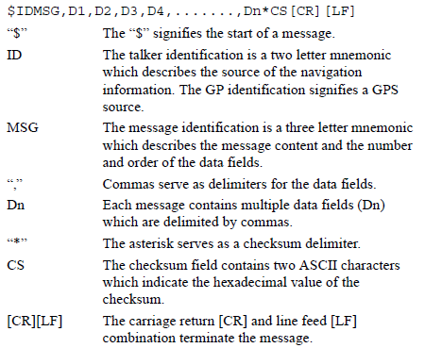
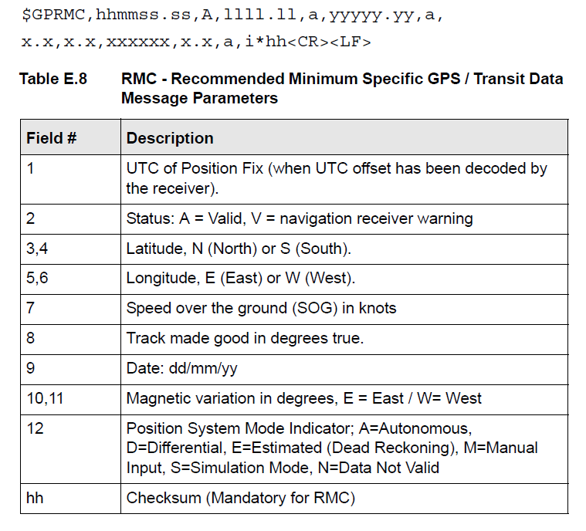
Example ASCII Serial Data: NMEA-0183

Slide 27
State Machine for Parsing NMEA-0183
Start
Any char. except *, \r or \n
Append char to buf. Inc. counter
$ Append char to buf.
Talker + Sentence Type
*, \r or \n, non-text, or counter>6
buf==$SDDBT, $VWVHW, or $YXXDR
Enqueue all chars. from buf
/r or /n
Sentence Body
Any char. except *
Enqueue char
*
Enqueue char
Checksum 1
Any char.
Save as checksum1
Checksum 2
Any char.
Save as checksum2

Slide 28
Parsing
switch (parser_state) {
case TALKER_SENTENCE_TYPE:
switch (msg[i]) {
‘*’:
‘\r’:
‘\n’:
parser_state = START;
break;
default:
if (Is_Not_Character(msg[i]) || n>6) {
parser_state = START;
} else {
buf[n++] = msg[i];
}
break;
}
if ((n==6) & … ){
parser_state = SENTENCE_BODY;
}
break;
case SENTENCE_BODY:
break;

Slide 29
KL25Z and Freedom Specifics

Slide 30
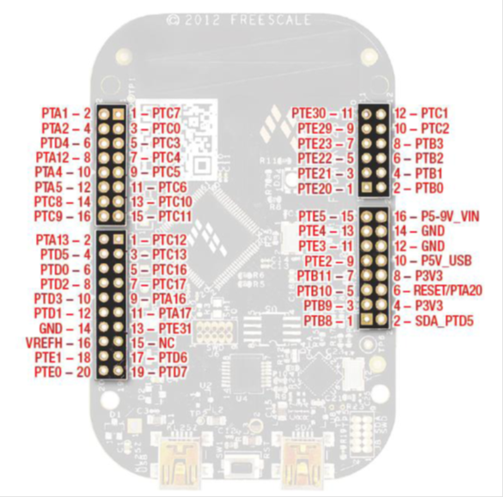
Freedom KL25Z Serial I/O
UART
SPI
I²C

Slide 31
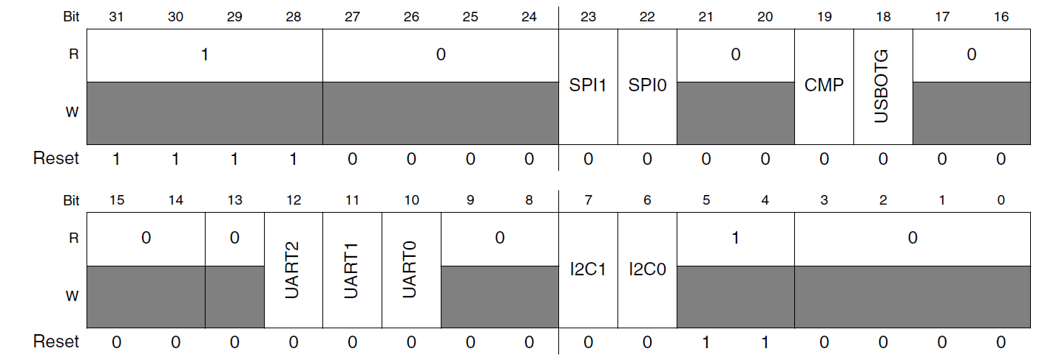
KL25Z Clock Gating for Serial Comm.
Set corresponding bit(s) in SIM_SCGC4 Register

Slide 32
Asynchronous serial (UART) Communications

Slide 33
Transmitter Basics
Data
bits
Data Sampling Time at Receiver
T_{bit}
T_{bit}
T_{bit}
T_{bit}
T_{bit}
T_{bit}
T_{bit}
T_{bit}
T_{bit}
T_{bit}
T_{bit}
Time Zero
If no data to send, keep sending 1 (stop bit) – idle line
When there is a data word to send
Send a 0 (start bit) to indicate the start of a word
Send each data bit in the word (use a shift register for the transmit buffer)
Send a 1 (stop bit) to indicate the end of the word

Slide 34
Receiver Basics
Data
bits
Data Sampling Time at Receiver
Time Zero
T_{bit}*1.5
T_{bit}*2.5
T_{bit}*3.5
T_{bit}*4.5
T_{bit}*5.5
T_{bit}*6.5
T_{bit}*7.5
T_{bit}*8.5
T_{bit}*9.5
T_{bit}*10.5
Wait for a falling edge (beginning of a Start bit)
Then wait ½ bit time
Do the following for as many data bits in the word
Wait 1 bit time
Read the data bit and shift it into a receive buffer (shift register)
Wait 1 bit time
Read the bit
if 1 (Stop bit), then OK
if 0, there’s a problem!

Slide 35
For this to work…
Transmitter and receiver must agree on several things (protocol)
Order of data bits
Number of data bits
What a start bit is (1 or 0)
What a stop bit is (1 or 0)
How long a bit lasts
Transmitter and receiver clocks must be reasonably close, since the only timing reference is the start of the start bit

Slide 36
KL25 UARTs
UART: Universal (configurable) Asynchronous Receiver/Transmitter
UART0
Low Power
Can oversample from 4x to 32x
UART1, UART2

Slide 37
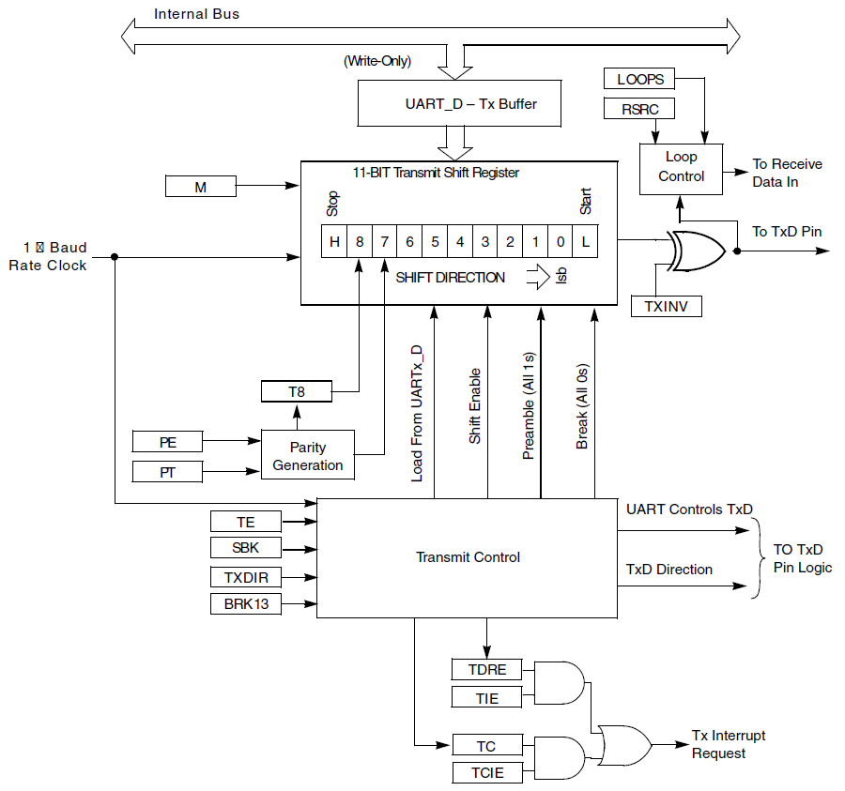
UART Transmitter

Slide 38
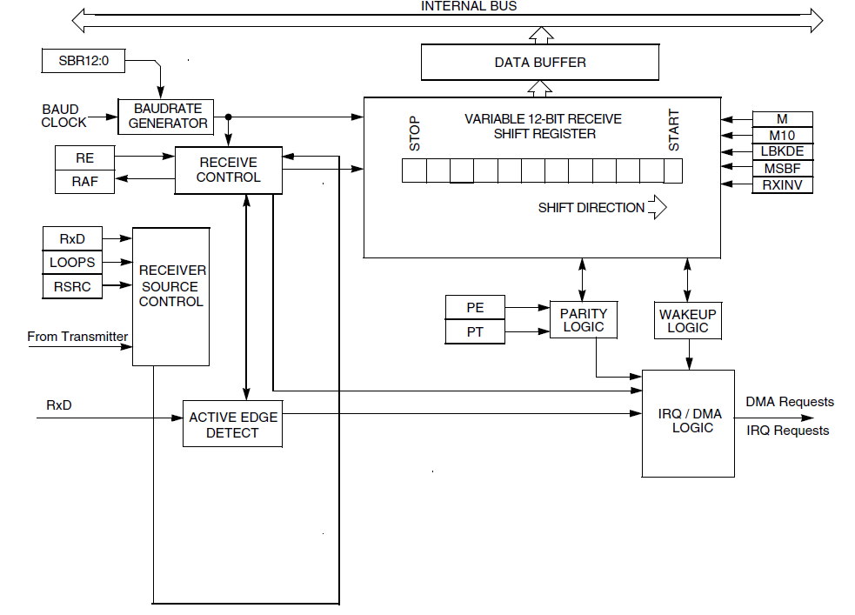
UART Receiver

Slide 39
Input Data Oversampling
When receiving, UART oversamples incoming data line
Extra samples allow voting, improving noise immunity
Better synchronization to incoming data, improving noise immunity
UART0 provides configurable oversampling from 4x to 32x
Put desired oversampling factor minus one into UART0 Control Register 4, OSR bits.
UART1, UART2 have fixed 16x oversampling

Slide 40
Baud Rate Generator
Need to divide module clock frequency down to desired baud rate * oversampling factor
Example
24 MHz -> 4800 baud with 16x oversampling
Division factor = 24E6/(4800*16) = 312.5. Must round to closest integer value ( 312 or 313), will have a slight frequency error.

Slide 41
Using the UART
When can we transmit?
Transmit buffer must be empty
Can poll UARTx->S1 TDRE flag
Or we can use an interrupt, in which case we will need to queue up data
Put data to be sent into UARTx_D (UARTx->D in with CMSIS)
When can we receive a byte?
Receive buffer must be full
Can poll UARTx->S1 RDRF flag
Or we can use an interrupt, and again we will need to queue the data
Get data from UARTx_D (UARTx->D in with CMSIS)

Slide 42
UART Control Register 1 (UART0_C1)
LOOPS: Enables loopback/single-pin (TX/RX) mode
DOZEN: Doze enable – disable UART in sleep mode
RSRC: Selects between loopback and single-pin mode
M: Select 9-bit data mode (instead of 8-bit data)
WAKE: Wakeup method
ILT: Idle line type
PE: Parity enabled with 1
PT: Odd parity with 1, even parity with 0

Slide 43
UART Control Register 2 (UART0_C2)
Interrupt Enables
TIE: Interrupt when Transmit Data Register is empty
TCIE: Interrupt when transmission completes
RIE: Interrupt when receiver has data ready
Module Enables
TE: Transmitter enable
RE: Receiver enable
Other
RWU: Put receiver in standby mode, will wake up when condition occurs
SBK: Send a break character (all zeroes)

Slide 44
UART Status Register 1 (UART_S1)
TDRE: Transmit data register empty, can write more data to data register
TC: Transmission complete.
RDRF: Receiver data register full, can read data from data register
IDLE: UART receive line has been idle for one full character time
OR: Receive overrun. Received data has overwritten previous data in receive buffer
NF: Noise flag. Receiver data bit samples don’t agree.
FE: Framing error. Received 0 for a stop bit, expected 1.
PF: Parity error. Incorrect parity received.

Slide 45
UART Status Register 2 (UARTx_S2)
LBDIF: LIN break detect interrupt flag
RXEDGIF: Active edge on receive pin detected
MSBF: Send MSB first. Should be 0 for RS232
RXINV: Invert received signals (data, start, stop, etc.)
RWUID: Set idle bit upon wakeup?
BRK13: Set break character to 13 bits long (not 10)
LBKDE: LIN break character time.
RAF: Receiver is actively receiving data (not idle line)

Slide 46
Software for Polled Serial Comm.
void Init_UART2(uint32_t baud_rate) {
uint32_t divisor;
// enable clock to UART and Port A
SIM->SCGC4 |= SIM_SCGC4_UART2_MASK;
SIM->SCGC5 |= SIM_SCGC5_PORTE_MASK;
// connect UART to pins for PTE22, PTE23
PORTE->PCR[22] = PORT_PCR_MUX(4);
PORTE->PCR[23] = PORT_PCR_MUX(4);
// ensure tx and rx are disabled before configuration
UART2->C2 &= ~(UARTLP_C2_TE_MASK | UARTLP_C2_RE_MASK);
// Set baud rate to 4800 baud
divisor = BUS_CLOCK/(baud_rate*16);
UART2->BDH = UART_BDH_SBR(divisor>>8);
UART2->BDL = UART_BDL_SBR(divisor);
// No parity, 8 bits, two stop bits, other settings;
UART2->C1 = UART2->S2 = UART2->C3 = 0;
// Enable transmitter and receiver
UART2->C2 = UART_C2_TE_MASK | UART_C2_RE_MASK;
}

Slide 47
Software for Polled Serial Comm.
void UART2_Transmit_Poll(uint8_t data) {
// wait until transmit data register is empty
while (!(UART2->S1 & UART_S1_TDRE_MASK))
;
UART2->D = data;
}
uint8_t UART2_Receive_Poll(void) {
// wait until receive data register is full
while (!(UART2->S1 & UART_S1_RDRF_MASK))
;
return UART2->D;
}

Slide 48
Example Transmitter
while (1) {
for (c='a'; c<='z'; c++) {
UART2_Transmit_Poll(c);
}

Slide 49
Example Receiver: Display Data on LCD
line = col = 0;
while (1) {
c = UART2_Receive_Poll();
Set_Cursor(col, line);
lcd_putchar(c);
col++;
if (col>7) {
col = 0;
line++;
if (line > 1) {
line = 0;
}
}

Slide 50
Software for Interrupt-Driven Serial Comm.
Use interrupts
First, initialize peripheral to generate interrupts
Second, create single ISR with three sections corresponding to cause of interrupt
Transmitter
Receiver
Error

Slide 51
Peripheral Initialization
void Init_UART2(uint32_t baud_rate) {
…
NVIC_SetPriority(UART2_IRQn, 128);
NVIC_ClearPendingIRQ(UART2_IRQn);
NVIC_EnableIRQ(UART2_IRQn);
UART2->C2 |= UART_C2_TIE_MASK |
UART_C2_RIE_MASK;
UART2->C2 |= UART_C2_RIE_MASK;
Q_Init(&TxQ);
Q_Init(&RxQ);
}

Slide 52
Interrupt Handler: Transmitter
void UART2_IRQHandler(void) {
NVIC_ClearPendingIRQ(UART2_IRQn);
if (UART2->S1 & UART_S1_TDRE_MASK) {
// can send another character
if (!Q_Empty(&TxQ)) {
UART2->D = Q_Dequeue(&TxQ);
} else {
// queue is empty so disable tx
UART2->C2 &= ~UART_C2_TIE_MASK;
}
}
…

Slide 53
Interrupt Handler: Receiver
void UART2_IRQHandler(void) {
…
if (UART2->S1 & UART_S1_RDRF_MASK) {
// received a character
if (!Q_Full(&RxQ)) {
Q_Enqueue(&RxQ, UART2->D);
} else {
// error - queue full.
while (1)
;
}
}

Slide 54
Interrupt Handler: Error Cases
void UART2_IRQHandler(void) {
…
if (UART2->S1 & (UART_S1_OR_MASK |
UART_S1_NF_MASK |
UART_S1_FE_MASK |
UART_S1_PF_MASK)) {
// handle the error
// clear the flag
}
}

Slide 55
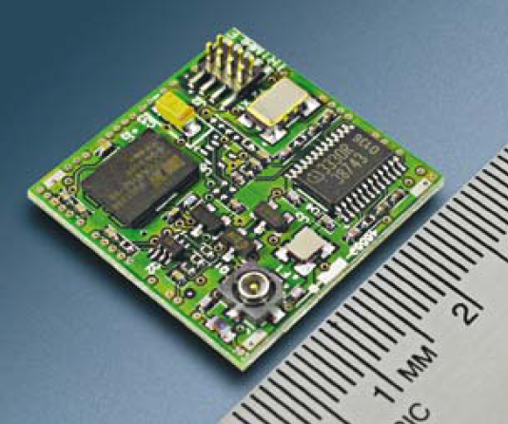
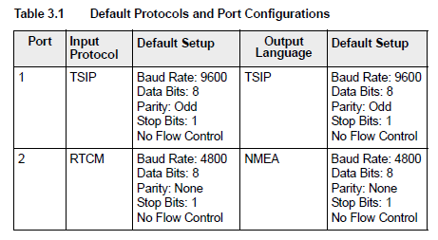
Example UART Application
Many subsystems connect with the rest of the system using asynchronous serial communications
Lassen iQ GPS receiver module from Trimble
Two full-duplex asynch. serial connections
Three protocols supported
Support higher speeds through reconfiguration

Slide 56
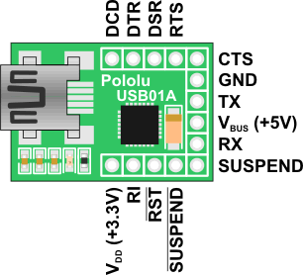
USB to UART Interface
PCs haven’t had external asynchronous serial interfaces for a while, so how do we communicate with a UART?
USB to UART interface
USB connection to PC
Logic level (0-3.3V) to microcontroller’s UART (not RS232 voltage levels)
USB01A USB to serial adaptor
http://www.pololu.com/catalog/product/391
Can also supply 5 V, 3.3 V from USB

Slide 57
Building on Asynchronous Comm.
Problem #1
Logic-level signals (0 to 1.65 V, 1.65 V to 3.3 V) are sensitive to noise and signal degradation
Problem #2
Point-to-point topology does not support a large number of nodes well
Need a dedicated wire to send information from one device to another
Need a UART channel for each device the MCU needs to talk to
Single transmitter, single receiver per data wire

Slide 58
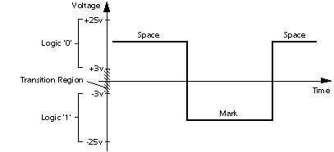
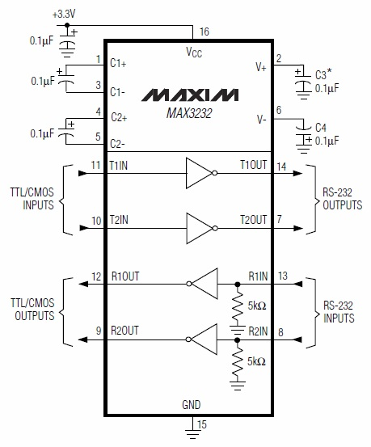
Solution to Noise: Higher Voltages
Use higher voltages to improve noise margin: +3 to +15 V, -3 to -15 V
Example IC (Maxim MAX3232) uses charge pumps to generate higher voltages from 3.3V supply rail

Slide 59
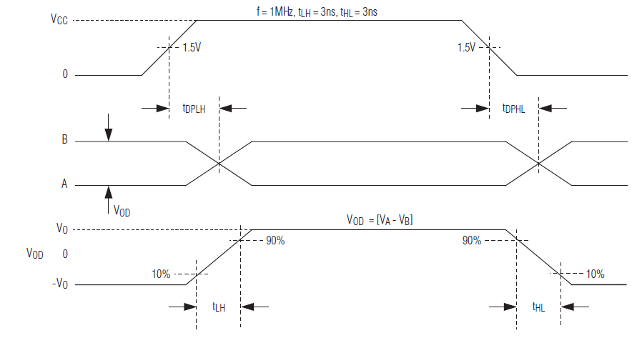
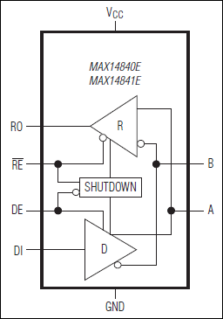
Solution to Noise: Differential Signaling
Data into Transmitter
Data out of Transmitter, on bus
Data out of Receiver
Use differential signaling
Send two signals: Buffered data (A), buffered complement of data (B)
Receiver compares the two signals to determine if data is a one (A > B) or a zero (B > A)

Slide 60
Solutions to Poor Scaling
Approaches
Allow one transmitter to drive multiple receivers (multi-drop)
Connect all transmitters and all receivers to same data line (multi-point network). Need to add a medium access control technique so all nodes can share the wire
Example Protocols
RS-232: higher voltages, point-to-point
RS-422: higher voltages, differential data transmission, multi-drop
RS-485: higher voltages, multi-point

Slide 61
Example Protocols
RS-232: higher voltages, point-to-point
RS-422: higher voltages, differential data transmission, multi-drop
RS-485: higher voltages, multi-point

Slide 62
SPI Communications

Slide 63
Hardware Architecture
All chips share bus signals
Clock SCK
Data lines MOSI (master out, slave in) and MISO (master in, slave out)
Each peripheral has its own chip select line (CS)
Master (MCU) asserts the CS line of only the peripheral it’s communicating with

Slide 64
Serial Data Transmission
Transmitting Device
Receiving Device
Clock
Serial Data
Data Sampling Time at Receiver
Use shift registers and a clock signal to convert between serial and parallel formats
Synchronous: an explicit clock signal is along with the data signal

Slide 65
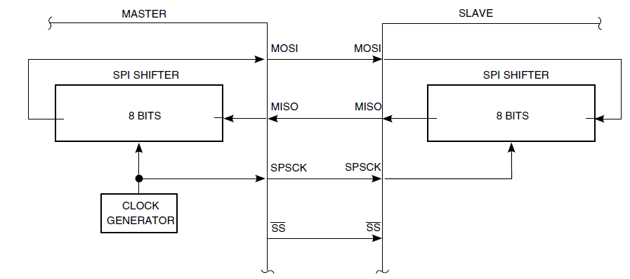
SPI Signal Connection Overview

Slide 66
SPI Control Register 1 (SPIx_C1)
SPIE: SPI interrupt enable for receive buffer full and mode fault
SPE: SPI system enable
SPTIE: SPI interrupt enable for transmit buffer empty
MSTR: select master mode
CPOL: Clock polarity
CPHA: Clock phase
SSOE: Slave select output enable

Slide 67
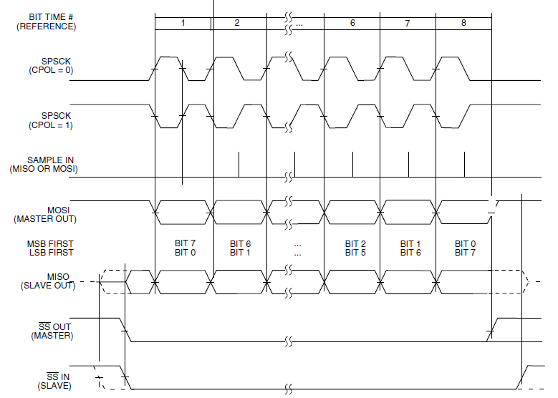
Clock and Phase Settings: CPHA = 1

Slide 68
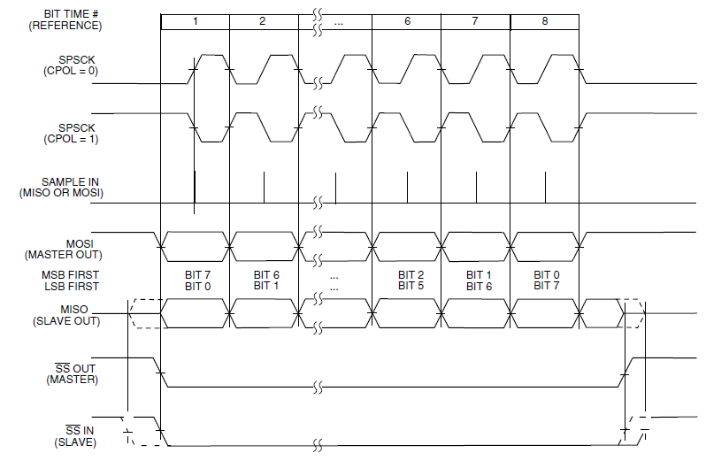
Clock and Phase Settings: CPHA = 0

Slide 69
SPI Control Register 2 (SPIx_C2)
SPMIE: SPI interrupt enable for receive data match
SPLPIE: SPI interrupt enable for wake from low-power mode
TXDMAE: Transmit DMA enable
MODFEN: Master mode-fault function enable
BIDIROE
RDDMAE: Receive DMA enable
SPISWAI: Stop SPI in wait mode
SPC0: Single wire (bidirectional) mode

Slide 70
SPI Baud Rate Register (SPIx_BR)
SPPR: SPI baud rate prescale divisor: divides by n+1
SPR: SPI baud rate divisor: divides by 2^{n+1}
f_{SPI} = f_{bus_clock}/((SPPR+1)*2^{SPR+1})

Slide 71
Normal and Bidirectional Modes

Slide 72
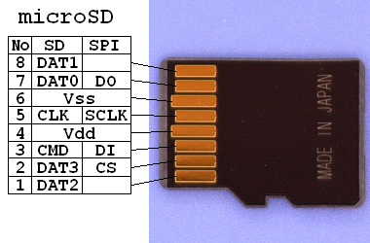
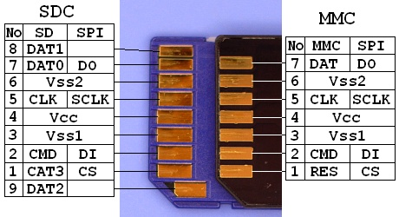
SPI Example: Secure Digital Card Access
SD cards have two communication modes
Native 4-bit
Legacy SPI 1-bit
SPI mode 0
CPHA=0
CPOL=0
V_{DD} from 2.7 to 3.6 V
CS: Chip Select (active low)
Source – FatFS FAT File System Module:
http://elm-chan.org/docs/mmc/mmc_e.html
http://elm-chan.org/fsw/ff/00index_e.html

Slide 73
SPI Commands
Host sends a six-byte command packet to card
Index, argument, CRC
Host reads bytes from card until card signals it is ready
Card returns
0xff while busy
0x00 when ready without errors
0x01-0x7f when error has occurred

Slide 74
SD Card Transactions
Single Block Read
Multiple Block Read
Single Block Write
Multipe Block Write

Slide 75
I²C Communications

Slide 76
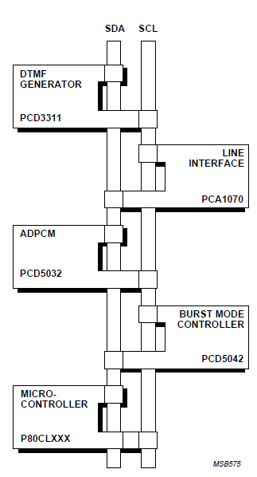
I²C Bus Overview
“Inter-Integrated Circuit” bus
Multiple devices connected by a shared serial bus
Bus is typically controlled by master device, slaves respond when addressed
I²C bus has two signal lines
SCL: Serial clock
SDA: Serial data
Full details available in “The I²C-bus Specification”

Slide 77
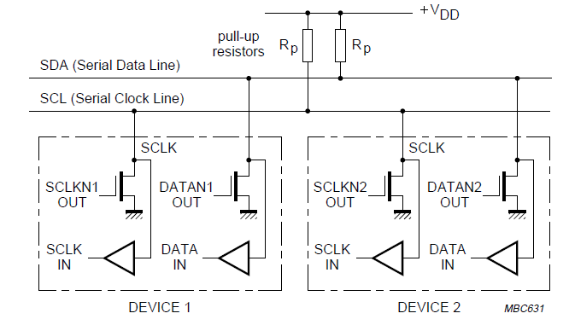
I²C Bus Connections
Resistors pull up lines to V_{DD}
Open-drain transistors pull lines down to ground
Master generates SCL clock signal
Can range up to 400 kHz, 1 MHz, or more

Slide 78
I²C Message Format
Message-oriented data transfer with four parts
Start condition
Slave Address transmission
Address
Command (read or write)
Acknowledgement by receiver
Data fields
Data byte
Acknowledgement by receiver
Stop condition

Slide 79
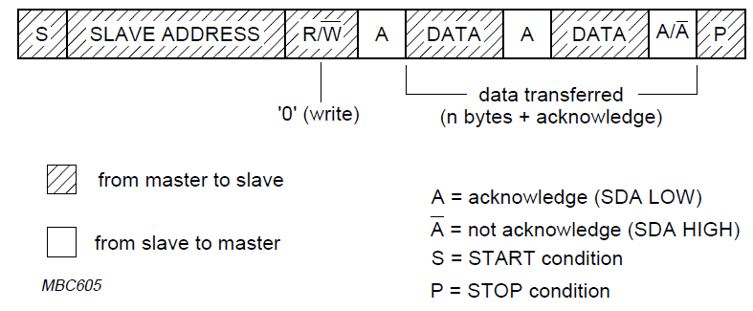
Master Writing Data to Slave

Slide 80
Master Reading Data from Slave

Slide 81
I²C with Register Addressing
Master drives communication
Sends start condition, address of slave, read/write command
Listens for acknowledgement from slave
Sends register address (byte)
Listens for acknowledgement from slave

Slide 82
I²C Addressing
Each device (IC) has seven-bit address
Different types of device have different default addresses
Sometimes can select a secondary default address by tying a device pin to a different logic level
What if we treat the first byte of data as a register address?
Can specify registers within a given device: eight bits
Example: Accelerometer has up to 58 registers

Slide 83
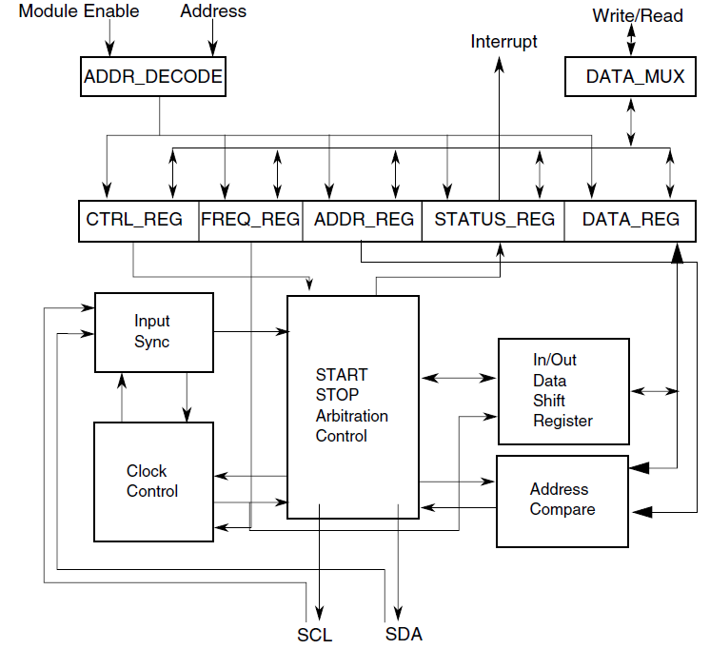
KL25Z I2C Controller

Slide 84
Setting the I²C Baud Rate
I2Cx_F: Frequency Divider register
MULT: specified multiplier mul = 2^{MULT}
valid values: 1, 2,4
ICR: Clock Rate
I2C baud rate = f_{bus}/ (2^{MULT} * ICR)

Slide 85
I2C Control Register 1 – I2Cx_C1
IICEN - enable I2C module
IICIE - enable I2C interrupt
MST - select master mode
0➔1 generates Start condition
1➔0 generates Stop condition
TX – Select 1 for master transmit and 0 for master receive
TXAK – Transmit Acknowledge enable
RSTA – Repeat Start
WUEN – Wakeup enable
DMAEN – Enable DMA

Slide 86
I2C Status Register – I2Cx_S
TCF – Transfer Complete flag set after transferring byte and acknowledge bit
IAAS – Addressed as a Slave
BUSY – bus busy
ARBL – arbitration lost
RAM – Range address match
SRW – when slave, indicates transmission direction (0: slave receive, 1: slave transmit)
IICIF: Interrupt pending flag
RXAK: 0: acknowledge signal received

Slide 87
I2C Data Register – I2Cx_D
8-bit data register
Master transmit mode
Writing to I2Cx_D starts a data transfer
Master receive mode
Reading from I2Cx_D starts reception of next byte

Slide 88
Macros in i2c.h
#define I2C_M_START I2C0->C1 |= I2C_C1_MST_MASK
#define I2C_M_STOP I2C0->C1 &= ~I2C_C1_MST_MASK
#define I2C_M_RSTART I2C0->C1 |= I2C_C1_RSTA_MASK
#define I2C_TRAN I2C0->C1 |= I2C_C1_TX_MASK
#define I2C_REC I2C0->C1 &= ~I2C_C1_TX_MASK
#define BUSY_ACK while(I2C0->S & 0x01)
#define TRANS_COMP while(!(I2C0->S & 0x80))
#define I2C_WAIT while((I2C0->S & I2C_S_IICIF_MASK)==0){} \
I2C0->S |= I2C_S_IICIF_MASK;
#define NACK I2C0->C1 |= I2C_C1_TXAK_MASK
#define ACK I2C0->C1 &= ~I2C_C1_TXAK_MASK

Slide 89
Writing a Single Byte to a Device
I2C_TRAN; /*set to transmit mode */
I2C_M_START; /*send start */
I2C0->D = dev; /*send dev address */
I2C_WAIT; /*wait for ack */
I2C0->D = address; /*send write address */
I2C_WAIT;
I2C0->D = data; /*send data */
I2C_WAIT;
I2C_M_STOP;

Slide 90
Reading a Single Byte from a Device
I2C_TRAN; /*set to transmit mode */
I2C_M_START; /*send start */
I2C0->D = dev; /*send dev address */
I2C_WAIT; /*wait for completion */
I2C0->D = address; /*send read address */
I2C_WAIT; /*wait for completion */
I2C_M_RSTART; /*repeated start */
I2C0->D = (dev|0x1); /*send dev address (read) */
I2C_WAIT; /*wait for completion */
I2C_REC; /*set to recieve mode */
NACK; /*set NACK after read */
data = I2C0->D; /*dummy read */
I2C_WAIT; /*wait for completion */
I2C_M_STOP; /*send stop */
data = I2C0->D; /*read data */

Slide 91
Reading Multiple Bytes from a Device: Set Up
I2C_TRAN; /*set to transmit mode */
I2C_M_START; /*send start */
I2C0->D = dev; /*send dev address */
I2C_WAIT; /*wait for ack */
I2C0->D = address; /*send read address */
I2C_WAIT; /*wait for completion */
I2C_M_RSTART; /*repeated start */
I2C0->D = (dev|0x1); /*send dev address (read) */
I2C_WAIT; /*wait for completion */
I2C_REC; /*set to receive mode */

Slide 92
Reading Multiple Bytes from a Device: Data
// For each byte
if(isLastRead) {
NACK; /*set NACK after read */
} else {
ACK; /*ACK after read */
}
data = I2C0->D; /*dummy read */
I2C_WAIT; /*wait for completion */
if(isLastRead) {
I2C_M_STOP; /*send stop */
}
data = I2C0->D; /*read real data */

Slide 93
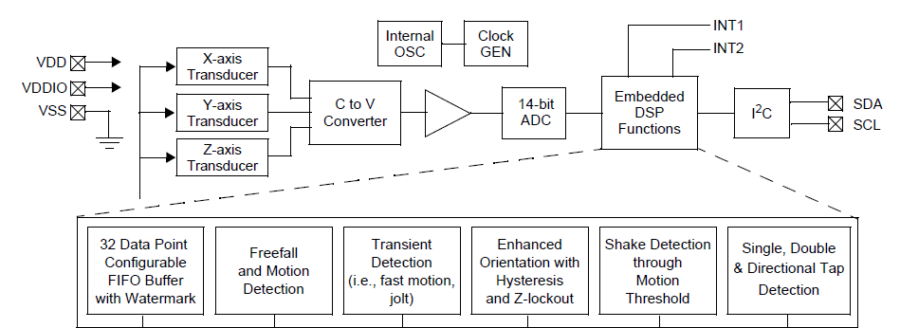
Example I²C Peripheral: 3-Axis Accelerometer
Freescale MMA8451, included in Freedom board
Can measure acceleration in x/y/z directions up to ±2g, ± 4g, ± 8g
Can compute rotation about x/y axes (pitch, roll)
I2C addresses are 0x3A (read) and 0x3B (write)
011101r (r=1 for read, r=0 for write)

Slide 94
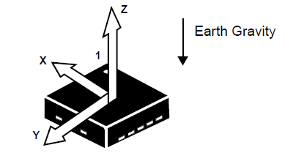
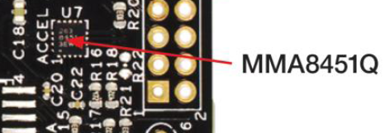
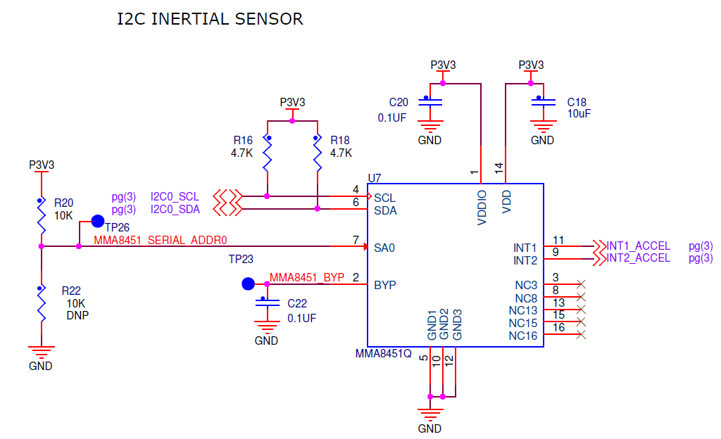
MMA8451 on Freedom KL25Z

Slide 95
Main Registers of Interest in MMA8451
Acceleration Data
Signed (two’s complement) data
14 or 8 bits per channel (left aligned)
X-axis: 0x01, 0x02
Y-axis: 0x03, 0x04
Z-axis: 0x05, 0x06
Resolution is about 1/4096 g per LSB (in +/- 2 g mode)
Who Am I?
Used to identify which device this is (IC-specific)
Device ID - 0x1A

Slide 96
Control Register 1 (0x2A)
ACTIVE: set to 1 to put in active (not standby) mode
FREAD: set to 1 to fast read just 8 MSBs of XYZ data
LNOISE: low noise mode
DR2-0: select output data rate from 1.56 Hz to 800 Hz
ASLP_RATE1-0: Select Sleep mode rate from 1.56 to 50 Hz
DR2 | DR1 | DR0 | Output Data Rate
0 | 0 | 0 | 800 Hz
0 | 0 | 1 | 400
0 | 1 | 0 | 200
0 | 1 | 1 | 100
1 | 0 | 0 | 50
1 | 0 | 1 | 12.5
1 | 1 | 0 | 6.25
1 | 1 | 1 | 1.56

Slide 97
Additional Registers
FIFO configuration
Interrupt control and status
Dynamic range
High-pass filter configuration
Portrait/Landscape detection settings
Freefall detection settings
Sleep control registers
Offset per axis
Transient event detection settings
Tap (pulse) detection settings

Slide 98
Demonstration: Configure the Accelerometer
if(i2c_read_byte(MMA_ADDR, REG_WHOAMI) == WHOAMI) {
Delay(10);
//set active, 14 bit data and 100 Hz ODR (0x19)
i2c_write_byte(MMA_ADDR, REG_CTRL1, 0x01);
return 1;
}
Source code at mma8451.c
Basic approach
Read byte from the WHOAMI register, verify it matches expected value for MMA8451
Delay…
Set to active, 14-bit mode, 100 Hz sampling rate

Slide 99
Demonstration: Read the Accelerations
Send I2C Start condition
Send read addresses (device and register)
Read first five bytes of data into data[i]
Read last byte of data into data[i] (also sends stop condition)
Append bytes to form 16-bit words (int16_t)
Divide by four to adjust for scaling
i2c_start();
i2c_read_setup(MMA_ADDR , REG_XHI);
for( i=0;i<5;i++) {
data[i] =
i2c_repeated_read(1);
}
data[i] = i2c_repeated_read(0);
for ( i=0; i<3; i++ ) {
temp[i] = (int16_t)
((data[2*i]<<8) |
data[2*i+1]);
}
// Right-justify, is 14 bits
acc_X = temp[0]/4;
acc_Y = temp[1]/4;
acc_Z = temp[2]/4;

Slide 100
Protocol Comparison

Slide 101
Factors to Consider
How fast can the data get through?
Depends on raw bit rate, protocol overhead in packet
How many hardware signals do we need?
May need clock line, chip select lines, etc.
How do we connect multiple devices (topology)?
Dedicated link and hardware per device - point-to-point
One bus for master transmit/slave receive, one bus for slave transmit/master receive
All transmitters and receivers connected to same bus – multi-point
How do we address a target device?
Discrete hardware signal (chip select line)
Address embedded in packet, decoded internally by receiver
How do these factors change as we add more devices?

Slide 102
Protocol Trade-Offs
Protocol | Speed | Signals Req. for Bidirectional Communication with N devices | Device Addressing | Topology
UART (Point to Point) | Fast – Tens of Mbit/s | 2*N (TxD, RxD) | None | Point-to-point full duplex
UART (Multi-drop) | Fast – Tens of Mbit/s | 2 (TxD, RxD) | Added by user in software | Multi-drop
SPI | Fast – Tens of Mbit/s | 3+N for SCLK, MOSI, MISO, and one SS per device | Hardware chip select signal per device | Multi-point full-duplex, multi-drop half-duplex buses
I²C | Moderate – 100 kbit/s, 400 kbit/s, 1 Mbit/s, 3.4 Mbit/s. Packet overhead. | 2: SCL, SDA | In packet | Multi-point half-duplex bus

